Slide 1

Tips for Rookie Teams
The Bionic Tigers - FTC 10464

Slide 2
Engineering Notebook
Put time into it!
It takes a lot of time and thinking to develop a good notebook
Collaborate → Have everyone on the team contribute
Use platforms like OneNote, Google drive, etc to store documents
Look at examples of how other teams do things
Hot Wired Robotics FTC Team #7013 (https://youtu.be/jfefMCHO-LA)
Create your own format
Make it work for your team
Keep the format throughout the notebook
same font, size, style, etc

Slide 3
Programming
Give yourself enough time
TeleOp
Program controls to assist your drivers
Communicate with drivers about controls
Autonomous
Figure out motor encoders
https://ftc-tricks.com/dc-motors/
gives a nice overview of how to program motors
Use sensors
good for awards and robot
GitHub
If you are going to use GitHub, our advice is to create a repository of the TeamCode folder.
If you don’t know how to do something, look it up! There are great forums for FTC

Slide 4
Robot Design
Standardize hardware
minimize tool needed to fix problems
Use the off-season to plan ahead
Use off-season projects to learn new skills and test
Design first
Cardboard prototyping
Use CAD to your advantage
Design reviews
Allow others to contribute to the idea and prototype
Research to discover designs and speed up the process

Slide 5
Robot Design
Parallel prototyping
Have multiple ideas going at the same time
Use data and scores to compare prototypes
Plan out where you will put the electronics in CAD
Plan wiring in CAD
Extremely important to avoid troubles and disconnects
Spend time together as a team
learn how each other work and form ideas together
Create priorities so that you are able to actually build a functional robot
If you focus on too much, you’ll end up with a robot that was supposed to do a lot, but doesn’t work

Slide 6
Robot Building
Care about quality when building
It matters!
Use standardized hardware
Have easy access to nuts and bolts
As you’re putting it together make sure you can easily take it apart
Use the right tool for the job
Understand that building your robot will take longer than you expected
Clean up after yourself so that it is easier to find things next meeting!
Have a clean workspace and area to work and store multiple ideas

Slide 7
Engineering Systems
Figure out what needs fixed before it does
Fail fast, analyze what is going wrong and change quickly
Set up systems so you are prepared
Have plan B,C, D ready in case A fails
Don’t forget to rewire things after fixing them
Plan wiring ahead and minimize connects
The more connections, the more places to disconnect
Full batteries are more important than you know
Change batteries frequently, systems run differently based on battery power (especially motors)
Work as a team to keep the systems going
Know your bot!

Slide 8
Use the Off-season!
The off-season is a great time to build the team and figure things out
Team bonding, outreach, practices
Three main ways to use the off-season:
team planning
community outreach
and side project building.
Off-season planning
Analyze what didn’t work last season and design ways to overcome the problems
Create structure and strategy in advance
Community Outreach
Find local events to share about FIRST and demonstrate your robots at
Help others who are considering starting a team
Side Projects
Find something fun to do
These are great for helping discover what needs pre-season planning

Slide 9
Things You Should Do/Know
Have goals for the season
as a team and as an individual
Set up a timeline of when different stages should be completed
plan ahead and leave more time than you think
Communicate with your team, other teams, and mentors
Make sure everyone on the team has a basic knowledge of everything
This is good for judging and in general
Care about doing high quality work
You put in a lot of work, so make sure it is worth it

Slide 10
Things You Should Do/Know
Test everything thoroughly
know what your wear/tear parts are
servos, screws, etc
Prepare for the judging presentation
practice questions and presentation
Keep making progress in the off season
continue to grow constantly
look into off season competitions
Find how you work as a team
every team is different
Have fun!
Attend scrimmages in your area
Great way to learn and meet other teams!

Slide 11
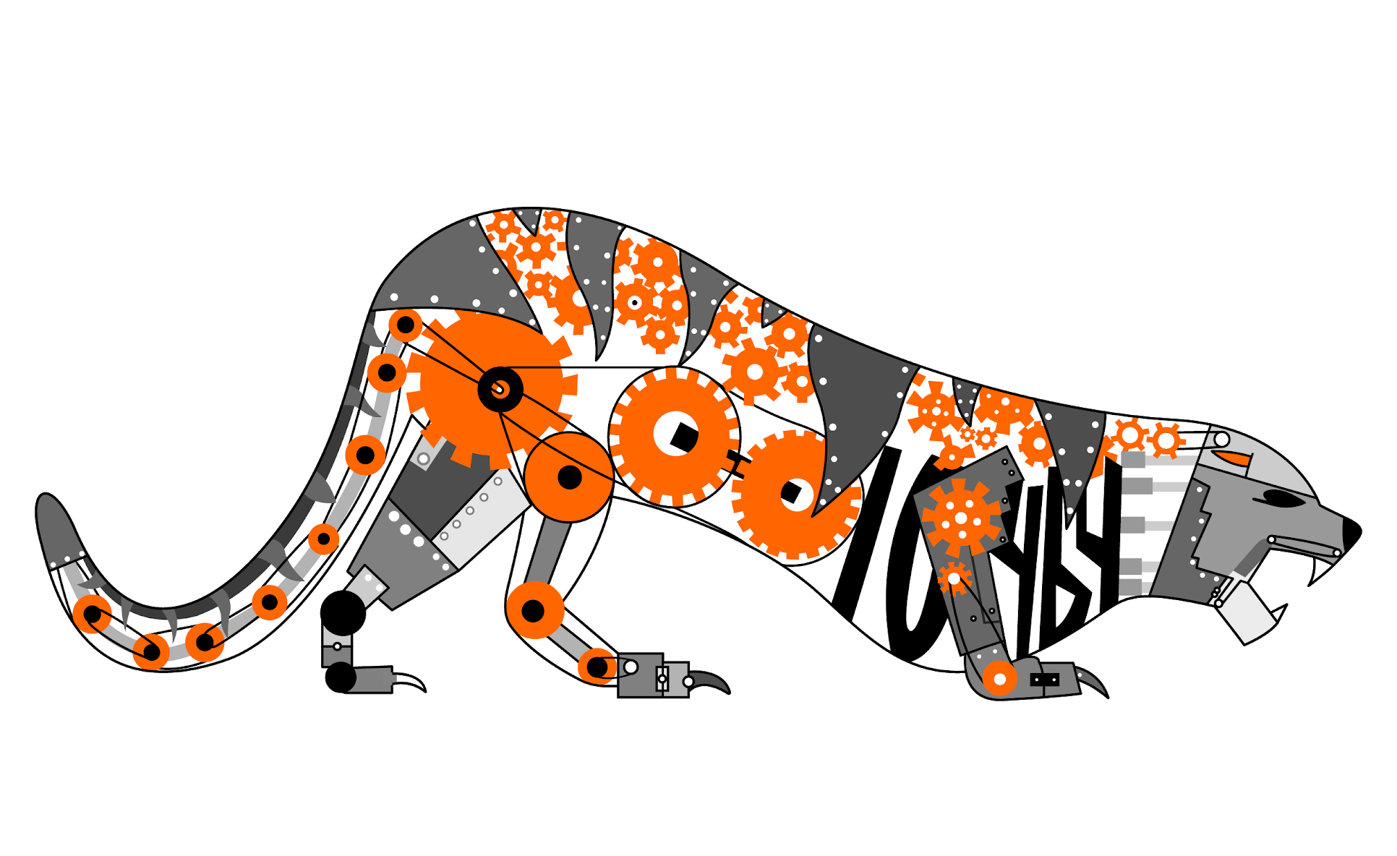
Credits
This lesson was written by The Bionic Tigers 10464 for FTCTutorials.com
You can contact the author at:
Website:
http://lovelandrobotics.com/team10464
Twitter:
@BionicTigersFTC
Email:
BionicTigers10464@gmail.com
More lessons for FIRST Tech Challenge are available at www.FTCtutorials.com
This work is licensed under a
Creative Commons Attribution-NonCommercial-ShareAlike 4.0 International License.

