Slide 1
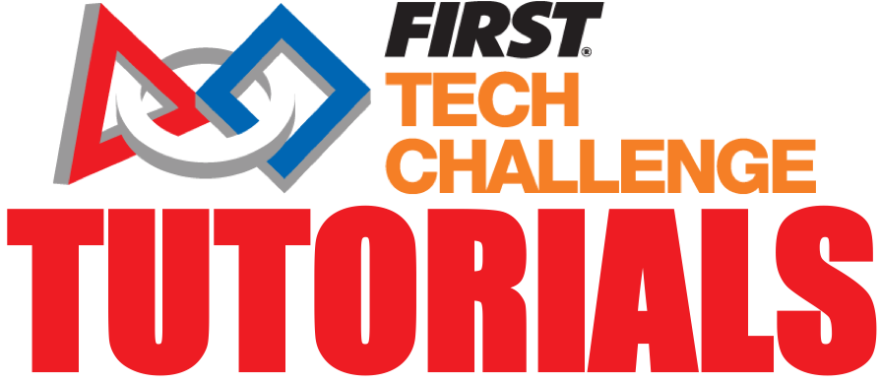
FTC Useful Tools and Resources
Team 13380 Quantum Stingers

Slide 2
Intro
Aside from vendor-sold parts, your team may find custom(ized) made parts handy
Custom parts allow for more versatile building, as well as options for robot personality
Can be obtained through 3D printing or cutting/carving (laser cutters, CNC machines, vinyl cutters, power drills, saws, etc.)
In addition, to assist and boost ease of building, there are many tools like a vice or a workbench
To assist with the design process, CAD/CAM softwares can also be used (Fusion 360, Inventor, Solidworks, etc.)
Can be used to help assemble digital and computerized models of your robot/parts of it
Can be used to sketch/model certain custom parts to print, cut, or carve

Slide 3
Hardware
Production tools that you may need:
3D Printer
CNC Machine
Vinyl Cutter
Laser cutter
Power Drill
Circular Saw
Hex Key
Torque Wrenches
Screwdriver Kits
Assistance tools that you may need:
Vise
Workbench

Slide 4
3D printer
Why might it be useful
Flexibility
As briefly mentioned before, there is a high probability that you won’t be able to find every single part that you are looking for, and you may want to innovate a part that requires a special component which many of the places you are going to buy parts from dont have
Ease in Integration
By using a 3D printer, you can innovate these parts with whatever constraints you would like them to have, and you can easily check your robot, to see how you can integrate the parts so that they work properly
Customization
It is always good to not only add various aspects of the tech challenge into your robot but your team personality as well, with the 3D printed parts, you can customize color schemes and other parts of your robot to make your robot represent
Con: They do take a while to actually be made and can break if the robot or part is not regulated properly. They are also quite expensive and can take up a lot of space
Where can you buy this?
https://tinyurl.com/v96gt9q
Here is one link, but there are still other options out there which is up to your team based on your team budget

Slide 5
CNC Machine
What are CNC Machines?
CNC Machines, otherwise known as computer numerically controlled machines, are electro-mechanical devices which you can use to manipulate tools/parts around varying parameters. They can cut metal, acrylic, plastic and wood
What are some uses?
Adaptability
Some parts that you buy down the line fit the purposes your require but not the parameters in order to integrate them into your robot, with a CNC machine, you can utilize CAM models in order to input to the machine what you want to cut off of the part through g-code
Speed
This is a subtractive process meaning that you take a part and cut it down whereas 3-D printing is an additive process where you start from scratch and use material, however, if there is a part similar to what you want, but maybe a bit loo large or there are some parts of it you don’t need, this is faster than 3-D printing the whole part from scratch
Con: It is considerably louder than that of a 3-D printer, however, if you have a garage allocated for your team, it shouldn’t pose a big problem, it is also very very expensive ranging from $1,500 - $20,000, so they may not be accessible to everyone
Where can I buy it?
https://tinyurl.com/tefywx3

Slide 6
Vinyl/Laser Cutter
Vinyl cutters: A computer-controlled machine that controls a sharp blade like a printer does a nozzle, and cuts over sheets of plastic
Can be used to make custom stickers, which help w robot personality
Pricing: Around a few hundred dollars
Laser cutters: similar to a CNC machine, however, it uses a laser instead of a blade
Often used to cut wood or plexiglass, which can be used for walls/side mounting on your robot, or additional supports/parts
Pricing: considerably costlier, with high-end high-quality ones up to a few thousand dollars
Where can I buy this?
Vinyl Cutter
https://tinyurl.com/wqcjjwz
Laser Cutter
https://tinyurl.com/sb9ded6

Slide 7
Circular Saw
What is a circular saw?
A circular saw is a power-saw using a spinning/rotating toothed or abrasive disc or blade to cut different materials
May be useful to cut pieces shorter, such as to shorten a channel, or slide, etc.
It’s a power tool, so make sure have adult supervisor nearby
It is also one of the best/most effective tools to cut parts of parts metal parts manually (vs automated via CNC )
Pricing:
Usually cost under $100
Where can I buy it?
https://tinyurl.com/sq7b8rj

Slide 8
Power Drill
Power Drills are an essential part in your journey to building your robot, and they have many different uses such as:
Drill Holes
It is important that you are drilling holes in order to make space for screws
Screw things in
Using power drills to screw things in is a much faster alternative than that of a screwdriver, and are a lot stronger as well, so you may be able to screw things in tighter’
A couple of cons of power drills include:
These power drills are fairly big and bulky so it might hard to reach into your robot when you have screws you need to tighten in places that are hard to reach, you will also have to be waiting on power after the drill runs out of charge, in which case a screwdriver is more reliable
Where can you buy it?
https://tinyurl.com/tzy38el

Slide 9
Vise/Workbench
A vise is a helpful resource which helps keep a part that you are working on stable and in place
A workbench is a helpful resource which you can use to work on different parts of your robot
Pros: Both a vise and workbench are reliable and very helpful resources because they allow for further stability and control over what you are working on
There really are no disadvantages of having a vise or a workbench, they are affordable, and are good to utilize while you are working
Where can I buy a vise?
https://tinyurl.com/tg8h6lt
Where can I buy a workbench?
https://tinyurl.com/ub9czrj

Slide 10
Hex Key
A Hex Key, also known as allen key, is essentially a tool which is used to drive in bolts and screws
A couple of benefits include:
The Hex Key is fairly small and easy to transport, so it is better than a power drill in terms of transportation
Because of its size, it also allows places which are too small to be accessed by a screwdriver or power drill to be screwed in tightly
Hex keys are very simple to use as opposed to having to screw in drill bits to a power drill and have adult supervision
Cons: Because of its size, it may be hard to keep a grip on if you are using the smaller side adjacent to the longer side
Where can I buy it?
https://tinyurl.com/rp27cun

Slide 11
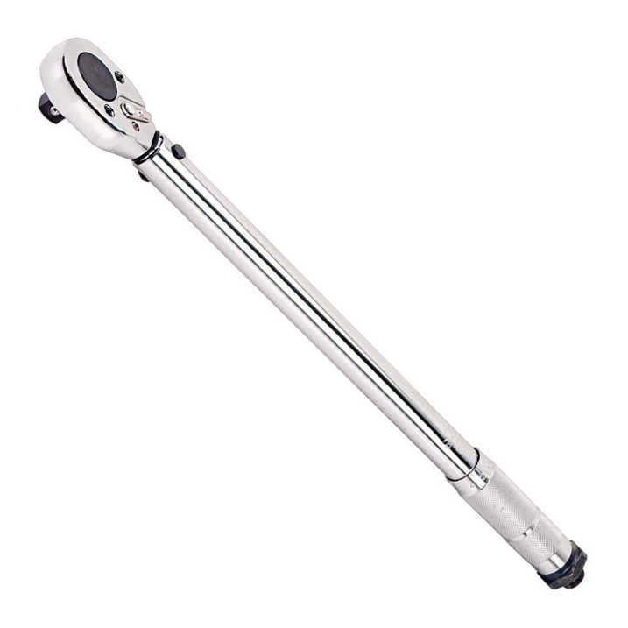
Torque Wrench
Torque wrenches are one of the most useful and important tools for FIRST teams
Torque wrench kits allow teams to fasten bolts of many different sizes
Torque wrenches fasten bolts much more tightly than if just a screwdriver was used
Here is a link to a useful kit of torque wrenches: https://www.amazon.com/Husky-H4PCSTS-Stubby-Handled-Combination-Adjustable/dp/B01N91QKFZ/ref=sr_1_1?dchild=1&keywords=husky+tools&qid=1586552469&sr=8-1

Slide 12
Screw Driver Kits
Screw driver kits are kits with multiple interchangeable screw driver heads
These are especially useful when using screws from multiple vendors, which often come in different sizes and shapes
These screw kits can replace the hoard of screws that many teams may have at home with one compact, useful kit
This greatly decreases clutter and the frantic search for the correct screwdriver or hex key
You can buy a screwdriver kit here
https://www.amazon.com/Precision-Screwdriver-Magnetic-Computer-Electronics/dp/B07TNS3D4X/ref=sr_1_1?dchild=1&keywords=royace+screwdriver+kit&qid=1586552742&sr=8-1

Slide 13

Credits
This lesson was written by Sashv Dave for FTCTutorials.com
You can contact the author davesashv@gmail.com
More lessons for FIRST Tech Challenge are available at www.FTCtutorials.com
This work is licensed under a
Creative Commons Attribution-NonCommercial-ShareAlike 4.0 International License.

