Slide 1

Team Plans
Patti Poston
FIRST Senior Mentor, Nevada

Slide 2
Team Plan
Strategic plan: Meeting goals
Business plan: Budget and financials
Sustainability Plan: Recruiting members/mentors
Explains steps to be taken by team to reach goals
Shared document allows collaboration

Slide 3
Strategic Plan
By mapping out where you plan to go during the season, goals you want to achieve and what you need to do to reach them, your team will be able to stay on track throughout the season.
Things to include:
Overview of FTC and the game
Team history
Outreach
Team involvement in community
Sponsorship details
Sponsor Letter
Team goals

Slide 4
Questions to Ask for Strategic Plan
What are your team goals?
How much money does your team need to get started and for what?
How much money to sustain team for multiple years?
How much money to raise through fund-raising efforts?
How much money expected through grants?
How much money or in-kind donations thru sponsors?
How will you promote a business or organization if you receive a sponsorship?

Slide 5
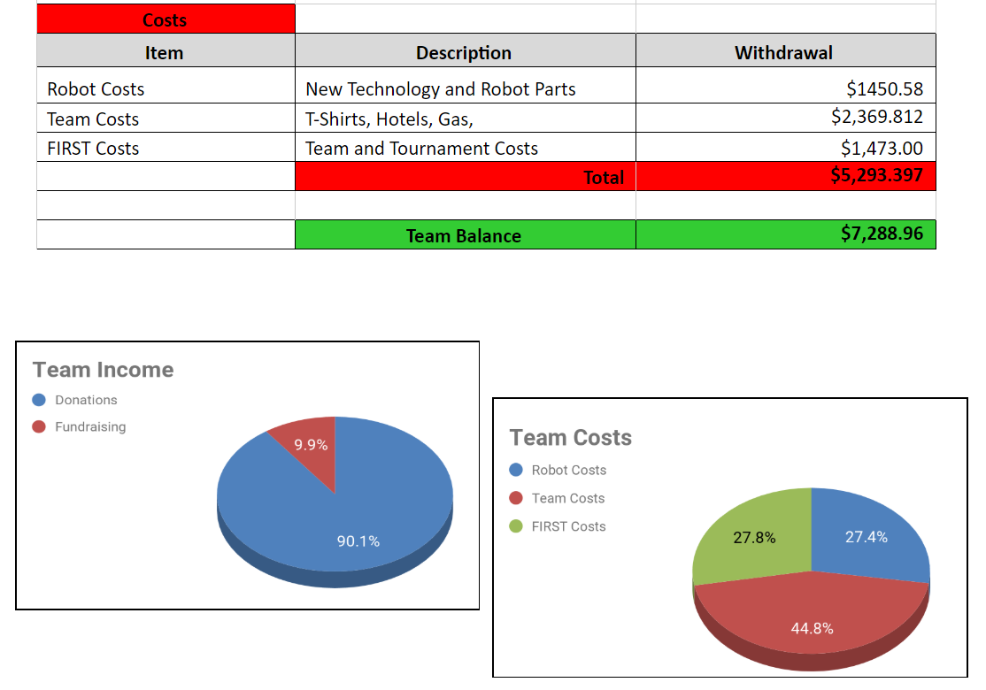
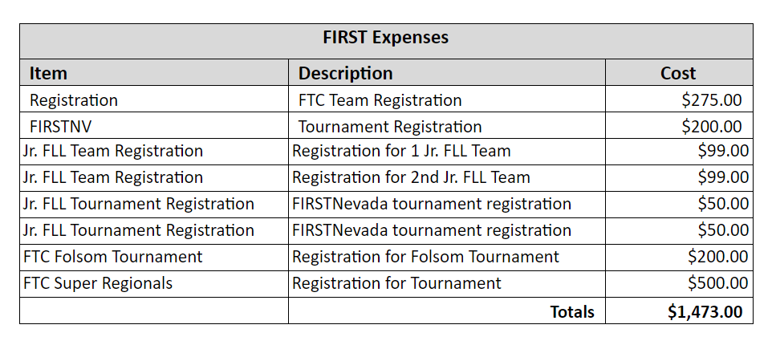

Business Plan
Create Team Budget
Income/Expenses
Graphs?
Share with team

Slide 6
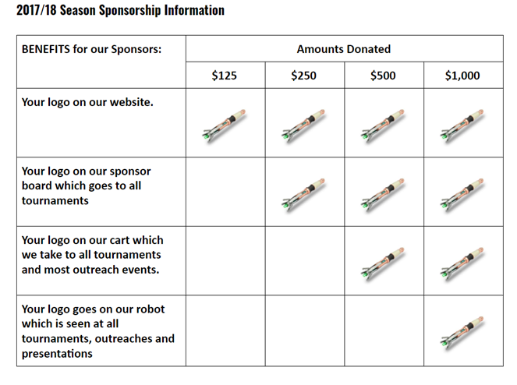
Team Sponsorships

Slide 7
Notebook Organization
How the team will grow
Plans to recruit: members, sponsors, mentors
Questions to ask:
How does your team plan to continue past this season
Are you training younger team members in key roles
Are their plans for recruiting new members and list them
Is there a plan to recruit mentors
How are you fund-raising for next season
How will your team leave a legacy

Slide 8
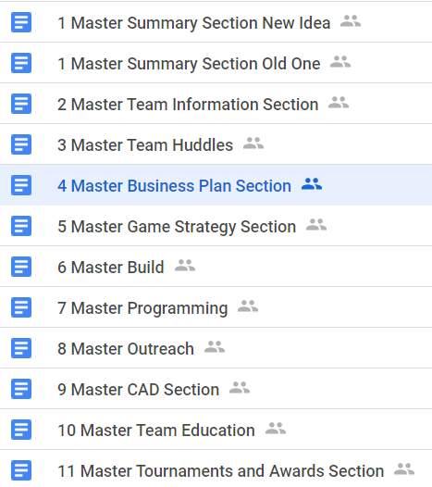
Notebook Organization
Google Drive
Have a folder for each section and subsection
Develop a template for each style of entry
Print your notebook well ahead of time

Slide 9
Sustainability Plan
Notebook is a living document
Main objective is to showcase your journey
Visuals, visuals, and visuals
Keep it consistent
Section summaries
Every page signed & dated by team members
Make it easy to read and eye-catching to reader
Include an Organizational Chart
Highlights
Timeline

Slide 10
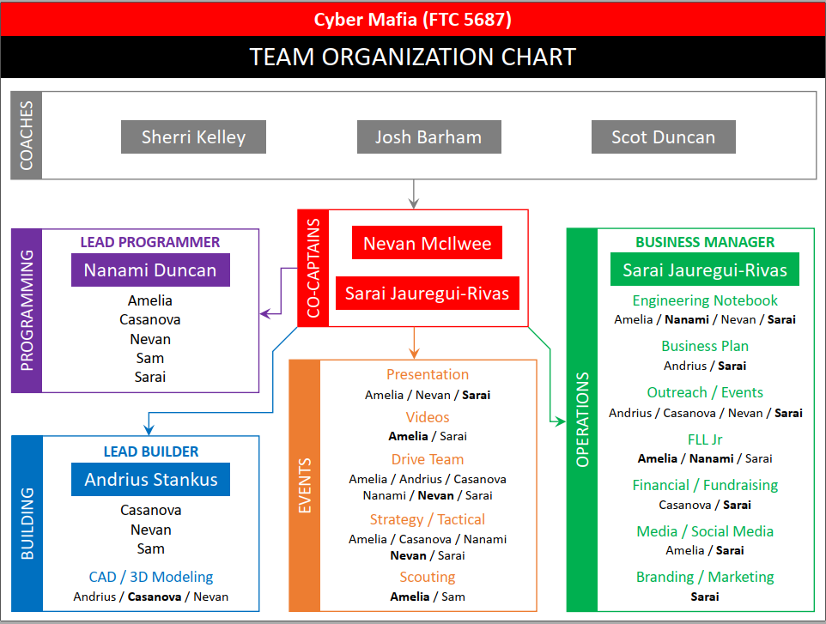
Example Organization Chart

Slide 11

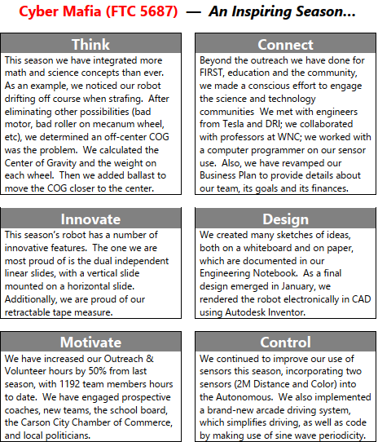
Example of How to Highlight

Slide 12
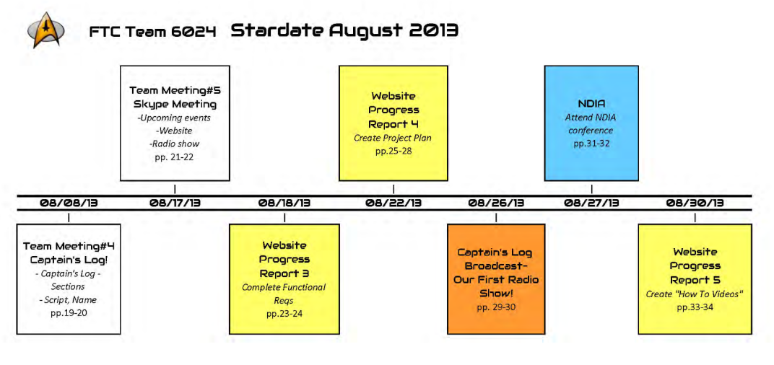
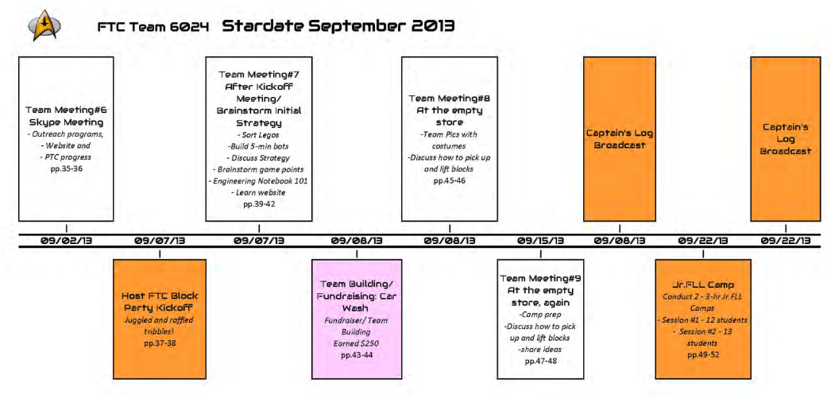
Example Timeline

Slide 13
Engineering Portfolio (What’s New)
Goals of Engineering Portfolio
Show students importance of clear and concise information sharing
Great learning experience for college or prof careers
Possible Content of Portfolio
Up to 15 pages of content
Highlight best pages/content from engrg notebook
Design concept
Drawings
Planning/execution of a well received outreach event
Prelim description of what you hope robot will do

Slide 14
Useful Links
FTC Team Management Documents
https://www.firstinspires.org/node/5226
FTC Engineering Notebook Guide
2019-2020 Season

Slide 15
Credits
This lesson was written by Patti Poston
You can contact the author at: pposton@firstinspires.org
More lessons for FIRST Tech Challenge are available at www.FTCtutorials.com
Image Credit: 6024 Enterprisers, 5326 Enterprisers, 11574 Sonic Screwdrivers, 10464 Bionic Tigers, 4250 Light Sabers, 5687 Cyber Mafia
This work is licensed under a
Creative Commons Attribution-NonCommercial-ShareAlike 4.0 International License.

