Slide 1

Programming Environment Setup for Android Studio
Team 13380

Slide 2

Android Studio
Android Studio is an integrated development Environment (IDE) for writing code in a collaborative environment
Some advantages of Android Studio as compared to other IDEs include
Its ability to debug in real-time
The ease of integrating libraries such as OpenCV or DogeCV
Android Studio works especially well with GitHub, as it allows multiple people to collaborate effectively

Slide 3

GitHub
GitHub is a Git repository hosting service that offers distributed version control and source code management
When integrated with Android Studio, it allows people to share their code, obtain other collaborators’ code, and access different iterations of the same code
This is known as “Version Control”
You can think of it as a collaborative “Google Drive” that can store all of your team’s code but also gives individuals the flexibility to work on specific programs

Slide 4
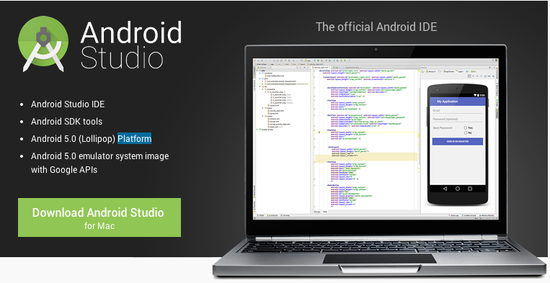
Installing Android Studio
Search up “Download Android Studio” and click on the link
It looks like this: “https://developer.android.com/studio”
Here is a video showing the installation process: https://www.youtube.com/watch?v=hP0u-ib_Tm8

Slide 5
Configuring GitHub
Click on this link: “https://github.com/” and make an account there
Open up Android Studio and select
“File” >> “Settings” >> “Version Control”
Click on “Git” and select “Test” (to the right of “Path to Git executable”)
Then click on “GitHub” and then on “Create API Token” and enter your GitHub account details there
Select “Apply” and then “OK”
This way you can access GitHub directly within Android Studio

Slide 6
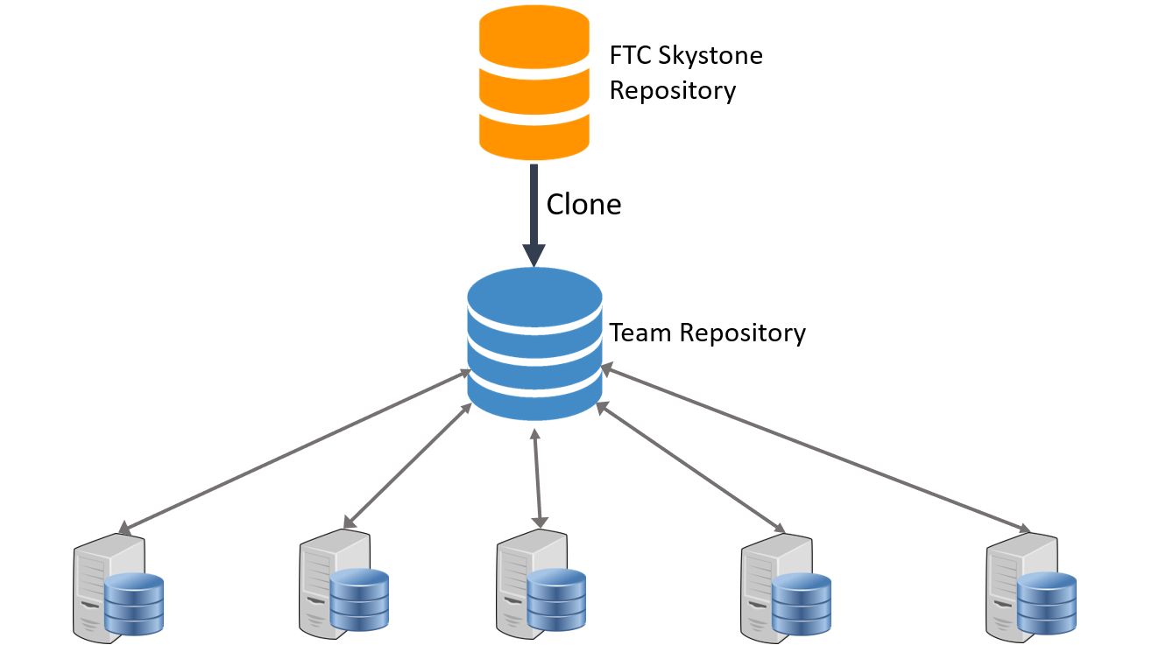
Creating Your Team Repository
Create a team account on GitHub
In order to create your team repository, fork the most current version of the FTC SDK using your team account The most current version of the SDK can be found at: https://github.com/ftctechnh/ftc_app.git
You can select “fork” in the top right hand corner
This will allow you to create a repository for your team which is built off of the FTC SDK repository, allowing you to access those libraries
Student 1’s copy
Student 2’s copy
Student 3’s copy
Student 4’s copy
Student 5’s copy

Slide 7
Getting Your Team on the Repository
In order for team members to access the repository, they need to create a GitHub account and request access from the repository admin (the person that created the team repository)
After the admin grants access, team members have to follow the following steps:
Go to the homepage of Android Studio (the one that shows up when you first open it up)
Click on “Check Out Project From Version Control”
Enter your team’s Git Repository URL
Then click “Test” and “Clone”
After successfully cloning the repository, team members can start contributing to the team repository

Slide 8
Creating a New File
Go to the folder where you want to add a file
Right click on the folder
Select “File” >> “new” >> “Java Class” >> Give it a name >> “OK”

Slide 9
Committing & Pushing Files
Committing
Press the check mark at the top right or go to VCS and press “Commit”
Enter a commit message and press “Commit”
Pushing
Instead of pressing “Commit,” click on the arrow near the commit button
Click “Commit and Push”
Select branch to push onto and press “Push”

Slide 10
Transferring Programs onto the Phones
Connect your Robot Controller phone (The phone that connects to the robot) to the computer you are working on using a USB
Build your program
Press the play button in the top right of Android Studio to download your program onto the phone
Wait for the phone to complete installation (A message will appear that says “Installed successfully in x seconds”)

Slide 11

Credits
This lesson was written by Ansh Kharbanda for FTCTutorials.com
You can contact the author at anshkhab@gmail.com
More lessons for FIRST Tech Challenge are available at www.FTCtutorials.com
This work is licensed under a
Creative Commons Attribution-NonCommercial-ShareAlike 4.0 International License.

