Slide 1

FTC Vendors and Base Kits
Team 13380 Quantum stingers

Slide 2
FTC Vendors
First Tech Challenge has many major vendors who each offer their own unique parts for robot building
Each of these vendors’ kits comes with advantages and disadvantages
The major vendors include
GoBilda
Tetrix
ServoCity
REV
Andymark
In this presentation, we’ll go over the vendors’ base kits, their pros and cons, and some unique parts each of them offer

Slide 3
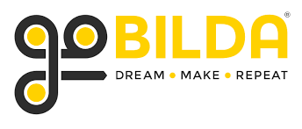
https://www.gobilda.com/
Advantages
GoBilda offers many unique parts specifically designed for FTC, and are always coming up with new innovative parts
Their hubs and collars use clamping screws, which are more efficient and safer than the set screws used by other vendors
GoBilda offers a wide array of Jack Planetary motors, which boast better torque:RPM ratios than the spur gear motors offered by other vendors
The main structural components (channels) offered by GoBilda have a hole pattern which shares holes with every other major vendor’s hole pattern
GoBilda offer a 25% discount to FTC teams, which can be applied for by visiting this link: https://www.gobilda.com/first-team-discounts/
GoBilda offers a strafer chassis kit, which is excellent for rookie teams: https://www.gobilda.com/strafer-chassis-kit/
Disadvatages
GoBilda’s channels are the largest of all the vendors, which results in larger builds

Slide 4
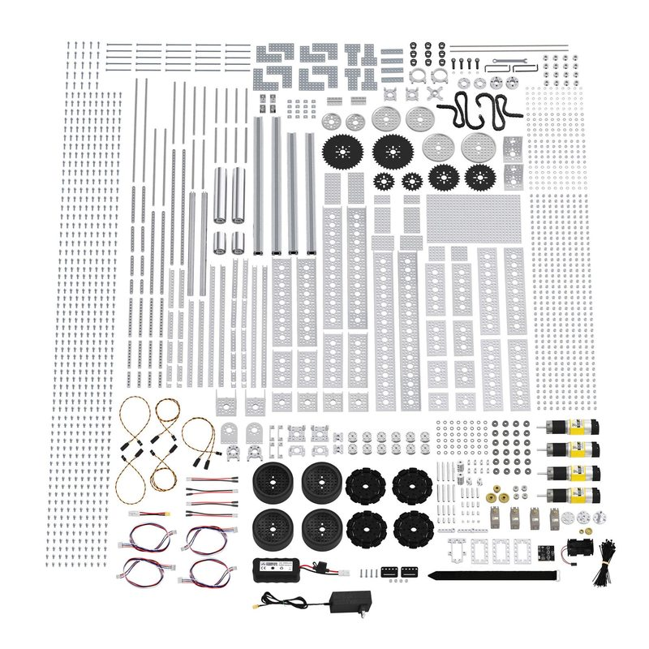
Base Kit
(https://www.gobilda.com/master-ftc-kit-2019-2020-season/)
Kit Review
Cost: $494.99 (After FTC discount)
While this kit contains an array of important structural parts, it is lacking in the department of wheels and motors, essential parts of building your first robot chassis.
The strafer chassis kit helps solve these problems, and would be an excellent complement were you planning to buy this kit.
Strater Chassis: https://www.gobilda.com/strafer-chassis-kit/

Slide 5

https://www.pitsco.com/Shop/TETRIX-Robotics/&TXredir=1
Advantages
Tetrix has simple parts which are easy to work with for rookie teams
Tetrix’s base kit is available to buy upon registration for rookie teams
Tetrix’s channels are much smaller than ServoCity and GoBilda’s, resulting in smaller and more compact builds
Tetrix boasts an excellent sprocket and chain system
Tetrix offer a 25% discount to FTC teams, which can be applied for by visiting this link: https://www.pitsco.com/Competitions-Clubs-and-Programs/FIRST-Tech-Challenge
Disadvantages
Tetrix’s structural components bend easier than other vendors
Tetrix operates upon a hole pattern that makes its structural components incompatible with all other major vendors except GoBilda
Tetrix has only one motor option, which is slow compared to the motors offered by other vendors
Tetrix does not have many options for channels, which can be an issue when looking to make precise builds

Slide 6
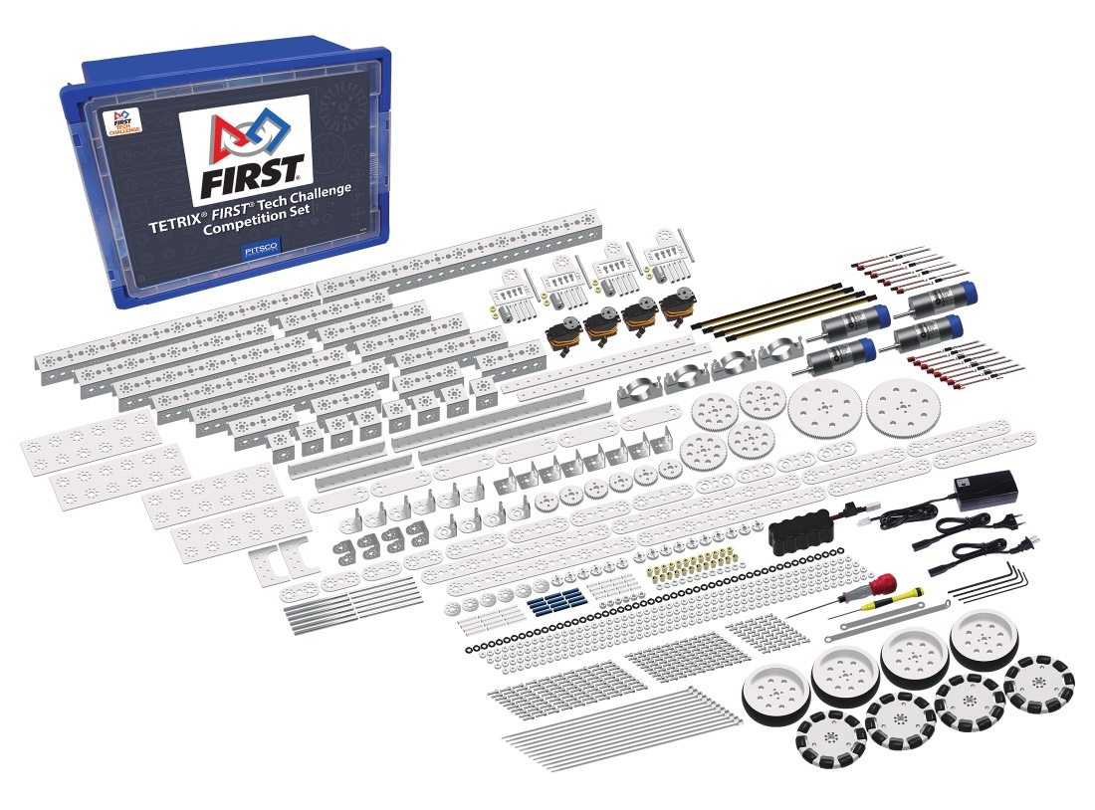
Base Kit
(https://www.pitsco.com/TETRIX-FTC-Competition-Set/&TXredir=1)
Kit Review
Cost: $709.95
This kit contains all of the essentials to get started with a robot, including a battery and tools.
While it does contain a fair few structural components, you will definitely need to order more to sustain you throughout the season.
One more purchase that anyone considering this kit may want to make is the Tetrix Mecanum wheels, which can be found at: https://www.pitsco.com/TETRIX-MAX-Mecanum-Wheels

Slide 7

https://www.servocity.com/
Advantages
ServoCity offers both extrusion based parts like REV, and channel based parts like Tetrix and GoBilda
ServoCity’s channels are the medium size between Tetrix and GoBilda, and are very sturdy. ServoCity also offers hole pattern adapters to connect to Tetrix parts
ServoCity also offers mini channels for when you need smaller builds, which are very similar to the size of Tetrix channels.
ServoCity offers a wide array of motors and servos; All the motors available on GoBilda are also available on ServoCity, plus some more.
ServoCity’s servoblock component is an extraordinarily useful part that helps servos survive longer and work more efficiently
ServoCity has many interesting and unique linear motion components, such as the linear actuator. Just be sure the kit you’re planning to use is FTC legal!
ServoCity offer a 25% discount to FTC teams, which can be applied for by visiting this link: https://www.servocity.com/first_team_discounts
Disadvantages
ServoCity isn’t the cheapest system, but is quite manageable with the 25% discount

Slide 8
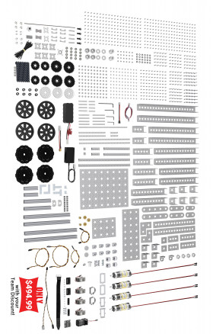
Base Kit
Kit Review
Cost: $494.99 (After FTC discount)
Nearly identical to the GoBilda Starter Kit, this kit has many important structural and motion parts, but does not have the best motors or wheels.
Wheels and motors can be bought separately.
Wheels: https://www.servocity.com/3606-series-mecanum-wheel-set-bearing-supported-rollers-100mm-diameter
Motors: https://www.servocity.com/motors-actuators/gear-motors
Servos: https://www.servocity.com/servos
(https://www.servocity.com/ftc-competition-kit)

Slide 9

http://www.revrobotics.com/
Advantages
REV uses an extrusion system, unlike the other vendors, which can give rookie teams more freedom with their builds
Extrusions allow for infinite mounting positions, which can help when building initial mechanisms
REV offers a small and compact, but sometimes quite annoying to work with, linear slide system that can be very efficient if used correctly
REV is the cheapest system
REV offer a 15% discount to FTC teams only on certain items, which can be found here: http://www.revrobotics.com/competition/ftc/discounts/
Disadvantages
Extrusions often need to be cut and sanded, which requires tools like bandsaws
Connecting extrusions together is not the easiest and often takes a long time
REV part connections loosen over time
The M3 screws used in REV are les strong than the M4’s used by other vendors, and can bend under large loads.

Slide 10
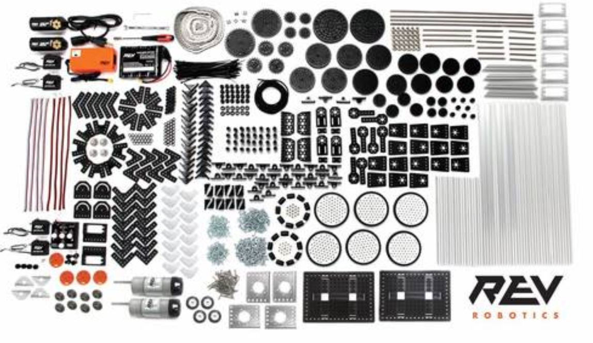
Base Kit
2 40:1 HD Hex Motors
2 Core Hex Motors
4 Smart Robot Servos with other attachments
Smart Robot Servo Programmer
15 mm aluminum extrusion, various lengths
Omni and traction wheels
32 gears in 7 different sizes
10 sprockets in 3 different sizes
Delrin brackets
Delrin bearings and pillow blocks
Motor and servo power/data cables
Slim Robot Battery and charger
5.5 mm nut driver and 5.5 mm hex wrench
Kit Review
Cost: $600.00
This system contains lots of motion components and brackets, but is lacking in structural parts and motors.
While structural parts from REV are quite cheap, you will still need to buy more motors across the season, as well as omni or Mecanum wheels, which, with the kit included, would cost around $800.
(http://www.revrobotics.com/rev-45-1270/)

Slide 11

https://www.andymark.com/
Advantages
Andymark offers the small, compact motor gearboxes which can exponentially increase the speed of any motor
Andymark offers an extrusion system with holes, which makes it much easier to use than REV’s system
Andymark boasts some of the best Mecanum wheels, and their tile runner chassis is known for its modularity and efficiency
AndyMark is mainly an FRC vendor, but has started expanding more into FTC in recent years, so it will continue to improve as time goes on
Disadvantages
Andymark is one of the most expensive vendors
The extrusions are only offered in 4 sizes, which can be a serious problem when building precise mechanisms
Being mostly an FRC vendor, AndyMark does not currently have a lot of the parts that other FTC vendors offer

Slide 12
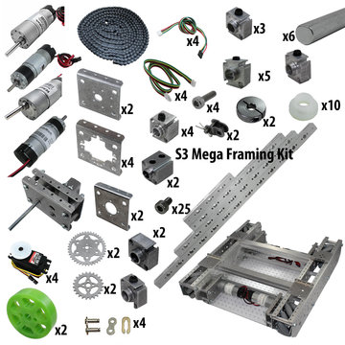
Base Kit
Foundation Bundle of your choice
TileRunner Bundle of your choice
1 - NeveRest Classic 40 Gearmotor (am-2964a)
1 - PicoBox Super Servo (am-3907)
1 - NeveRest Classic 60 Gearmotor (am-3103)
1 - NeveRest Orbital 3.7 Gearmotor (am-3461a)
1 - NeveRest Orbital 20 Gearmotor (am-3637)
4 - Hi-Tech Servo, model HS-311 (am-2586)
2 - Plate for PicoBox Solo (Motor Mount Plate) (am-3440)
2 - PicoBox LEO Mount Plate (am-3474)
4 - PicoBox Servo Motor Plate (am-3899)
5 - 6 mm D-Bore Single Boss Nub with Set Screw (am-3443a)
3 - 6 mm D Bore Double Boss Nub with Set Screw (am-3215a)
2 - 6 mm D-Bore XL Double Boss Nub with Set Screw (am-3441a)
1 - 6 mm Round Bore Single Boss Nub with Set Screw (am-3442a)
1 - 6 mm Round Bore Double Boss Nub with Set Screw (am-3413a)
4 - 24 Tooth Servo Nub with Set & Servo Screw (am-3668)
2 - 6 mm Round Bore Split Collar Clamp (am-3667)
2 - 6 mm Round Bore Split Collar Clamp (am-3473)
1 - 36 mm, 6 mm D Shaft (am-3226-036)
2 - 100 mm, 6 mm D Shaft (am-3226-100)
2 - 175 mm, 6 mm D Shaft (am-3226-175)
1 - 450 mm, 6 mm D Shaft (am-3226-450)
2 - S25-24 Ninja Star Sprocket (am-3283)
2 - S25-40 Ninja Star Sprocket (am-3285)
1 - #25 Single Strand-Riveted Roller Chain, 10' (am-0370)
4 - #25 Connecting Link for Roller Chain (am-0371)
2 - #25 Half Link for roller Chain (am-0682)
25 - M3-0.5 x 5 mm Socket Head Cap Screw (am-1443)
10 - 6 mm x 8 mm Nylon Bushing (am-1289)
4 - Hall Effect Encoder Cable with 4-pin Connector (am-2992)
4 - M2.5 - 0.45 x 8 mm Socket Head Cap Screw (am-1496)
4 - Encoder Cable for NeveRest Motor to REV Expansion Hub (am-3926a)
2 - 8 mm Bore 35 Durometer Green 2 in. Compliant Wheel (am-3572_green)
(https://www.andymark.com/products/ftc-starter-kit-options/)
Kit Review
Starting at $1320 and going up to $2400 based on your kit choices, this new kit released this year is by far the most expensive starter kit.
However, it does offer by far the most parts, with all the parts mentioned on the left + a large kit of structural components + a TileRunner chassis kit.
While this may be enough to build a starter robot, it is still quite the risk. Since most of these parts are new and the kit has just been released this year, it will be much harder to find resources or robots to model off of.

Slide 13

Credits
This lesson was written by Dhruv Gupta from Quantum Stingers Team 13380 for FTCTutorials.com
You can contact the author at dhruv.gupta@norcalrobotics.org
More lessons for FIRST Tech Challenge are available at www.FTCtutorials.com
This work is licensed under a
Creative Commons Attribution-NonCommercial-ShareAlike 4.0 International License.

