Slide 1
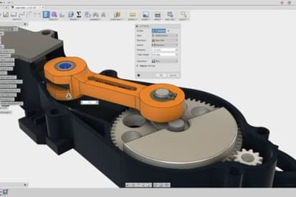


FTC: Introduction to CAD/CAM
Team 13380 Quantum Stingers

Slide 2
Intro
CAD/CAM stands for Computer Aided Design/Computer Aided Manufacturing
Can be helpful to sketch or design to 3D print or cut via CNC
By designing a 3d model, you can assure that parts fit in their intended assembly before buying them
Can help create computerized/digital assemblies or models for ease of design along the design process
For assemblies of robot, you can find bought parts from their respective online vendors (Pitsco, GoBilda, etc.) and import into your model
Going forwards, becoming more advanced, it can be used to simulate real life conditions, testing certain builds without actually needing to build them
There are many CAD softwares out there, but the main ones used for FTC are Fusion 360, Inventor, and Solidworks

Slide 3

Fusion 360
Recommended RAM: 4 GB
Pros:
Cloud-based
Runs directly on both Windows and Mac OS
Allows for team collaboration on shared projects
Has simulation features
3 year free educational license
Lots of material available so easier to pick up/learn for beginners
Cons:
If you have bad internet, will frequently be slow
Can’t handle as complex builds as effectively as Inventor

Slide 4

Inventor
Recommended RAM: 20 GB
Pros:
Runs directly on Windows
More powerful/complex than Fusion 360, so can handle more complicated/intricate designs
1 year free educational license
Cons:
Since it stores files on your hard drive, exporting files will not be as smooth/automated as cloud-based softwares like Fusion 360
Thus, harder for collaboration of whole team
More powerful/complex than Fusion 360, so can be a bit overwhelming at first for beginners to learn
Doesn’t run directly on Mac OS

Slide 5

Solidworks
Recommended RAM: 16 GB
Pros:
Can be local or cloud-based
Runs directly on Windows
Can handle very large/complicated designs and assemblies
Can export directly to AR/VR applications for even more immersed interactions with CAD models
Best simulation tools/features out of all the three
Cons:
Doesn’t run directly on Mac OS
No free educational license, instead only perpetual or subscription license

Slide 6
Basic CAD Tutorial
Most CAD systems are very similar, so here is our tutorial based on Fusion 360; No matter which system you decide on this tutorial will help
Here’s how to get started/how we got started:
Step 1: Get an Autodesk account
Go to https://www.autodesk.com/products/fusion-360/students-teachers-educators
Click Create Account (steps to creating should be self explanatory) and verify via email
Step 2: Get access to the software
Go back to https://www.autodesk.com/products/fusion-360/students-teachers-educators
Click Get Access, then Download and run the .exe setup file

Slide 7
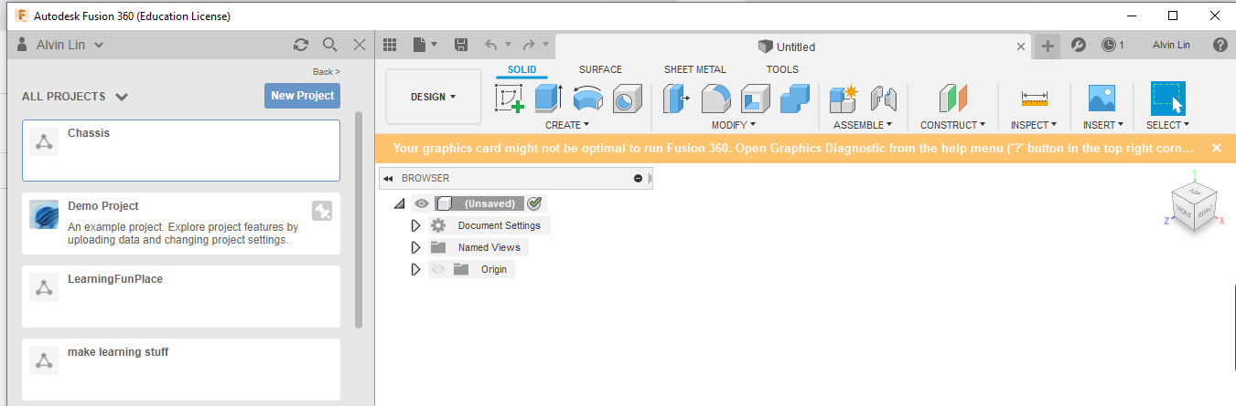
Creating Your First File
Step 3: Create your first project!
After launching up Fusion 360 for the first time, you should see a blank workspace and a dashboard area to the left
Click New Project and name it

Slide 8
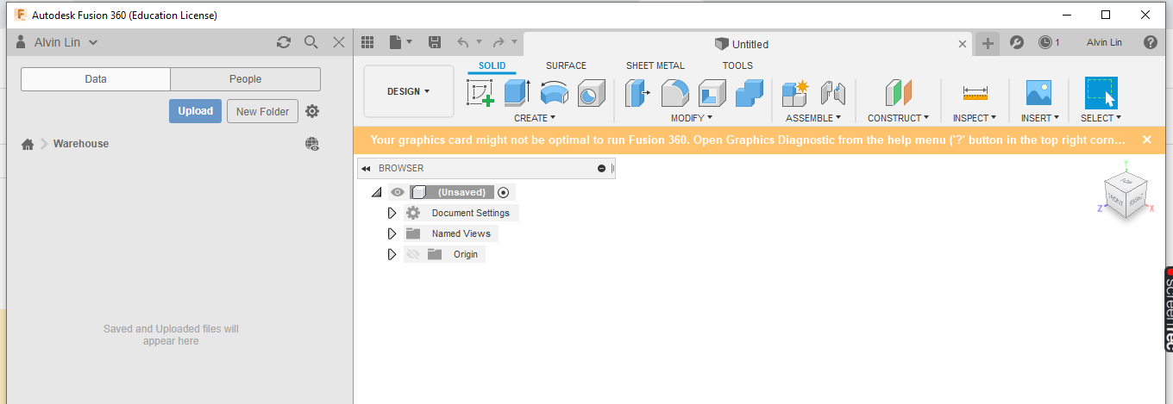
Learning to Use
Step 4: Learn to use
Double click the project you just made to enter it
You should see a blank project page in your dashboard area
Now, you can upload files through the blue upload button
In addition, anything you start making in the workspace can now be saved to your project

Slide 9
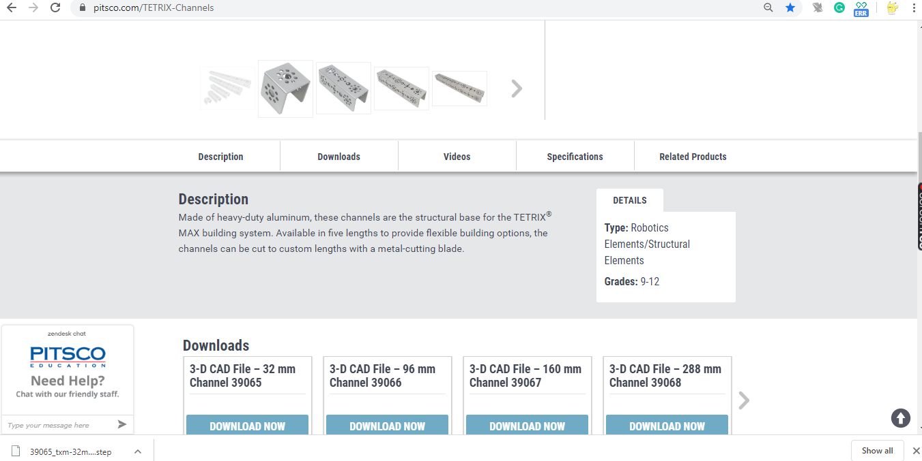
Uploading Files
Step 4: Learn to upload
Google up your desired component, and go to its product page
Find an area for “Resources” or “Downloads” something of the like, in which you can download the component as a .step file

Slide 10
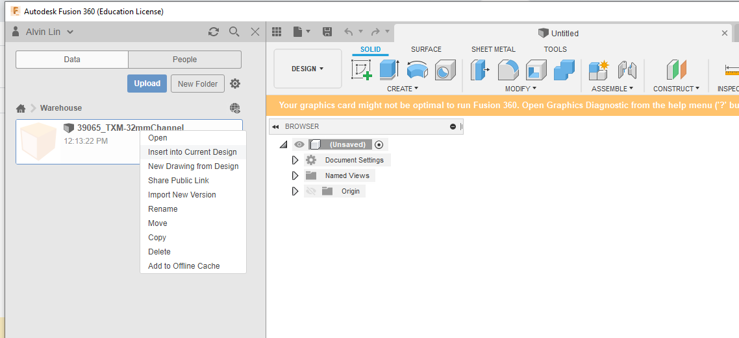
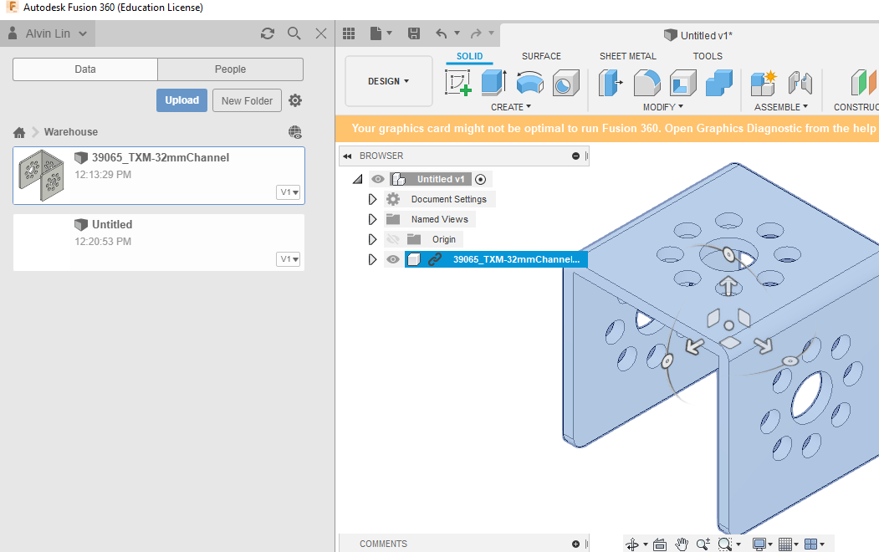
Uploading Files
Step 4 cont.: Learn to upload
Go to back to Fusion and click Upload. You can select what you just downloaded (may need to be unzipped) & upload it (may take a while)
When done/completed, the file should appear in the dashboard area, now no longer blank
Save the Untitled design to keep/edit it (In the future, version description when saving is good to fill out specifically to what iteration you made this session to keep track but is not necessary). Now it is in you project page dashboard area.
Right click your component and click “Insert into Current Design”, or simply click and drag it into the left (now blank) workspace
Tada! You now have your first assembly!

Slide 11
More CAD Tutorials
That was just a brief basic tutorial to get used to the file structure of Fusion 360
Uploading is great if you have existing parts or files from other sources
Will be used a lot in assembly, in which you put parts together to pseudo-build it and make a model there on CAD
Other tutorials for other skills in CAD (sketching, animating, etc.) can be found online
Some personally recommended courses are:
Autodesk’s own tutorials for Fusion 360
https://f360ap.autodesk.com/courses
https://f360ap.autodesk.com/courses/getting-started-in-fusion-360/lessons/course-overview -for beginners/to start off
Autodesk’s own tutorials for Inventor
https://academy.autodesk.com/software/inventor-tutorial
SolidWorks lessons
http://solidworkstutorialsforbeginners.com/solidworks-tutorials-for-beginners/
http://www.solidworkstutorials.com/

Slide 12

Credits
This lesson was written by Alvin Lin for FTCTutorials.com
You can contact the author Alvin Lin at alvinlinsv@gmail.com
ADD YOUR TEAM LOGO HERE
More lessons for FIRST Tech Challenge are available at www.FTCtutorials.com
This work is licensed under a
Creative Commons Attribution-NonCommercial-ShareAlike 4.0 International License.

