Slide 1

Programming Options
Team 13380
QUANTUM STINGERS

Slide 2
Introduction
FIRST offers many options on how to program your FTC robot
These options include
Android Studio
OnBot Java
Blocks Coding
Each of these options comes with their own advantages and disadvantages

Slide 3
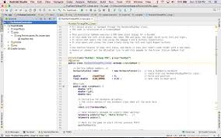
Android Studio
Android Studio is an integrated development Environment (IDE) for writing code in a collaborative environment
This tool is the same tool that professional Android app developers use.
Android Studio is recommended for users who have some Java programming experience.
For more information on Android Studio and how to set it up, look at FTC tutorial: http://ftctutorials.com/translations/en-us/Robot/ProgrammingEnvironmentSetup.pdf

Slide 4
Pros and Cons
Debugs in real time
Information can be logged
Easy integration of libraries
Work can be done from anywhere
Pairs up well with github
Most collaborative of the platforms
Complicated to connect phone and computer
Set up is more complicated

Slide 5
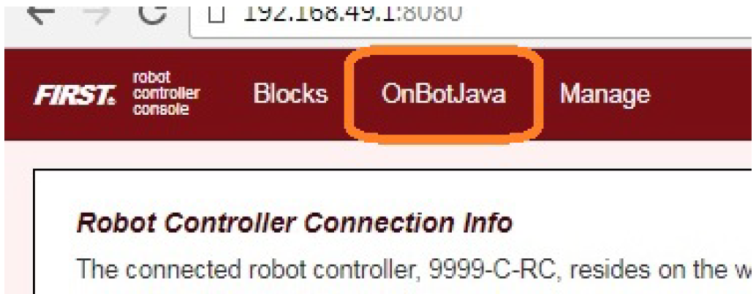
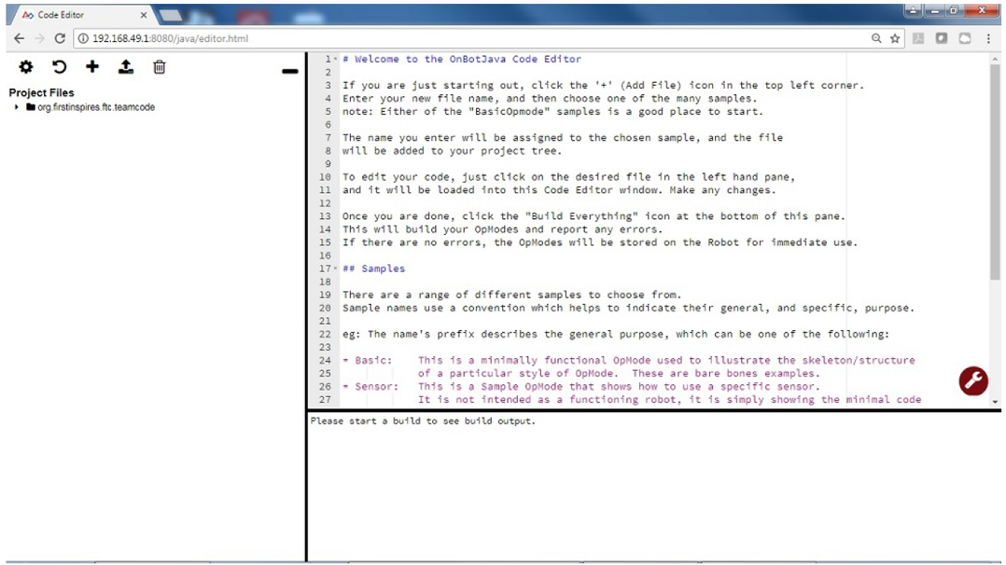
OnBot Java
FTC OnBot Java is an online web-based tool that allows for editing, creating, and saving Java Op Modes
Easy to use and requires no set-up

Slide 6
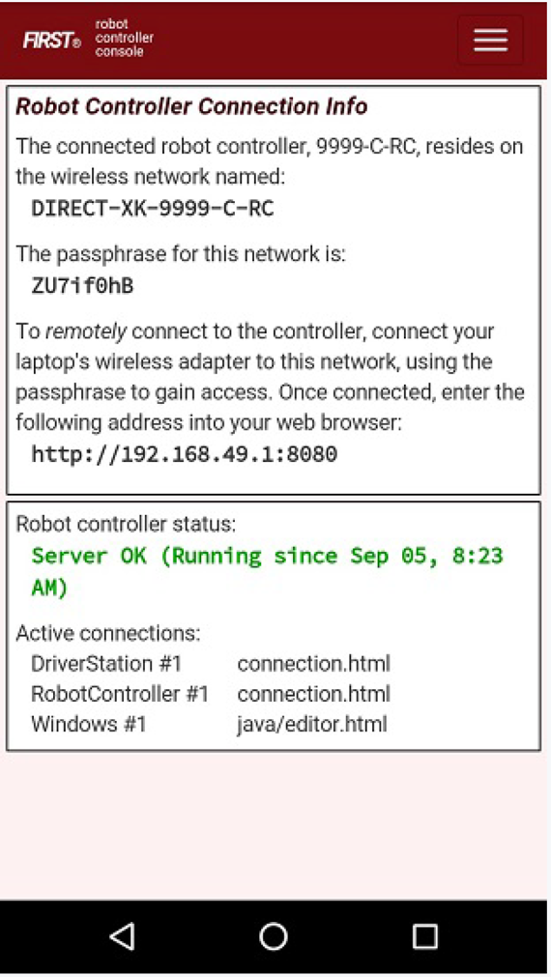
How To Access
On your Driver Control App go to Program and Manage by clicking the 3 dots on the top right
Connect to the Wifi starting under Robot Controller Connection Info using the passphrase on your computer
Go to your browser and enter the link http://192.168.49.1:8080
Select Onbot Java on the top left

Slide 7
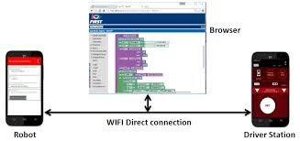
Pros and Cons
No Software install Required
Easy to set-up and very basic to use
Wireless
Extremely basic, limited functionality
No version control
Computer has to be connected to phone wifi during programing and testing (You can only code when you have the RC phone)
Only one person can code at once

Slide 8
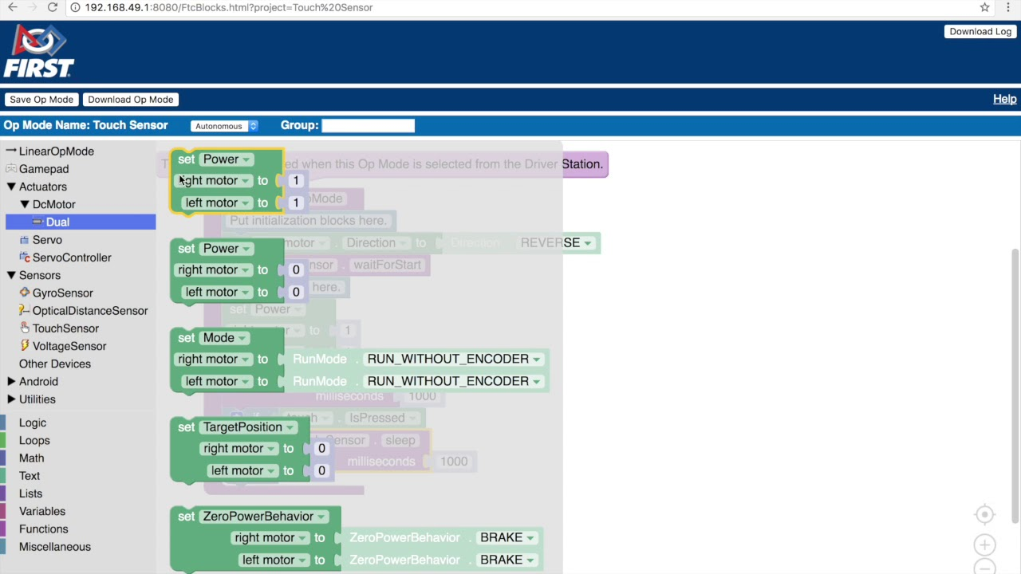
Blocks
The FTC Blocks Programming Tool is a user-friendly programming tool.
Drag and drop jigsaw-shaped programming blocks onto a design “canvas” and arrange these blocks to create the program logic for their op mode.
Powered by Google’s Blockly software and was developed with support from Google.

Slide 9
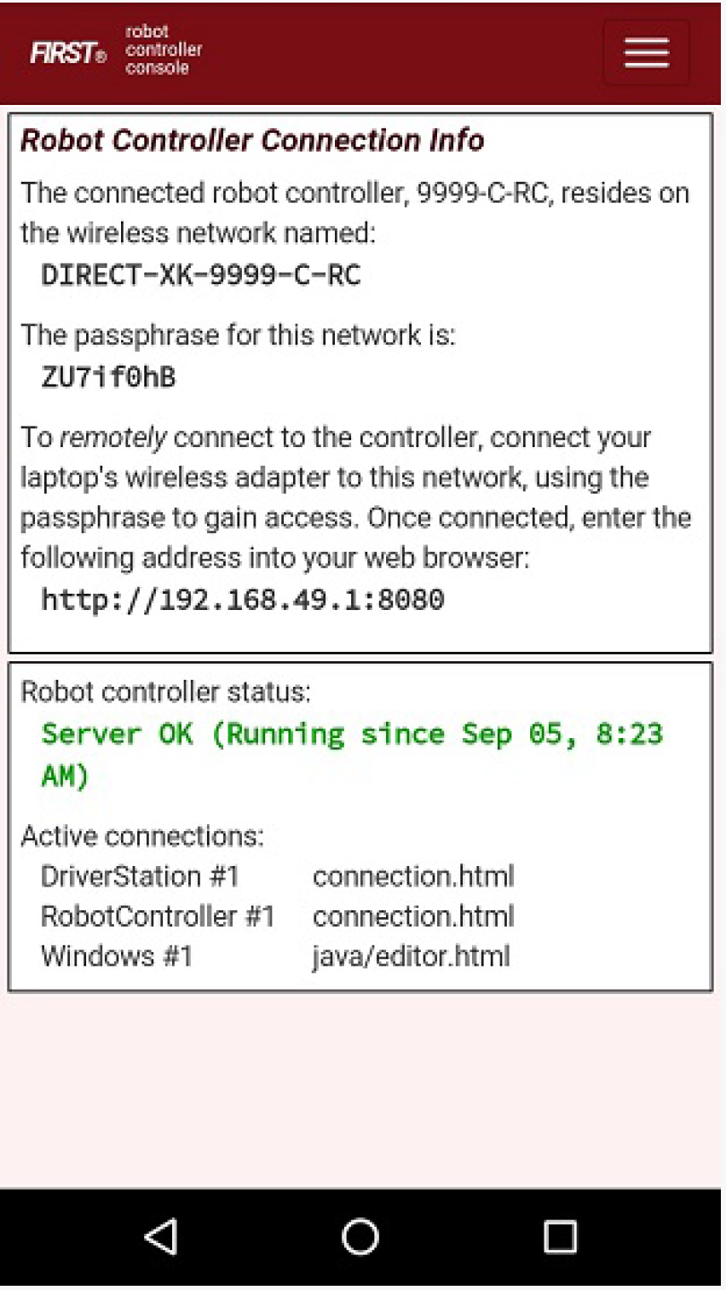
Set Up
On your Driver Control App go to Program and Manage by clicking the 3 dots on the top right
Connect to the Wifi starting under Robot Controller Connection Info using the passphrase on your computer
Go to your browser and enter the link http://192.168.49.1:8080
Result is main blocks programming webpage

Slide 10
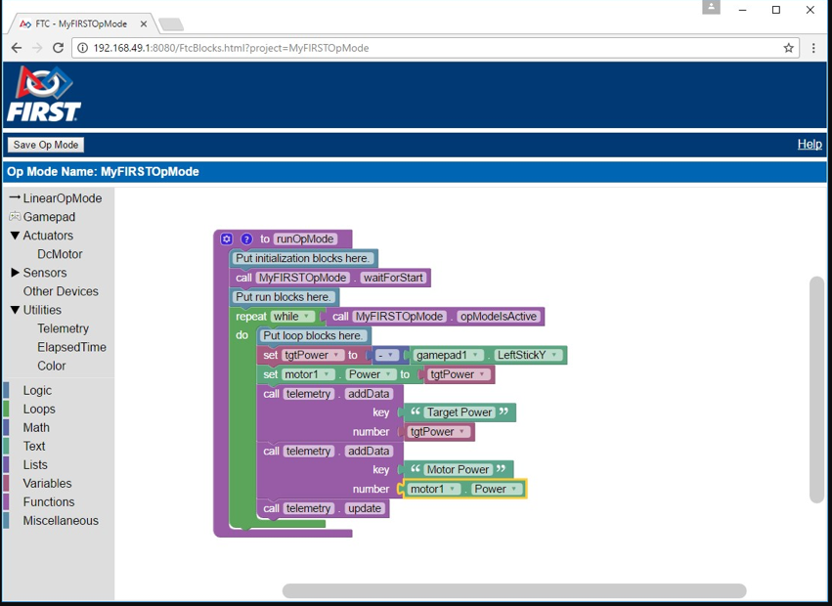
Pros and Cons
Easy to learn and useful for beginners
Wireless and easy to send code to robot
No Version Control
Not as powerful as either of the other two systems
Computer has to be connected to phone wifi during programing and testing
Only one person can code at once

Slide 11

Credits
This lesson was written by Aaryan Rustagi and Akshaj Gupta from Quantum Stingers for FTCTutorials.com
You can contact the author at rustagiaaryan@gmail.com and aksh8work@gmail.com
More lessons for FIRST Tech Challenge are available at www.FTCtutorials.com
This work is licensed under a
Creative Commons Attribution-NonCommercial-ShareAlike 4.0 International License.

