Slide 1

FLL to FTC
Team 13380 Quantum Stingers

Slide 2
FLL vs FTC
For FLL teams, FTC is the next competition in the FIRST progression
FIRST Tech Challenge is a very different competition to FLL
Robot Building: FTC involves a jump from the LEGO bricks used in FLL and FLL Jr to metal structural parts
Judging: There is no core values or project judging in FTC
Outreach: FTC teams have to engage in outreach, which is spreading FIRST and robotics throughout their community
Engineering Notebook: FTC teams must create their own engineering notebooks which scrupulously document their season
Budget: FTC teams have a much larger budget, going from costs of around $1,000 in FLL to up to $10,000 in FTC
Events: FTC teams can attend up to 3 qualifier events, unlike FLL teams who only have one chance per season to advance to regionals
Season Length: Due to this, there are many more FTC tournaments and the FTC regionals happen around 2 months after FLL regionals

Slide 3
Robot Building
Size
While FLL robots can be made up of thousands of pieces, they are nowhere near as large as FTC robots
The size limit for FTC robots is 18x18x18 inches, and most robots are built very closely to those guidelines
Material
In FLL only LEGO parts were allowed to be used in robot building
In FTC, almost any part or material can be used, including acrylic and 3d printed parts. Only certain parts, like pneumatics, are banned
For more info, look at this link: https://www.firstinspires.org/sites/default/files/uploads/resource_library/ftc/game-manual-part-1.pdf
Mid Game Changes
In FLL, many teams use things called attachments, changing the robot in the Home Base during the game to be able to do different missions
In FTC, you can not touch any robots once the round starts

Slide 4
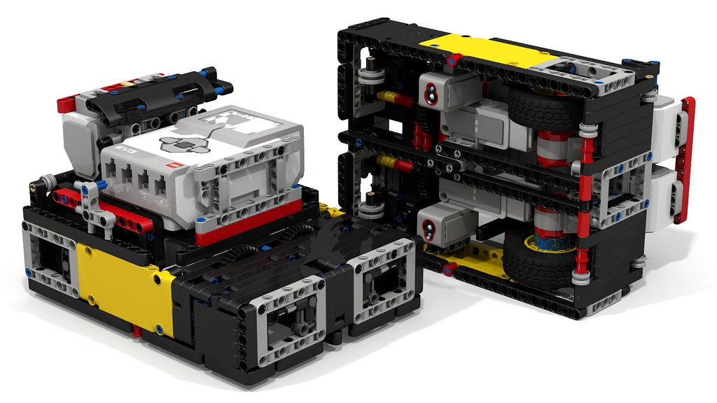
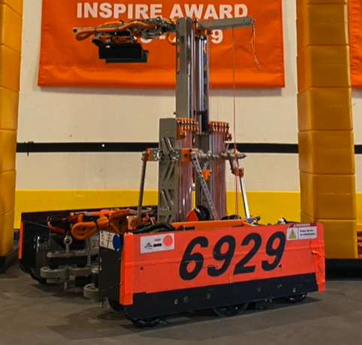
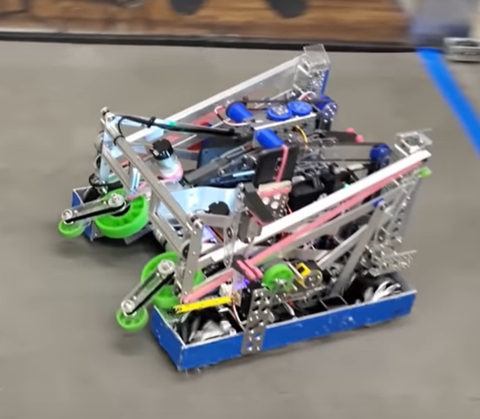
Robot Building (Cont.)
Design Process
Most robots in FLL are built on the fly; You have an idea in mind which you build up from.
3D design systems like Fusion 360, OnShape and SolidWorks allow FTC teams to completely design robots before building or buying parts
Tools
No tools were needed in FLL robot building
In FTC, you will need to use tools like screwdrivers, drills, saws, 3d printers, wrenches, grips, etc.

Slide 5
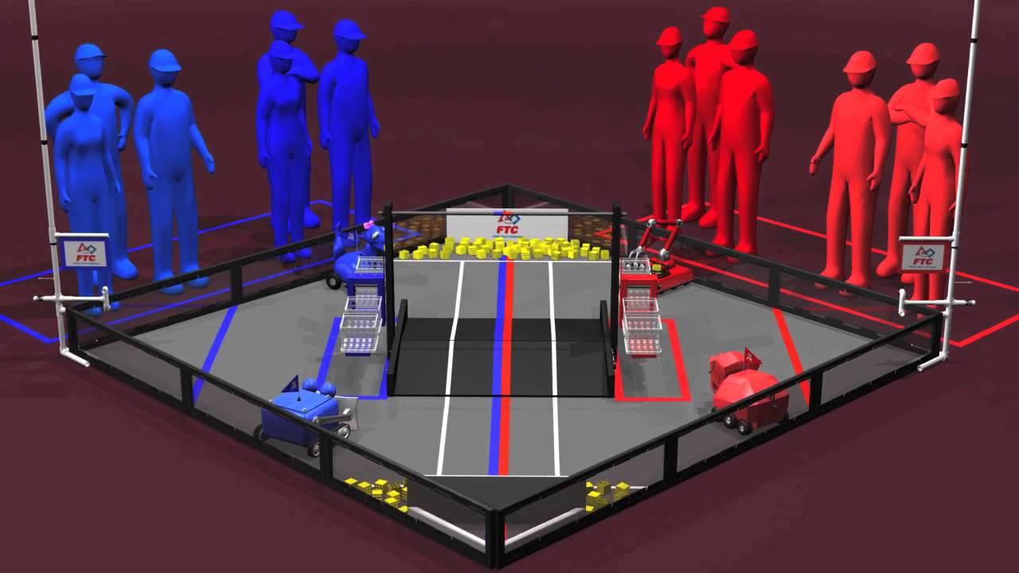
Robot Game
In FLL, the robot game is all pre-programmed and your score is based only on your own performance
In FTC, the first half minute is pre-programmed and the next two minutes are driver controlled
Your score in FTC is based upon not only your score, but also your alliance partner's score
In FTC, games are played in alliances of 2 competing against each other, with the winning duo securing 2 ranking points
There is no individual score, only your alliance’s score matters

Slide 6
Judging
Project and Core Values
In FLL, there are 3 separate judging events
Robot Design
Core Values
Project
In FTC, there is only one judging round. It is 10 minutes long, with 5 minutes for a team’s presentation and 5 minutes for questions
During this judging, the things tested are robot design, the engineering notebook and outreach (more info on these in next slide)
Gracious Professionalism, which is similar to core values, is tested throughout the day, during judge’s pit visits and also by referee’s during rounds

Slide 7
Judging(Cont.)
Outreach
Outreach is spreading FIRST, robotics and STEM throughout the community
Some outreach events include having booths at events, organizing robotics info sessions or classes, or mentoring other FTC/FLL teams
Most FLL teams did something similar to Outreach when presenting their project to people in their community, so they will have some experience with this already
Engineering Notebook
Unlike in FLL, FTC engineering notebooks are required if you want to be eligible for most awards
Only one engineering notebook is required per team, and they are usually between 150 and 300 pages
Each award has a corresponding part in the engineering notebook that has to be present for eligibility for that award

Slide 8
Budget
In FLL, robot related expenses usually do not exceed $600 per season
In FTC, however, robot costs are significantly more.
For your first season, robot building costs may be around $3000 - $7000
Every season after that, it will continue to get less as you accumulate more and more parts
Other than this, FTC also has many other expenses
The yearly challenge kit (The Mission Models) can cost up to $450
Qualifier registration can also be quite a lot depending on which region you’re team is centered in

Slide 9
Budget (Cont.)
In FTC, however, there are also many more ways that you can deal with this price surge
FTC teams can be up to 15 students, meaning that the money can be split more ways than in FLL
FTC teams have many grants available to them. Qualcomm offers rookie grants to all teams who apply for them, and many other technology companies such as Google and Apple also offer teams who have one of their employees as a mentor grants
Many companies have 1:1 matching
If teams donate $5,000 to a non profit or school, the company will also donate $5,000. Thus, you will have an account of $10,000 with the non profit or school

Slide 10
Events
Qualifiers
In FLL, you can only attend one qualifier event to qualify for the regionals event
Qualifiers go on for up to 3 months depending on the region your team is based in
In FTC, each team can attend up to 3 qualifier events to reach the regionals
Qualifiers go on for up to 5 months depending on the region your team is based in
Scoring
In FTC, every round’s score matters, unlike in FLL
While only your top score matters in FLL, you are judged based on wins and losses in FTC, so consistency is of paramount importance

Slide 11

Credits
This lesson was written by Dhruv Gupta from Quantum Stingers Team 13380 for FTCTutorials.com
You can contact the author at dhruv.gupta@norcalrobotics.org
More lessons for FIRST Tech Challenge are available at www.FTCtutorials.com
This work is licensed under a
Creative Commons Attribution-NonCommercial-ShareAlike 4.0 International License.

