Slide 1

Advanced Ev3 programming LESSON 2: Gyro Turns
By Droids Robotics

Slide 2
Why use the Gyro Sensor
This lesson will help you turn your robot using the gyro
The gyro is a bit difficult to use correctly, but if you learn how to use it, you can make your robot make much more accurate turns
Read the comments in the code carefully to understand how to use it correctly.
Start at Stage 1 in the corresponding EV3 file
There are 2 common Gyro Errors….we provide some simple solutions

Slide 3
PROBLEM 1: Calibration & RESET
For a color sensor, you have to “teach” the robot what is black and white
For your gyro, you need to calibrate the sensor to understand what is “still”
Unfortunately, there is no gyro calibration block. The “stage 1” program shows how to calibrate the sensor.
You will also need to Reset the gyro at this stage

Slide 4
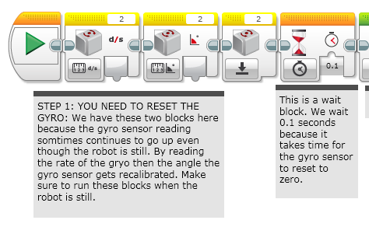
BEFORE You use your GYRO
SECOND, RESET GYRO. ADD A WAIT BLOCK TO GIVE THE SENSOR A BIT OF TIME TO FULLY RESET
FIRST CALIBRATE. NOTE: THE ROBOT MUST BE STILL.

Slide 5
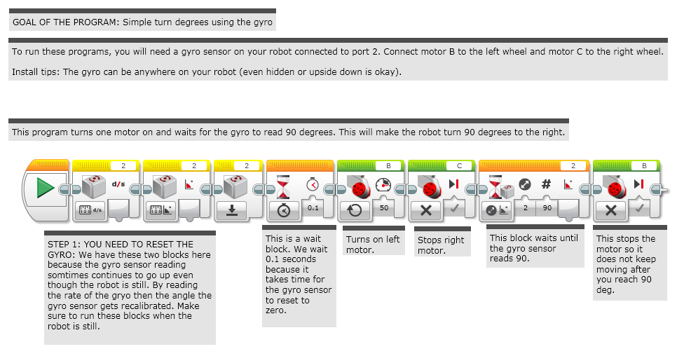
STAGE 1: SIMPLE Gyro turn

Slide 6
PROBLEM 2: Lag
What is lag?
The gyro sensor readings lag behind the true value sometimes
When the turn starts, it takes time for the gyro to begin changing
Stage 2 in the corresponding EV3 file shows one way to compensate for this delay

Slide 7
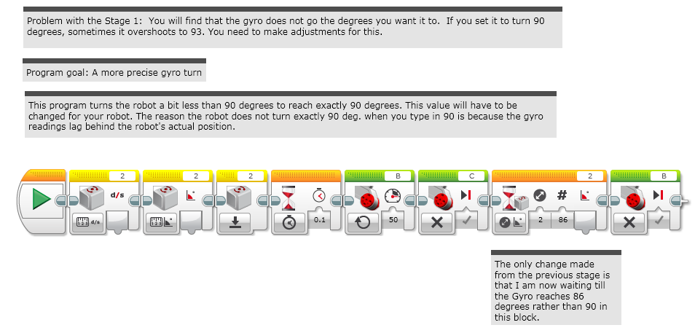
STAGE 2: Dealing with lag

Slide 8
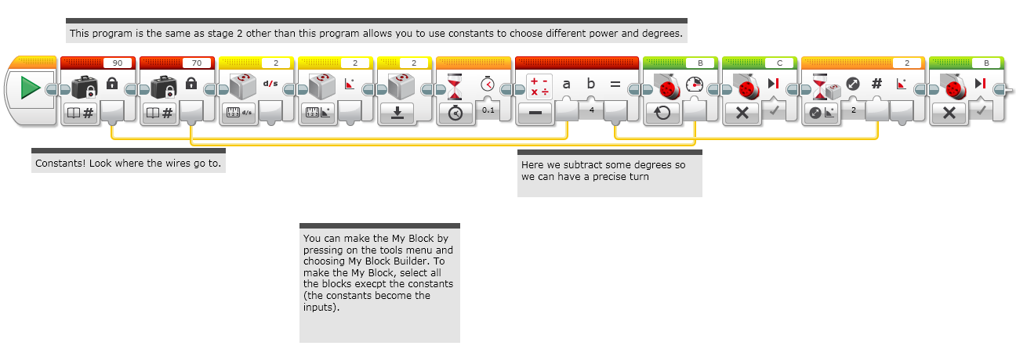
STAGE 3: Making a My block

Slide 9
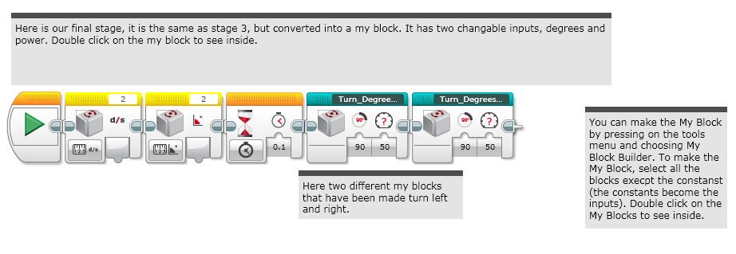
Stage 4: using the my block

Slide 10
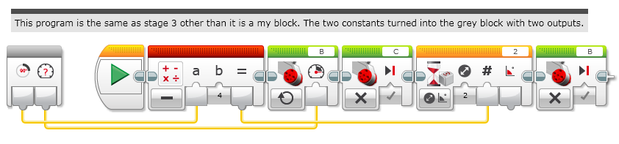
INSIDE THE MY Block: Turn Degrees RIGHT

Slide 11
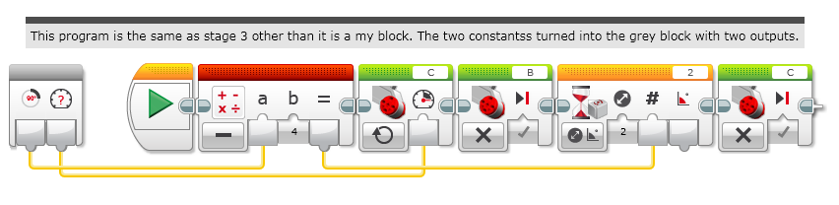
INSIDE THE MY Block: TURN DEGREES LeFT

Slide 12
CREDITS
These slides and the corresponding EV3 project files were made by Sanjay Seshan and Arvind Seshan from FLL Team: Not the Droids You Are Looking For.
They are free to use and distribute. We just ask that you send us an email letting us know if you liked the material, how you used it and if you have any corrections or suggestions for improvement.
www.droidsrobotics.org
team@droidsrobotics.org
Calculator for converting CM/IN into degrees: http://www.droidsrobotics.org/FLL2014/Resources/wheelconverter/
Other useful resources: http://www.droidsrobotics.org/Droids_Robotics/World_Class_Resources.html

