Slide 1

Advanced Ev3 programming LESSON 1: My Blocks OVERVIEW (Part 1)
By Droids Robotics

Slide 2
What is a My Block?
A My Block is a combination of one or more blocks that you create that can be grouped into a single block
My Blocks are basically your own custom block in NXT or EV3
Once a My Block is created, you can use it in multiple programs
Just like any other block in EV3, My Blocks can have both inputs and outputs

Slide 3
Why should you bother?
Because of Move Inches and Turn Degrees My Blocks, your missions will look like this…
Instead of this….
This makes your code easier to read and easier to modify!!!

Slide 4

When do you use a my block
Whenever the robot is going to repeat an action inside your program
When code is repeated in a different program
Organize and simplify your code
Example: You have 2 different versions of a robot run in FLL and the first half of both of them are identical, then making the first half of the code into a My Block allows you to “clean up your code” in both programs.

Slide 5
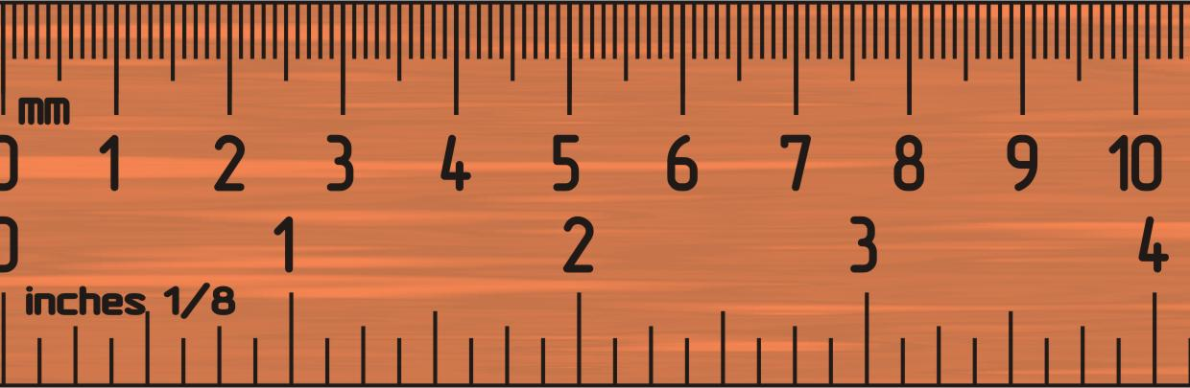
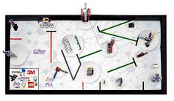
Why IS A Move InChes My Block a Good IDEA
Built-in move blocks will not take inputs (values) in centimeters or inches.
Much easier to measure distance with a ruler than degrees or rotations.
If you change your robot design to have bigger or smaller wheels late in the season you don’t have to re-measure every movement of your robot
Instead of changing distances in every single program you wrote, just go into your cool Move Inches Block and change the value for how many inches/cm one motor rotation would take.

Slide 6
What makes a useful my block
Note: Making My Blocks with inputs and outputs can make them far more useful. However, you need to be careful not to make the My Block too complicated.
Question: Look at the list of three My Blocks below. Which ones do you think are useful for a team to use?
1) Move2Inches (Moves the robot two inches)
2) MoveInches with an inches and power input
3) MoveInches with inches, power, angle, coast/brake, etc. inputs
Answer:
Move2Inches may be used often but you will be forced to make other My Blocks for other distances. This will be hard to update or fix later on.
MoveInches with inches, power, angle, coast/brake, etc. might look more useful but most of the inputs might never be used in any mission.
MoveInches with inches and power as inputs is probably the best choice for most teams.

Slide 7
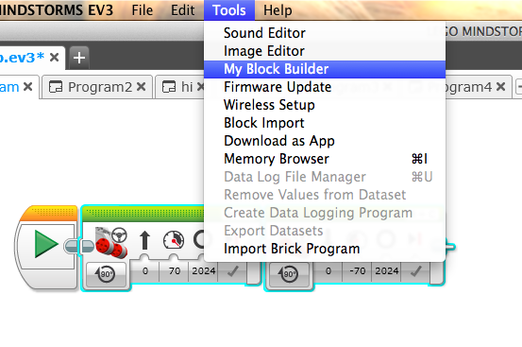
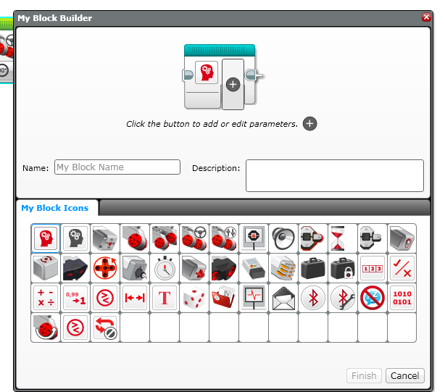
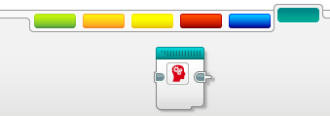
How to make a my block
Step 1: Select the blocks you think you will reuse. Go to Tools and Pick My Block Builder
Step 2: Pick a name and icon and set inputs & outputs
Step 3: You can use your block anytime – found in the turquoise tab

Slide 8
Advanced Ev3 programming LESSON 1: MOVE INCHES MY BLOCK (Part 2)
By Droids Robotics

Slide 9
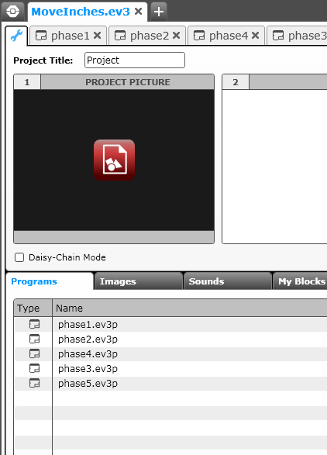
My blocks with inputs and outputs (Move InChes)
See the corresponding EV3 Files for step-by-step instructions and the actual code for you to learn how to make a Move Inches My Block. The code has been made in steps (phases).
Start at the Phase 1 tab and read all the comments in each one. We also give all the code so you can follow along and try it out.
The next few slides are screen captures of the lesson.

Slide 10
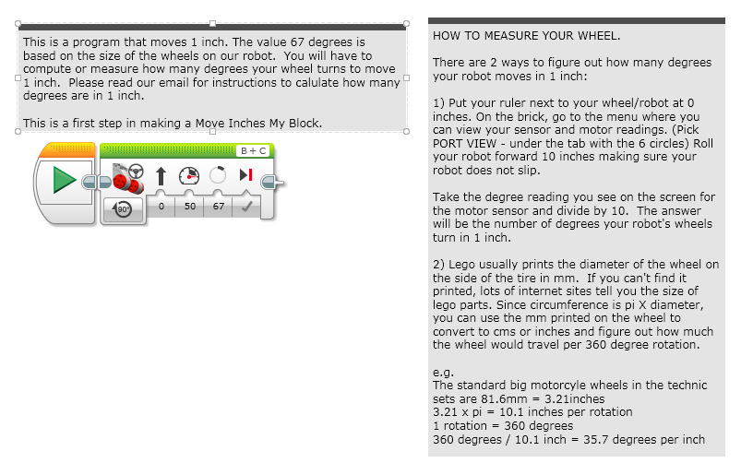
PHASE 1: MEASURE WHEELS

Slide 11
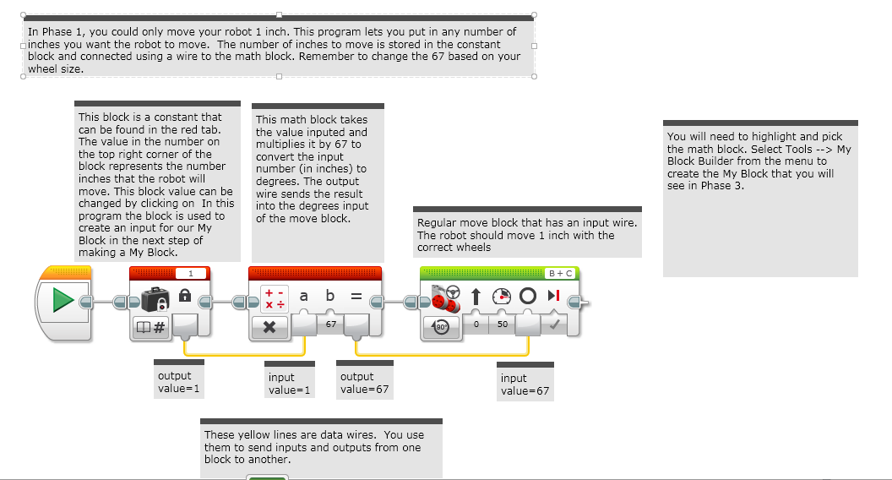
PHASE 2: Making aN INCHES TO DEGREES My Block

Slide 12
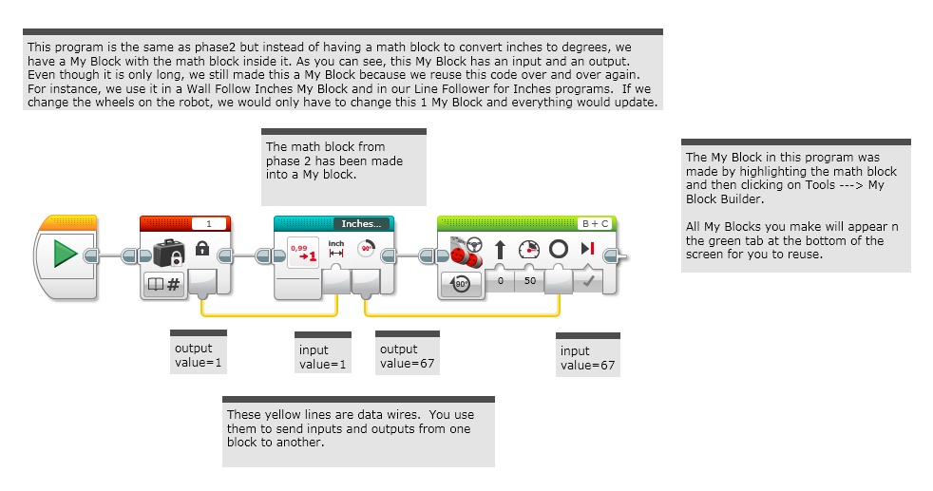
PHASE 3: Using the INCHES TO DEGREES MY BLOCK

Slide 13
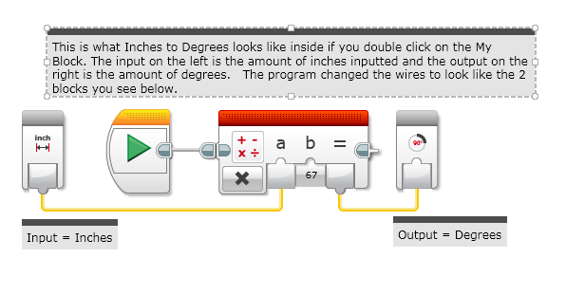
A LOOK INSIDE INCHES to DEGREES

Slide 14
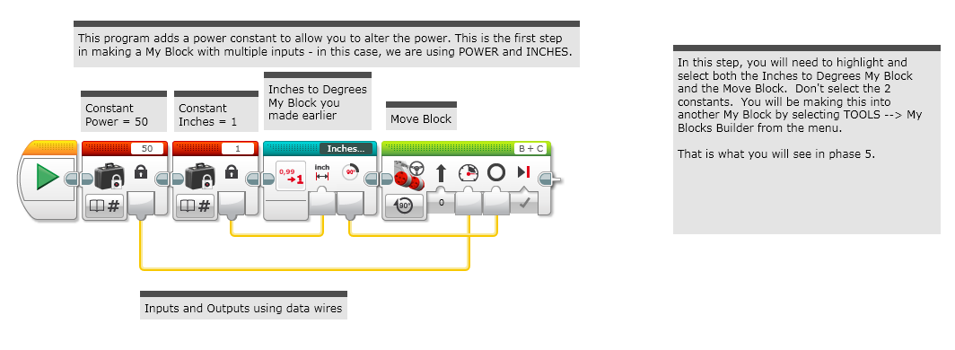
PHASE 4: ADDING INPUTS

Slide 15
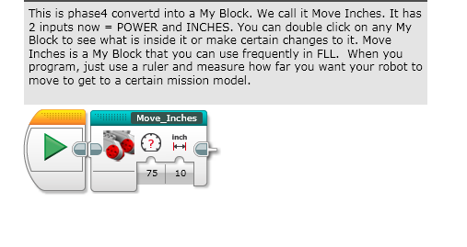
PHASE 5: COMPLETED Move InChes MY BLOCK

Slide 16
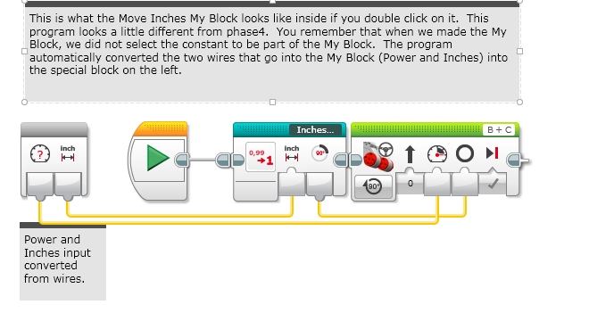
A LOOK INSIDE Move InChes

Slide 17
Advanced Ev3 programming LESSON 1: TURN DEGREES MY BLOCK (Part 3)
By Droids Robotics

Slide 18
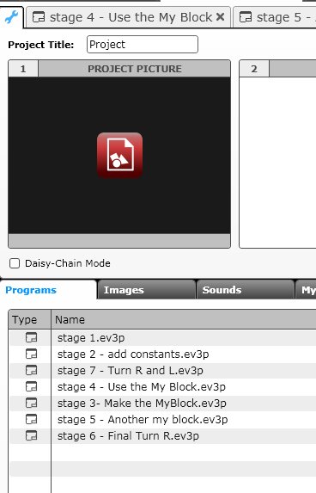
My blocks with inputs and outputs (TURN DEGREES)
See the attached EV3 Files for step-by-step instructions and the actual code for you to learn how to make a useful My Block to turn.
Start at the Stage 1 tab and read all the comments in each one. We also show you the final programs.
The project file has instructions for a Turn Degrees My Block. Some supplemental information is on the next few slides.

Slide 19
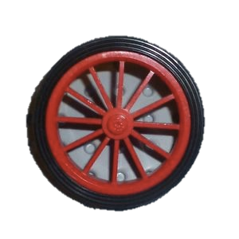
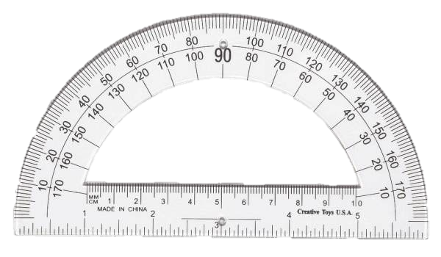
Making a Turn My Block
Just like Move Inches, you can also create a My Block for turns. In Move Inches, we had to figure out how much the robot wheels rotate for one inch on a ruler.
To make a Turn Degrees My Block, you have to figure out how much your rotation sensor on the motor turns for one degree on a protractor
A Turn My Block will be extremely useful to any FLL team because now you can measure your turns using a protractor!!!
You can use the EV3 to measure how much your wheel turns. We call this rotation degrees.
45 degree turn by the robot in the real world can be measured with a protractor. We call this protractor degrees.

Slide 20
Measuring the Rotation Sensor
The EV3 has a Port View Function which lets it display values measured by sensors
In this section, we will show you how to use the port view to measure turns.
Step 1: Go to Port View on your brick. On the EV3, it is on the third menu to the right. Look for the value for one of your drive motors (motors attached to your wheels)
Step 2: Turn the robot 90 degrees (Pivot Turn) yourself – using your hands to turn one wheel. Make sure the wheels don’t slip when you do this.
Step 3: Look at the rotation degrees value and write down the number of degrees (n)
Step 4: Divide the number from step 3 (n) by 90 (n/90)
This is the number of how many motor rotation degrees are in 1 protractor degree.
You can now use this information to make a Pivot Turn My Block called Turn Degrees. Please see my attached EV3 file. There are Phases marked for you to follow. Once you understand the code, you can modify this code to make a Spin Turn My Block as well.

Slide 21
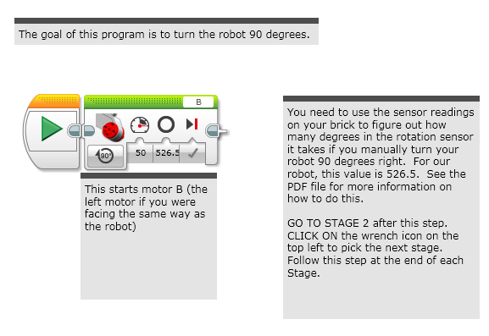
STAGE 1: MEASURE TURNS

Slide 22
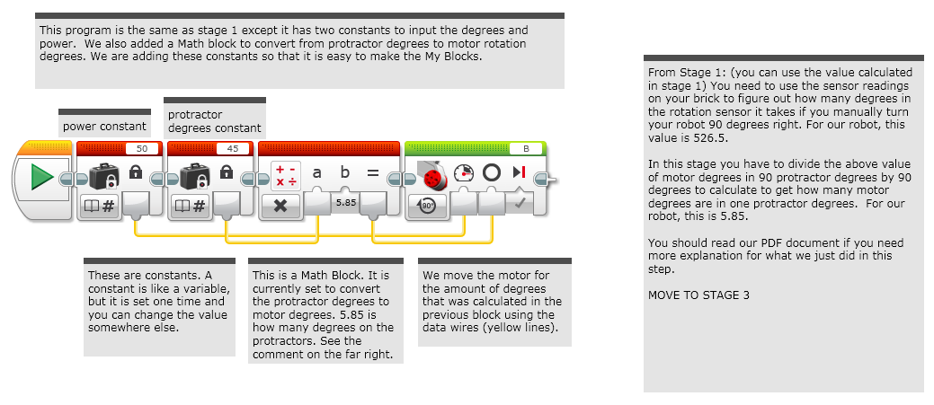
STAGE 2: ADD CONSTANTS

Slide 23
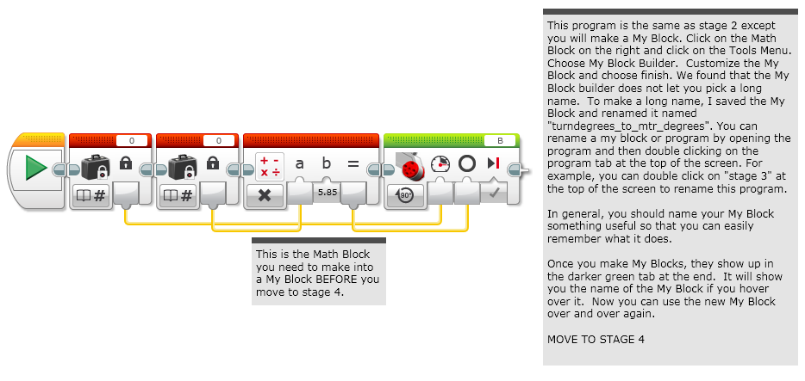
STAGE 3: MAKE My BLOCK

Slide 24
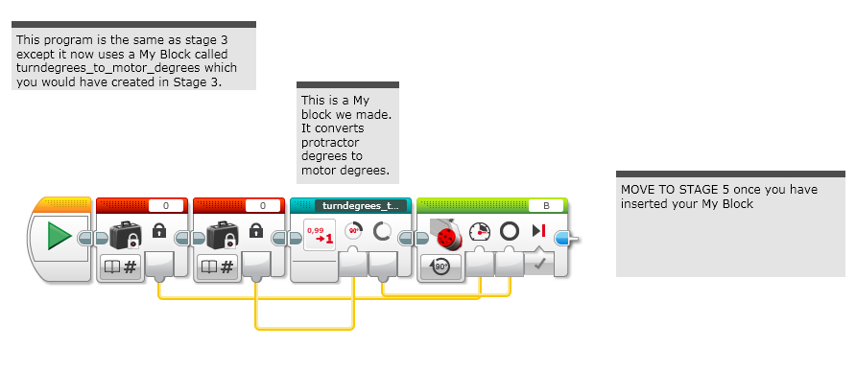
STAGE 4: USE My BLOCK

Slide 25
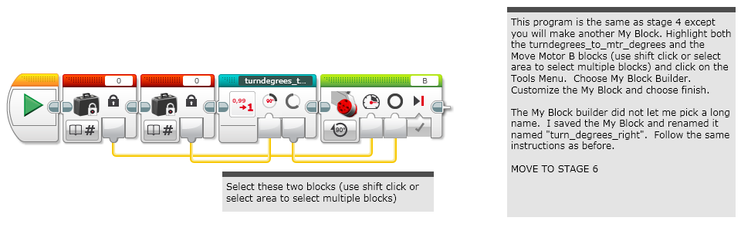
STAGE 5: ANOTHER MY BLOCK

Slide 26
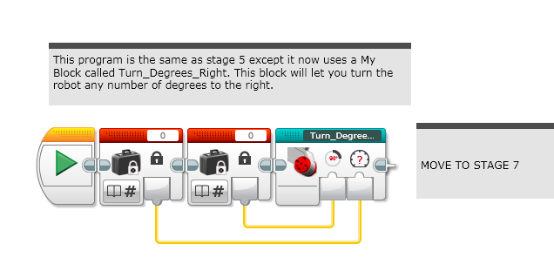
STAGE 6: TURN DEGREES Right

Slide 27
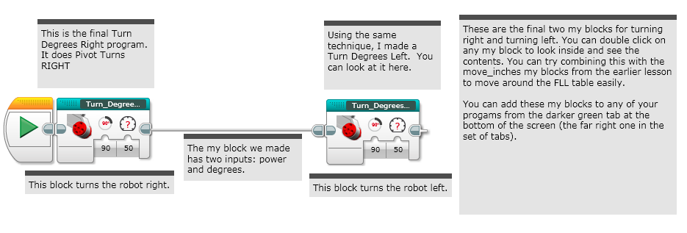
STAGE 7: Final Turn DEGREES

Slide 28
CREDITS
These slides and the corresponding EV3 project files were made by Sanjay Seshan and Arvind Seshan from FLL Team: Not the Droids You Are Looking For.
They are free to use and distribute. We just ask that you send us an email letting us know if you liked the material, how you used it and if you have any corrections or suggestions for improvement.
www.droidsrobotics.org
team@droidsrobotics.org
Calculator for converting CM/IN into degrees: http://www.droidsrobotics.org/FLL2014/Resources/wheelconverter/
Other useful resources: http://www.droidsrobotics.org/Droids_Robotics/World_Class_Resources.html

