Slide 1
Debugging Techniques

Slide 2
Why Debugging Techniques?
Debugging is a useful strategy to figure out where in your program something is going wrong
Once your code starts to become long/complicated (e.g. using sensors), it can become hard to figure out where in the program you are
The following slides show you some ways of knowing where you are in your program or knowing what values your sensors see
Locate Error
Think of Solution
Fix Error
Re-Test Program
HURRAY!

Slide 3
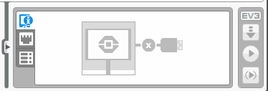
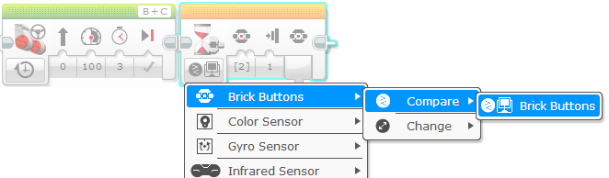
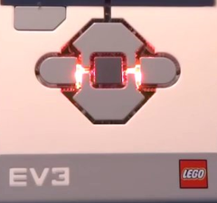

Button Press
Play Selected
To place a wait for button press block in your program, place a wait block into your program.
Go under brick buttons > compare > brick buttons, then choose which button needs to be pressed to continue the program.
Place these wait for button presses every block or two close to where the robot is not working correctly.
This can help you pinpoint which block is causing the robot to fail.
Play selected is useful for running small parts of the program, instead of waiting for your robot to complete other missions before getting to the one you want to see
You can also tell which block is running if you have bluetooth or if the cable is attached during the run
If you don’t have bluetooth built in the computer, we recommend that you purchase a bluetooth dongle ($10-15) because it makes this type of debugging easier

Slide 4
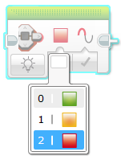
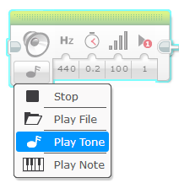
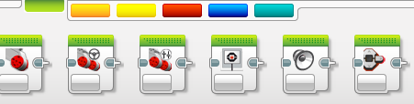

Visual Alerts
Sound Alerts
You can insert different sounds at intervals (about every 5 blocks or so, and then run the program again while listening for beeps.
Once you pick Play Tone, select Play Type and pick “play once”
These sounds can help you narrow down where in the program something is going wrong.
Brick status light blocks can be used for warnings and a disco robot.
Now we know it’s between Move Inches and Spin Turn!
Sound
block
Brick
Status
Light
block
BEEP!

Slide 5
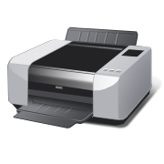
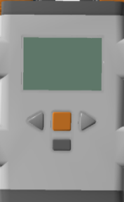
Print to Screen
You can use two different types of printing to screen: showing which block is playing, or showing the readings for the sensors at the current time.
Showing which block is playing on your robot can help debug when your robot refuses to move and you don’t know which block your robot is trying to run.
Then you can get on your computer, find the block, and find out what is going wrong.
Seeing the sensor readings is very helpful for calibrating your robot accurately, as you can place your robot’s color sensors over the line and find out if the readings are correct.
Also, you can see the sensor readings on your computer with Bluetooth.
Move inches
Light-1 100
Light-2 100

Slide 6
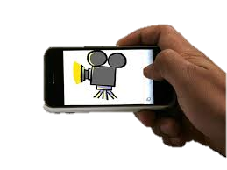

Other Debugging Techniques
Recordings:
You can record your runs with a camera. Then watch each run and observe what went wrong.
Comments:
You can also use “comments” to help debug – we add comments to remember what older values were entered into a block. We watch the run and then adjust these values.

