Slide 1

Advanced Ev3 programming LESSON 3: ALIGNING ON A LINE/Squaring off
By Droids Robotics

Slide 2
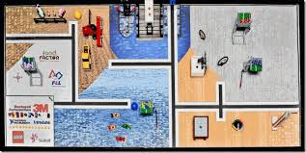
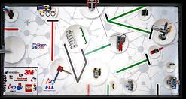
Aligning on a line
Another team asked us if we could do a lesson on aligning on a line, aka Squaring on a Line. This lesson is dedicated to your team.
FLL mats have lines that you can follow but also useful lines that you can use to square on. We highlight some examples below.
Start at Step 1 in the corresponding EV3 Program.

Slide 3
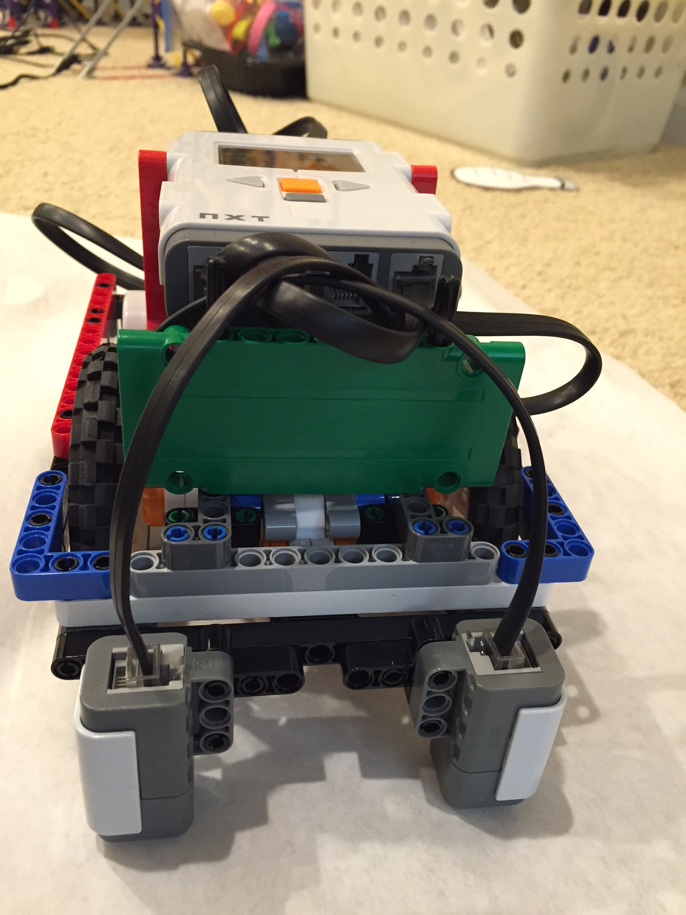
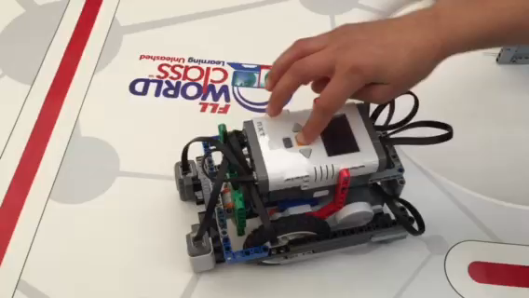
Goal: Robot that Straightens on a Line
You will need 2 Color Sensors (connected in Ports 1 and 4 in this program). Works on EV3 and NXT.
You should adjust the ports as needed - e.g. this assumes that a color sensor on port 1 is next to the wheel on motor port B and color sensor on port 4 is next to the wheel on motor port C.
Click on video

Slide 4
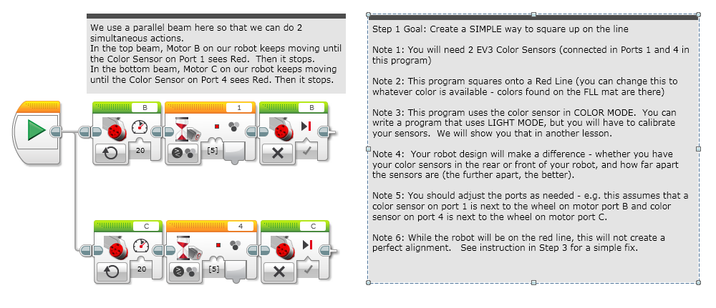
STEP 1: Moving until Line

Slide 5
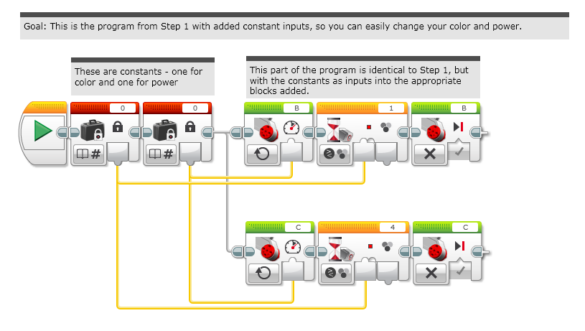
Step 2: ADDinG INPUTS

Slide 6
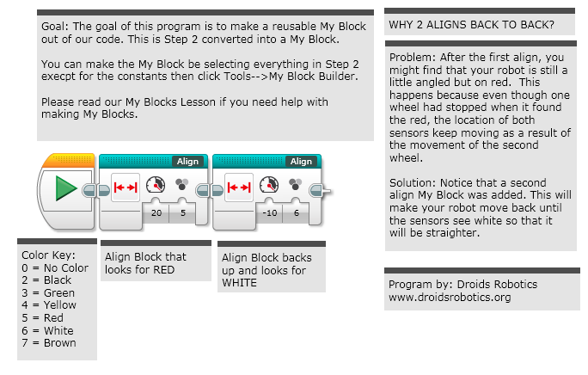
STEP 3: MY Block With DUAL STAGE FIX

Slide 7
TIPS
You will get better results
….if your color sensors are closer to the ground
….if you shield your color sensors
….if you don’t come at the line at steep angles
….if you keep your color sensors spread apart

Slide 8
CREDITS
These slides and the corresponding EV3 project files were made by Sanjay Seshan and Arvind Seshan from FLL Team: Not the Droids You Are Looking For.
They are free to use and distribute. We just ask that you send us an email letting us know if you liked the material, how you used it and if you have any corrections or suggestions for improvement.
www.droidsrobotics.org
team@droidsrobotics.org
Other useful resources: http://www.droidsrobotics.org/Droids_Robotics/World_Class_Resources.html

