Slide 1

INTERMEDIATE Ev3 programming LESSON 2: Color Line Follower My Block with INputs
By Droids Robotics
www.EV3LESSONS.com

Slide 2
LESSON OVERVIEW
Another team asked us how to create a line follower My Block that would allow you to take multiple inputs – power, degrees and color
This requires you to use your EV3 Color Sensor in Color Mode
You will not have to Calibrate your color sensor for this lesson
You will have to know how to make a basic My Block and use data wires (We show you in the comments, but you can check our My Blocks lesson in the Advanced section)
Follow along in the companion EV3 File. Always start at Stage 1
Note: We use a simple line follower in this lesson. You can combine these techniques with any line follower.
Next steps: Droids Robotics recommends that teams learn how to create a proportional line follower for light or a smooth line follower for color → check out our Advanced Lessons.

Slide 3
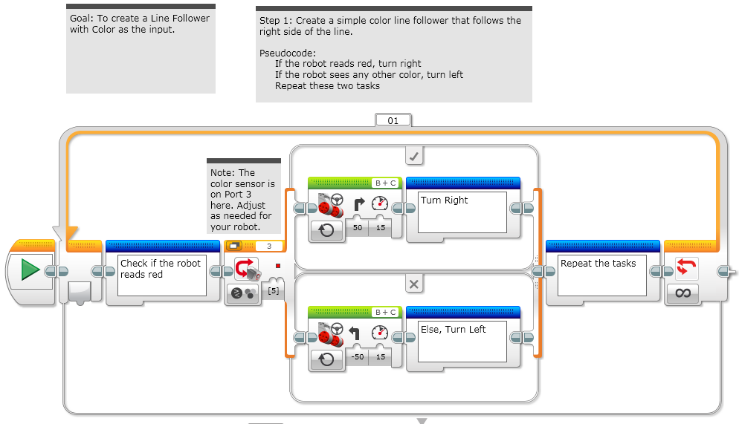
STAGE 1: Simple Color Line Follower

Slide 4
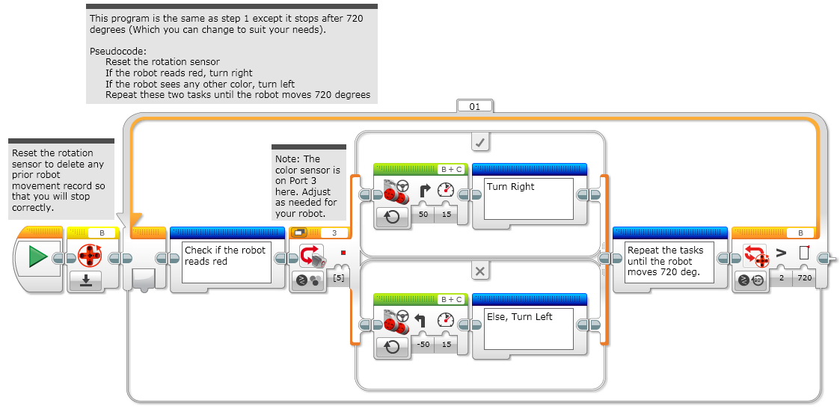
STAGE 2: RESET & DEGREES

Slide 5
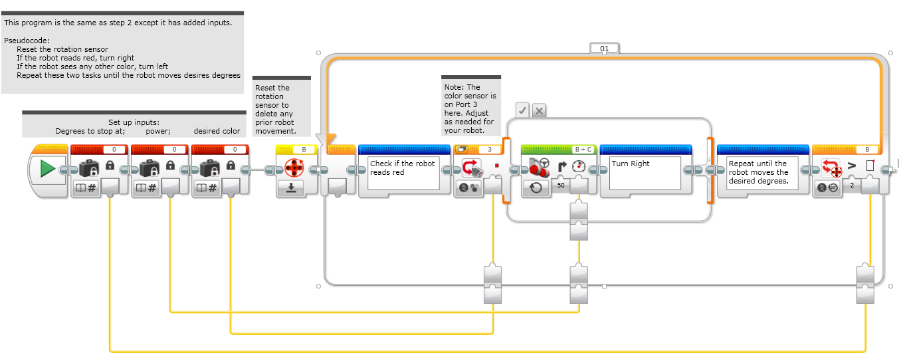
STAGE 3: ADDING INPUTS

Slide 6
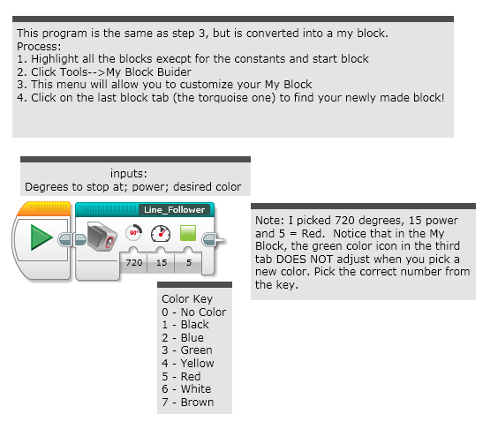
STAGE 4: MY BLock

Slide 7
CREDITS
This lesson was made by Sanjay and Arvind Seshan from FLL Team Not the Droids You are Looking For.
This material is free to use and distribute. Please credit Droids Robotics if you use it.
Please send us an email letting us know if you liked the material, how you used it, and if you have any corrections or suggestions for improvement.
team@droidsrobotics.org
More lessons at: www.ev3lessons.com

