Slide 1

ADVANCED PROGRAMMING Lesson
Proportional Control
By Droids Robotics

Slide 2
WHY Proportional Control?
Proportional control is very useful for FLL
The robot moves proportionally – moving more or less based on how far the robot is from the target distance
For a line follower, the robot may make a sharper turn if it is further away from the line
Proportional Control can be more accurate and faster for getting missions done!
Every proportional control program consists of two stages:
Computing an error → how far is the robot from a target
Making a correction → make the robot take an action that is proportional to the error (this is why it is called proportional control)

Slide 3
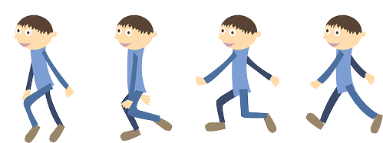
LEARNING WHAT IS PROPORTIONAL
On our team, we discuss “proportional” as a game.
Blindfold one teammate. He or She has to get across the room as quickly as they can and stop exactly on a line drawn on the ground (use masking tape to draw a line on the floor).
The rest of the team has to give the commands.
When your teammate is far away, the blindfolded person must move fast and take big steps. But as he gets closer to the line, if he keeps running, he will overshoot. So, you have to tell the blindfolded teammate to go slower and take smaller steps.
You have to program the robot in the same way!

Slide 4
LEARN How to Code proportional control
To learn how to use proportional control, we give you three different examples:
Dog Follower: uses ultrasonic
We used proportional ultrasonic moves in Nature’s Fury to make sure we hit the Base Isolation Model and the Evacuation Sign just the right amount
Line Follower: uses color sensor
We use proportional (or full PID) on all lines on the mat to make our moves more efficient
Gyro Turn: uses gyro sensor
We use proportional control to make sure that we have turned the amount we want

Slide 5
APPLICATIONS OF PROPORTIONAL CONTROL
Application | Objective | Error | Correction
Dog Follower | Get to a target distance from wall | How many inches from target location (current_distance – target_distance) | Move faster based on distance
Line Follower | Stay on the edge of the line | How far are our light readings from those at line edge (current_light – target_light) | Turn sharper based on distance from line
Gyro Turn | Turn to a target angle | How many degrees are we from target turn | Turn faster based on degrees remaining

Slide 6
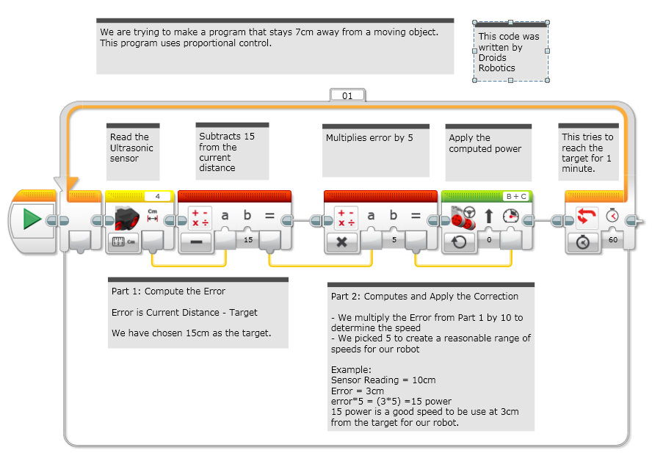
ULTRASONIC: Dog Follower

Slide 7
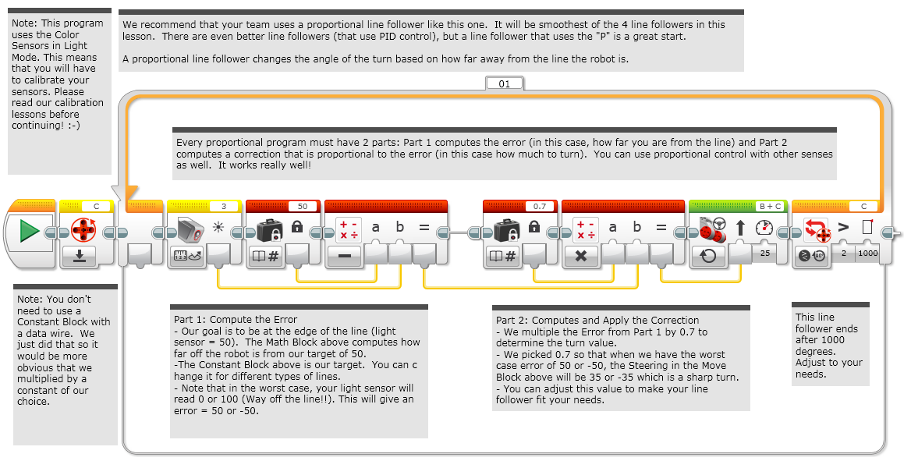
COLOR: Line Follower

Slide 8
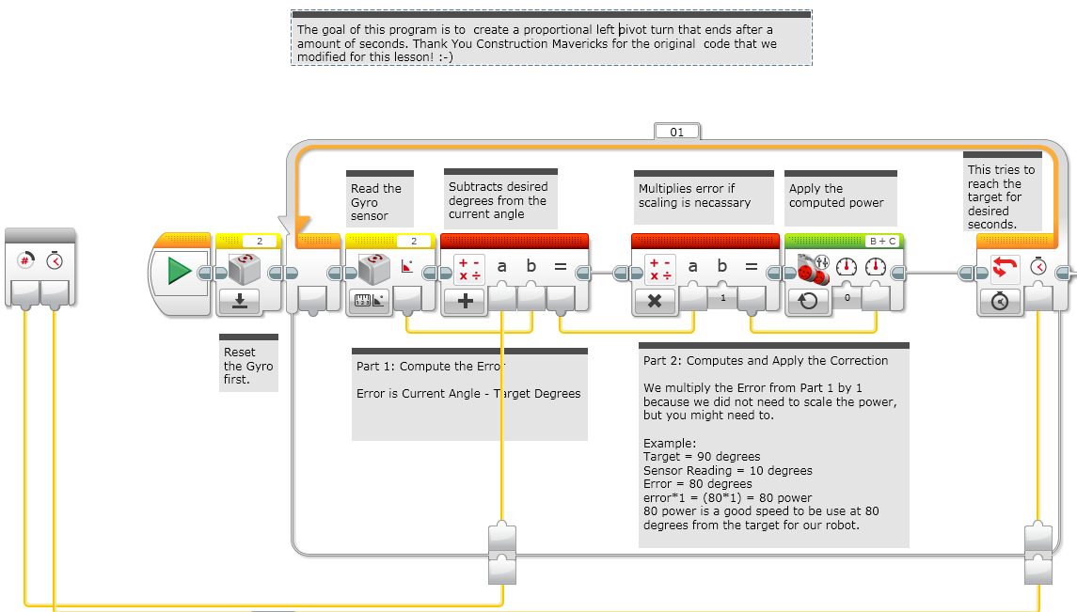
Gyr0: LEFT Turn

Slide 9
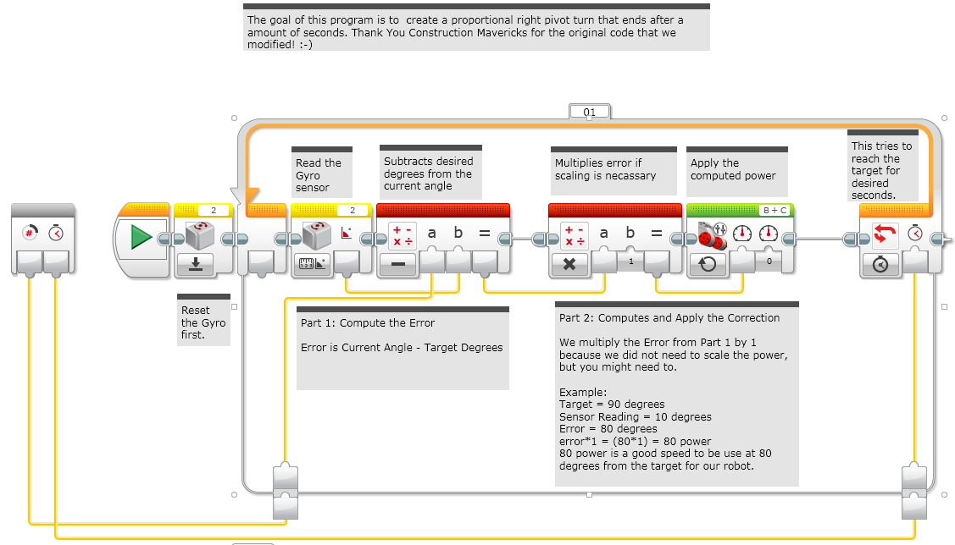
GYRO: RIGHT TURN

Slide 10
CREDITS
This lesson was written by Sanjay Seshan and Arvind Seshan from Droids Robotics
The original code for the Gyro Turn was from The Construction Mavericks. We modified it a little to use in this lesson.
The Construction Mavericks can be contacted at: frank.levine@gmail.com
More lessons at ev3lessons.com
Contact us: team@droidsrobotics.org

