Slide 1

BEGINNER EV3 PROGRAMMING Lesson 1
Intro to Brick and Software, Moving Straight, Turning
By: Droids Robotics
www.ev3lessons.com

Slide 2
Section 1: EV3 BASICS

Slide 3
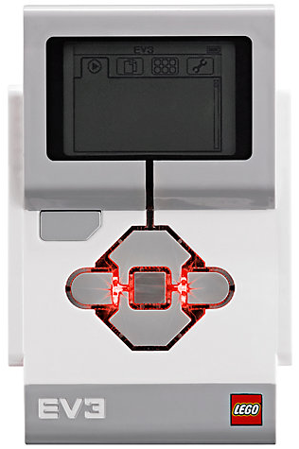
The “Brick” Buttons
1 = Back Undo Stop Program Shut Down EV3
2 = Center Button Select options Run Program
3 = L, R, Up, Down Navigate menus
1
3
3
2
3
3

Slide 4
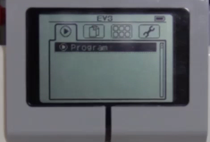
The “Brick” Screen
Tabs on Screen
Run Recent Find programs you ran recently
2. File Navigation Find all programs by project
3. Brick Apps Port views
4. Settings Bluetooth, Wifi, Volume
1
2
3
4

Slide 5
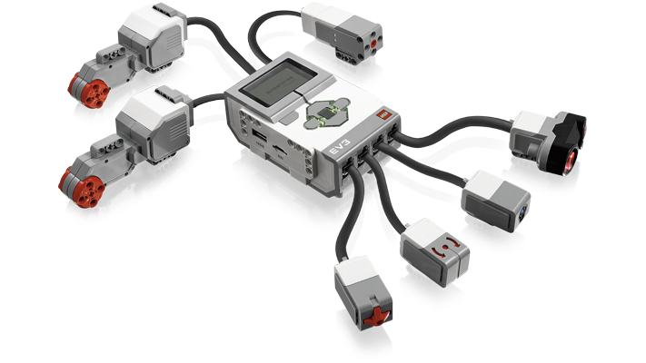
Ports, Sensors, motors
Ports A, B, C, D = Motors
Default setup assumes Right Motor in C, Left Motor in B
B
Default setup
C
Ports 1, 2, 3, 4 = Sensors

Slide 6
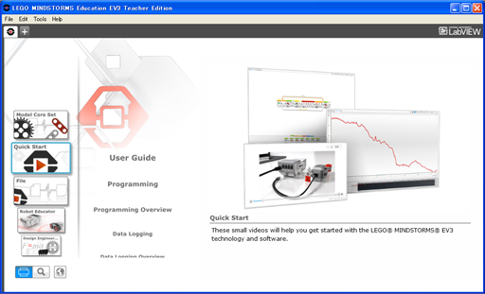
EV3 Software
Open Saved Project
Open New Project

Slide 7

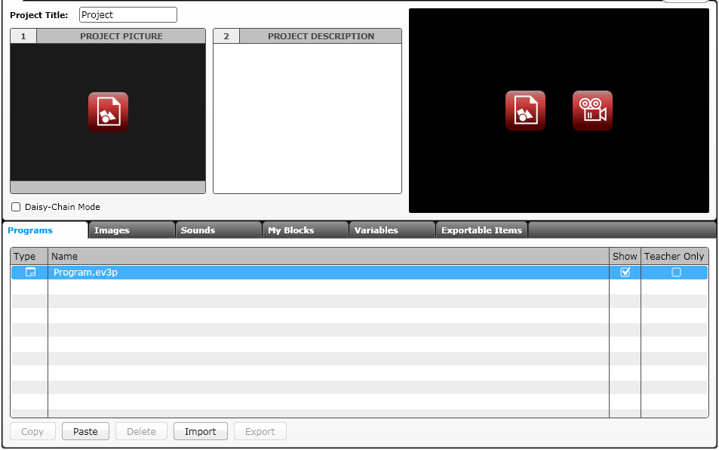
EV3 Software: Starting A new program
Create a Project
Opened Projects
Opened Programs
Create a Program
Project Properties
List of programs

Slide 8
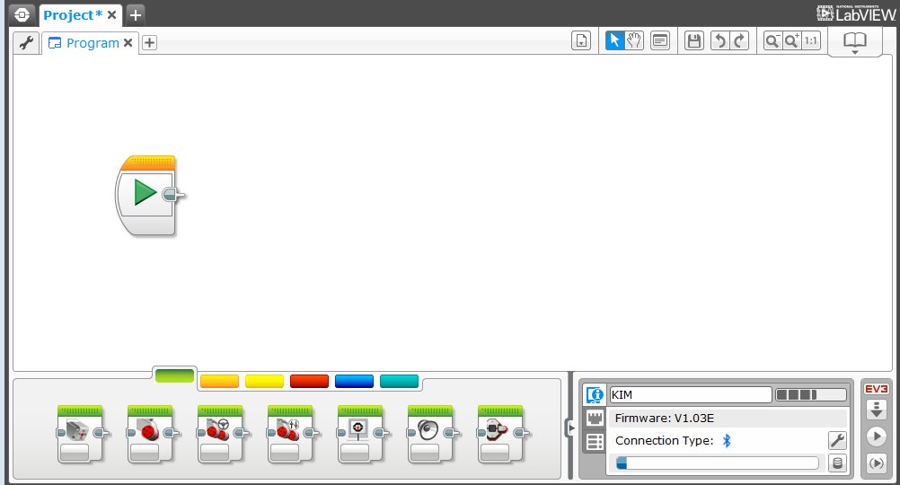
EV3 Software: Programming screen
Programming Area or Canvas
Programming Blocks in
6 Colored Tabs
Brick Status & Downloading

Slide 9
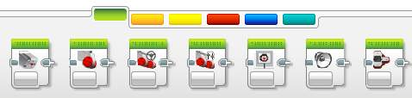
EV3 Blocks: Colored Tabs
ACTION BLOCKS
Move, Large & Medium Motor, Display…
FLOW BLOCKS
Start, Wait, Loop, Switch, Loop Interrupt
SENSOR BLOCKS
Brick Buttons, Gyro, Color, Ultrasonic
DATA OPERATIONS
Variables, Array, Logic, Math, Compare…
ADVANCED BLOCKS
Data Logging, Unregulated Motor…
MY BLOCKS
Custom Blocks you create

Slide 10
Section 2: MOVING STRAIGHT

Slide 11

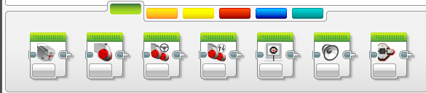
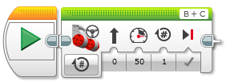
CHALLENGE: Move Straight
STEP 1: Green Block Tab, Click and hold Move Steering and drag to programming area
STEP 2: Drop next to the Start Block (green arrow)

Slide 12
Move STEERING Block
B
C
Mode of operation
Brake/Coast
Steering: Straight or turn
Power/Speed
Duration/Distance

Slide 13
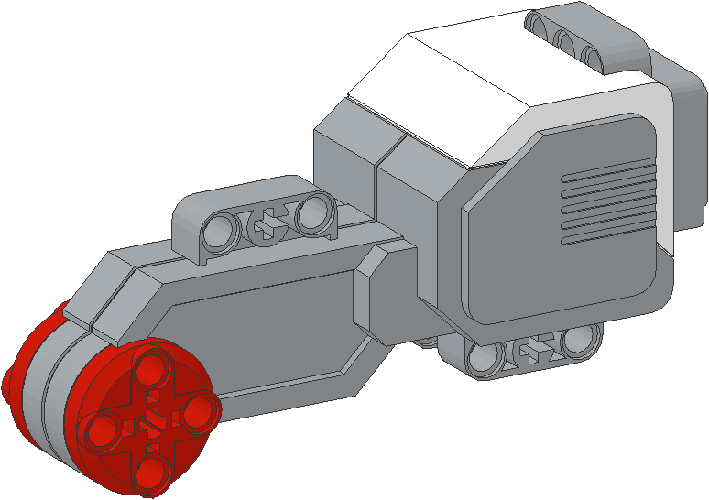
NEGATIVE & POSITIVE POWER: BACKWARD & FORWARD
Negative Power = Backwards
Positive Power = Forward

Slide 14
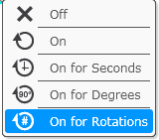
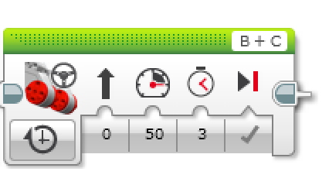
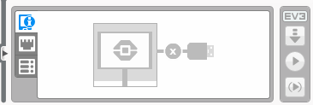
CHALLENGE: Move Straight (3 SECONDS)
STEP 1: Green Block Tab, Click and hold Move Steering and drag to programming area
STEP 2: Drop next to the Start Block (green arrow)
STEP 3: Select Options. Move “3 Seconds”
STEP 4: Connect USB cable to EV3 and Laptop.
STEP 5: Download to EV3

Slide 15
Move Straight: Seconds vs. degrees vs. rotations
FINISH
CHALLENGE: Move your robot forward from the start line to the finish line (1) and back to the start (2).
Try: Select SECONDS, DEGREES or ROTATIONS
Try: Different speeds
What are some advantages or disadvantages of using each one?
Did you have to do a lot of guess and check to reach the line?
1
2
B
START
C

Slide 16
MOVE STRAIGHT CHALLENGE – PART 1 SUMMARY
TEAMS | SECONDS | DEGREES | ROTATIONS
Team 1
Team 2
Team 3
Team 4

Slide 17
MOVE STRAIGHT discussion
Teams | Did you guess and check a lot? | Did changing the speed matter? | What was more accurate? Seconds? Degrees? | Do you think wheel size will matter? | Do you think battery level matters?
Team 1
Team 2
Team 3
Team 4

Slide 18
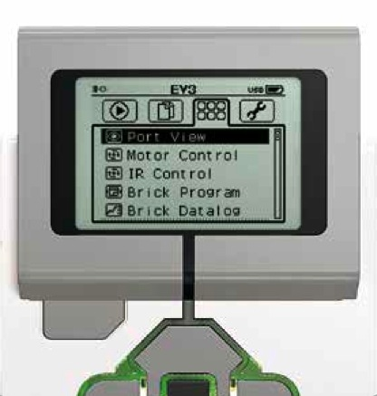
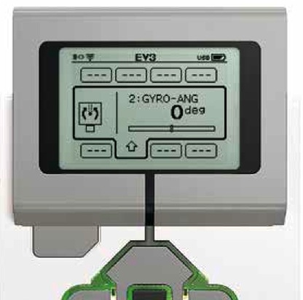
Moving Straight more accurately: Use Port View
Try “port view” on brick (on Brick Apps tab)
Move your robot with your hand from your start line to your end line
Read how many degrees your robot moved
Use this number in the Move Steering Block to move the correct distance.

Slide 19
SECTION 3: TURNING

Slide 20
PIVOT Vs. SPIN Turns
180 Degree Pivot Turn
Notice where the robot ends in both pictures after a 180 degree turn.
In the Spin Turn, the robot moves a lot less and that makes Spin Turns are great for tight positions. Spin turns tend to be a bit faster but also a little less accurate.
So when you need to make turns on the FLL board, you should decide which turn is best for you!
B
End Position
Motor
B Moves
C
B
Start Position
C
180 Degree Spin Turn
Start Position
End Position
B
B
Motors
B and C Move
C
C

Slide 21
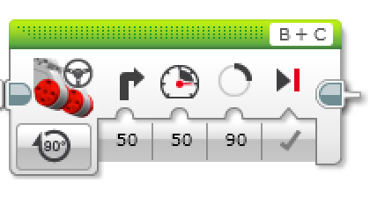
How to Make Pivot and Spin turns
Steering Value
50 | -50 | 100 | -100
Pivot Turn Right | Pivot Turn Left | Spin Turn Right | Spin Turn Left
B
B
B
B
C
C
C
C
Change Steering value here

Slide 22
MAKING A Pivot turn for 90 DEGREES
?
B
B
C
C
Program your robot to turn 90 degrees....Does the robot actually turn 90 degrees if you just pick 90 degrees for distance?

Slide 23
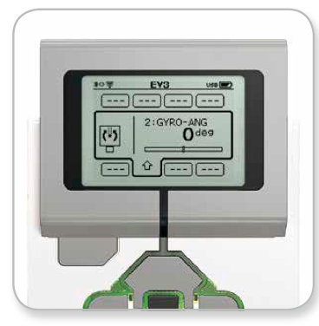
how do you make the robot turn 90 degrees?
Ans. Try using the port view again to measure the turn and then input the correct number of degrees.

Slide 24
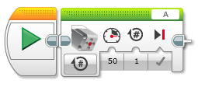
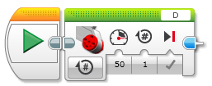
TURNING An Attachment ARM, not just the wheels
Attach a medium motor to Port A or a large motor to Port D as needed.
Move Steering vs. Motor Block
For moving your wheels you should use a Move Steering Block that syncs both wheel motors.
For moving your attachment your arm, you use either a Medium Motor Block or a Large Motor Block because you don’t need to sync your motors.
Medium Motor Block
Large Motor Block

Slide 25


Motor “On” and “Wait” Blocks
Leaving the motor “on” and “off”
Why use the “on” instead of “degrees”?
May want the program to do other tasks while moving
“Wait” block in Flow Tab
Wait for seconds
WAIT!

Slide 26
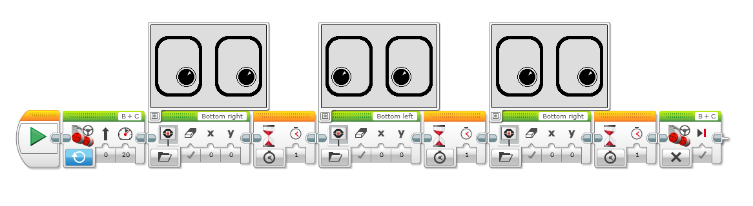
Something fun: Display Block
Use the Display Block to display information and pictures on the screen
You can control the location and size of text
You can use this same block to display sensor readings and instructions.
Challenge: Can you display eyes on the screen while moving? Alternate eyeballs that look left and right.
Use the Display Block, Motor On and Wait Block

Slide 27
CHALLENGE Solution
Motor On
Display Block
Wait Block
Motor Off

Slide 28

CREDITS
This tutorial was created by Sanjay Seshan and Arvind Seshan from FLL Team Not the Droids You Are Looking For (Droids Robotics)
We have additional material for more advanced lessons available on request.
Useful tools for FLL teams and robot programmers are available at www.ev3lessons.com
The material is made available to you free of charge. However, we would greatly appreciate a letter indicating that you are using the materials and what you think of them.
Feedback and suggestions are encouraged.
Email: team@droidsrobotics.org

