Slide 1

BEGINNER EV3 PROGRAMMING Lesson 2
Touch Sensor
Color Sensor
By: Droids Robotics
www.ev3lessons.com

Slide 2
SECTION 4: TOUCH SENSOR

Slide 3
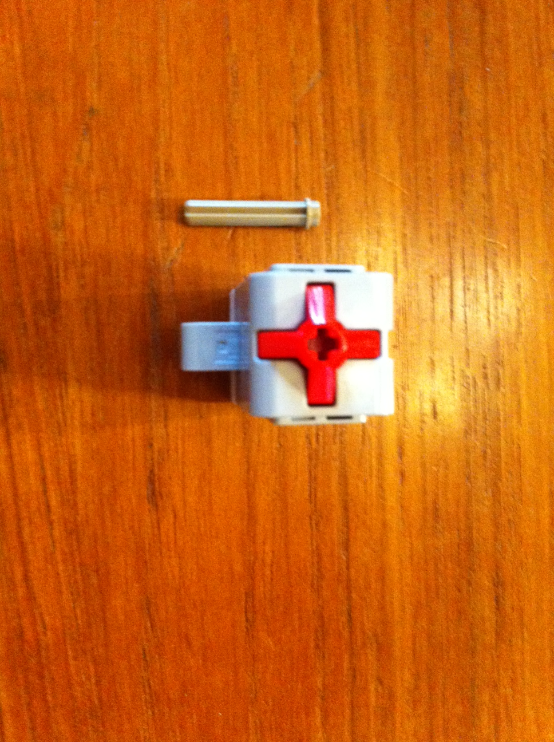
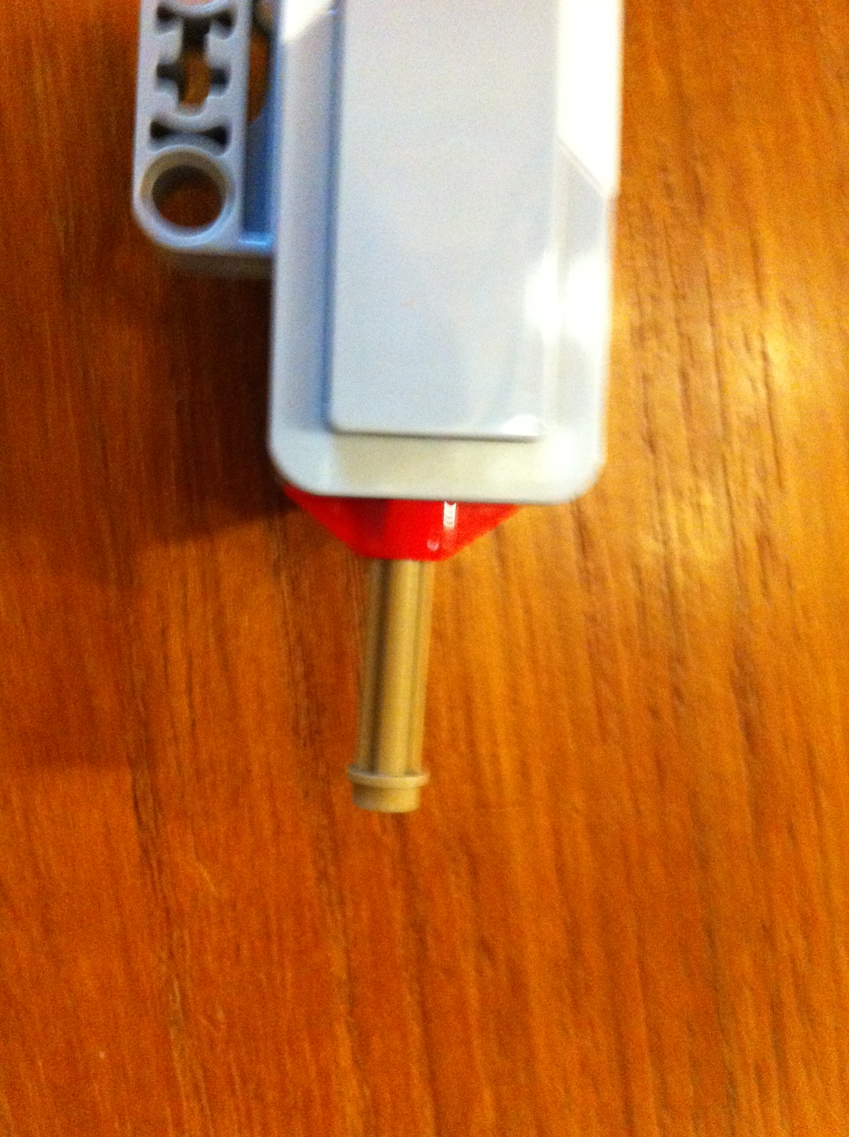
Modification to your Robot Build
If you built the robot that we recommended, you will have to make a minor modification to the design so that the touch sensor is more accessible.

Slide 4


SENSOR TAB vs. FLOW TAB (READING VS Wait for Sensor)
Compare sensor block to wait block
When should we use one or the other
Sensor Tab Sensor Blocks = Reading and Comparing Sensor Values
Flow Tab Wait For Block = Wait until a sensor reading
In this tutorial, we will use the
Wait For Block

Slide 5
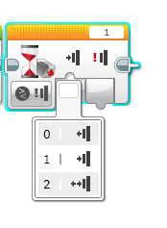
Using The Touch Sensor
Challenge 1: Program your robot to move straight until you touch the sensor with your hand.
Challenge 2: Program your robot to move until it hits the edge of the FLL table past the dog and cat missions. Then back up to the black line and turn right 90 degrees.
0 = released
1 = pressed
2 = bumped
Hint: You will combine everything you have learnt so far: Move Steering + Turning + Wait Block

Slide 6
SECTION 5: Color SENSOR

Slide 7
Using the color sensor
One of the ways for the robot to know its location is to take advantage of the markings on the field mat.
Every year, the Robot Game’s mat has lines or dark markings that can be detected by the Color Sensor.
Common uses:
Move until a line
Follow a line
Introduce color sensor
Modes:
Color, Reflected Light, Ambient Light
We will use the COLOR mode in this tutorial.

Slide 8
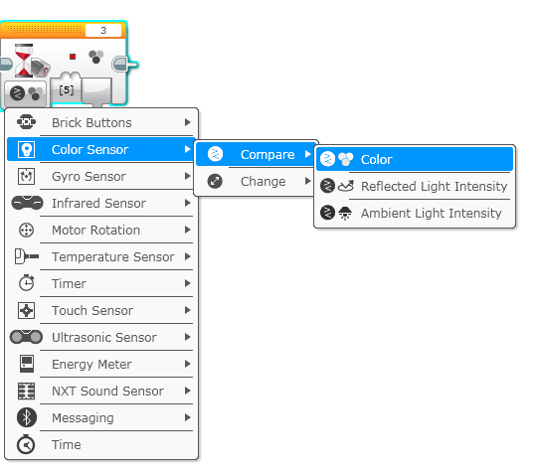
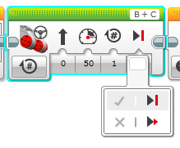
Using Color Sensor in color mode
CHALLENGE: Make the robot move up to the green line using the color sensor?
Step 1: Use Wait For Color
Step 2: Use the color sensor in COLOR MODE
Step 3: Coast or Break?
Tip: Coast will make the motors keep moving. Break makes the motors stop immediately. Which do you use to stop EXACTLY on the green line?

Slide 9
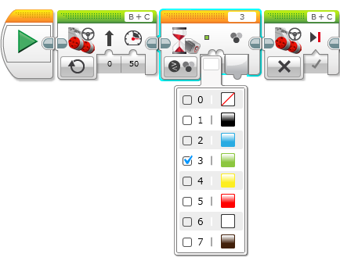
Color Sensor Challenge Solution
FINISH
Move Steering
Set to “ON”
Move Steering
Set to “OFF” with BREAK
START
Wait until Color is Green (#3)

Slide 10

CREDITS
This tutorial was created by Sanjay Seshan and Arvind Seshan from FLL Team Not the Droids You Are Looking For (Droids Robotics)
We have additional material for more advanced lessons available on request.
Useful tools for FLL teams and robot programmers are available at www.ev3lessons.com
The material is made available to you free of charge. However, we would greatly appreciate a letter indicating that you are using the materials and what you think of them.
Feedback and suggestions are encouraged.
Email: team@droidsrobotics.org

