Slide 1

BEGINNER EV3 PROGRAMMING Lesson 3
Switches and Loops
By: Droids Robotics
www.ev3lessons.com

Slide 2
SECTION 6: REPEATING ACTIONS

Slide 3
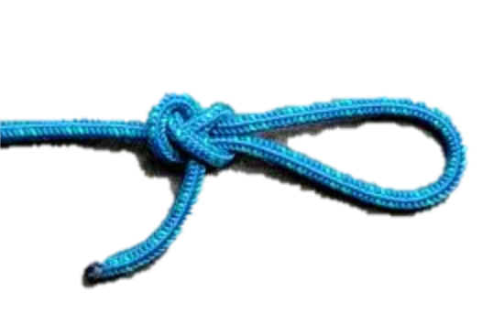
Repeating an Action
How can we move around a box using the commands we already know?
(move + turn) + (move + turn) + (move + turn) …
Loops make repeating a task multiple times easy
Is there an easier way?
Hint:

Slide 4

Loops
Loops make repeating a task multiple times easy
KEEP GOING….Forever, for a Count, Until touch (or something else)
Challenge: Write a program to go around the box until touched

Slide 5
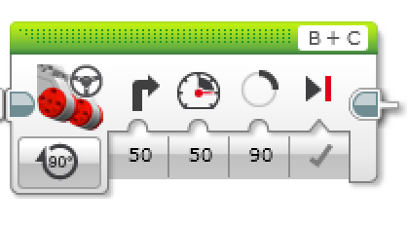
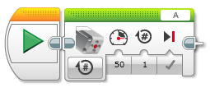
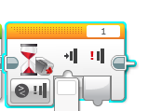
WHAT WE KNOW SO far
1) What is each Block called?
2) Where do you find it?
3) What does it do?
4) When do we use it?
A
B
D
C
E

Slide 6
SECTION 7: SWITCHING BETWEEN ACTIONS

Slide 7
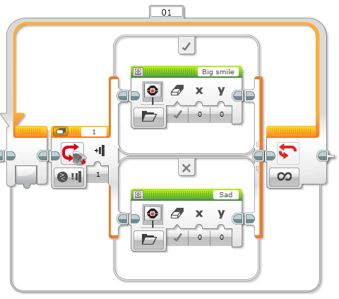

Switch Blocks
Switch block
Asking the robot a question and doing something different based on the answer
Example: Is the robot’s touch sensor pressed? Or not?
Does the robot see a line? Or not?
Basically a YES/NO QUESTION
Switch blocks are found in the orange/flow tab

Slide 8
Switch Block CHALLENGE 1
Challenge: Write a program that changes based on if the touch sensor is pressed or not pressed.
If pressed, your EV3 is happy! Display a smiley face. If not pressed, the EV3 is sad! Display a sad face.
Hint: You will need to use the display block and loops from yesterday and switch blocks from today!

Slide 9
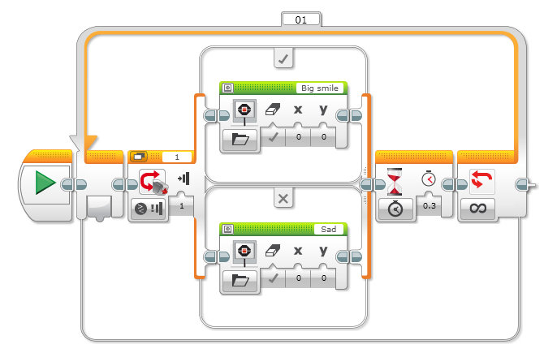
Challenge 1 SOLUTION
Display Block
Touch Sensor
Selected
Wait Block
Loop
Display Block

Slide 10
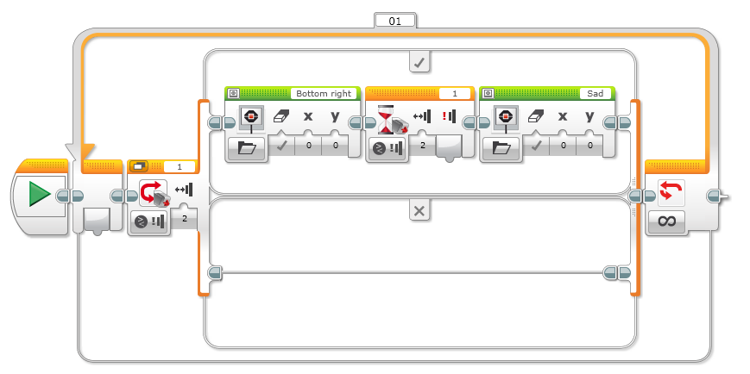
Switch Block Challenge 2
Can you write a program that displays a smiley if you touch it once and a sad face if you touch it a second time and toggles back and forth.

Slide 11

CREDITS
This tutorial was created by Sanjay Seshan and Arvind Seshan from FLL Team Not the Droids You Are Looking For (Droids Robotics)
We have additional material for more advanced lessons available on request.
Useful tools for FLL teams and robot programmers are available at www.ev3lessons.com
The material is made available to you free of charge. However, we would greatly appreciate a letter indicating that you are using the materials and what you think of them.
Feedback and suggestions are encouraged.
Email: team@droidsrobotics.org

