Slide 1

BEGINNER EV3 PROGRAMMING Lesson 4
Ultrasonic Sensor (Must complete Lesson 3 first)
Final Challenge
By: Droids Robotics
www.ev3lessons.com

Slide 2
SECTION 8: ULTRASONIC

Slide 3
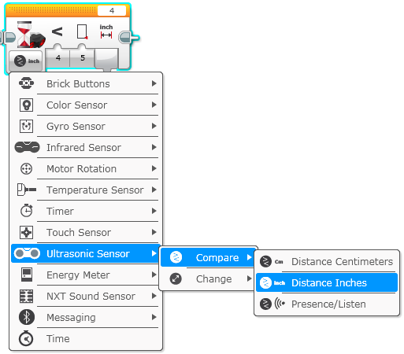
Move for ultrasonic
Challenge: Make the robot move until it is 5 inches away from the wall.
Step 1: Make a new program
Step 2: Set move to “on”
Step 3: Set wait block to use the Ultrasonic
Step 4: Set move block to “off”

Slide 4
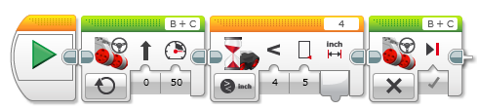
Challenge 1 solution:

Slide 5
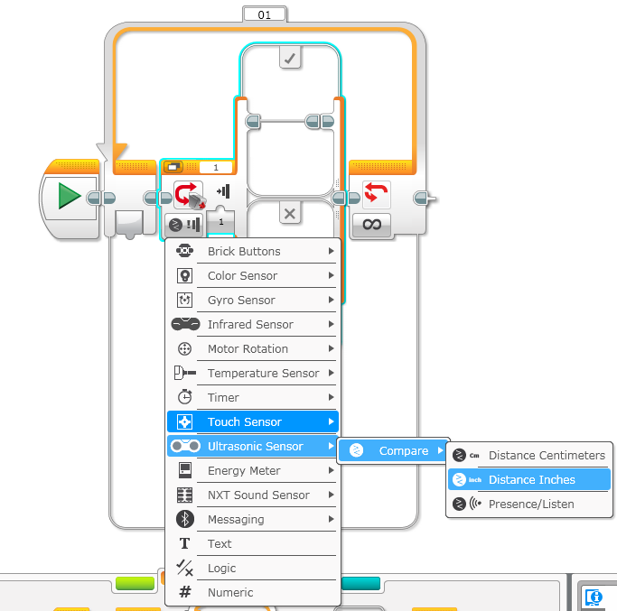
Challenge 2: Dog Follower
Challenge: If the robot is closer than 5 inches away from your hand move backward, otherwise move forward.
Step 1: Drag a loop from the orange tab
Step 2: Drag switch inside loop
Step 3: Set switch to Ultrasonic
Step 4: Set move steering block to ON and place in TRUE
Step 4: Set move steering block to OFF and place in FALSE

Slide 6
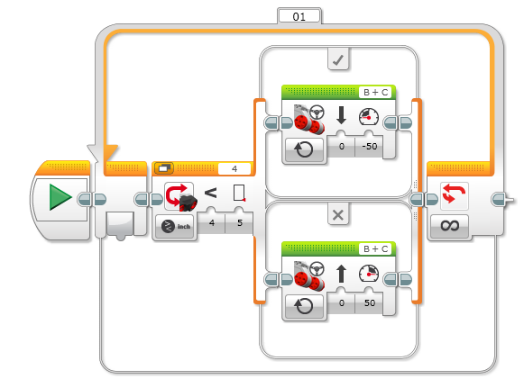
Challenge 2 solution:

Slide 7
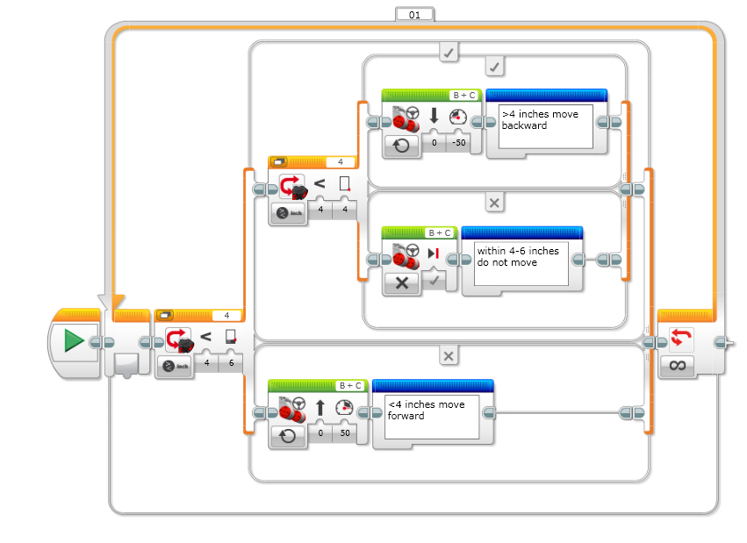
Better Dog follower:

Slide 8
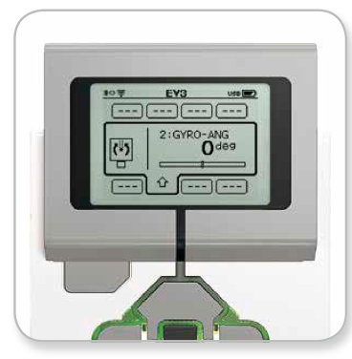
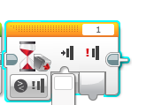
REVIEW
Turns: Spin and Pivot
Port View: Sensor readings on the brick
B
Spin (used in tight spaces)
C
B
Pivot
C
Wait Block:
Wait for a sensor reading (touch, ultrasonic, color) or time
Move until line, Move until touch

Slide 9
SECTION 9: FINAL CHALLENGE

Slide 10
FINAL MAZE CHALLENGE
Combine everything you know to navigate a maze like this.
END
Touch this,
back up
Do not knock obstacles
Safe Zone You pick up here
START
Do not Touch this

Slide 11

CREDITS
This tutorial was created by Sanjay Seshan and Arvind Seshan from FLL Team Not the Droids You Are Looking For (Droids Robotics)
We have additional material for more advanced lessons available on request.
Useful tools for FLL teams and robot programmers are available at www.ev3lessons.com
The material is made available to you free of charge. However, we would greatly appreciate a letter indicating that you are using the materials and what you think of them.
Feedback and suggestions are encouraged.
Email: team@droidsrobotics.org

