Slide 1

INTERMEDIATE PROGRAMMING Lesson
Simple Line Follower
By: Droids Robotics
www.ev3lessons.com

Slide 2
Line follower
The following slides are animated
It explains how a robot line follower works.

Slide 3

FOLLOW THE MIDDLE?
Humans want to follow the line in the middle.
Let’s have the robot do the same thing using the Color Sensor
What type of questions can we ask using this sensor
Are you on line or not?

Slide 4
If we are on black, keep going straight
If we are on white, turn left to get back to the line
Seems to work fine here…

Slide 5
If we are on black, keep going straight
If we are on white, turn left to get back to the line
OH NO… my robot is running away….
When the robot leaves the left side of the line, the program no longer works!

Slide 6
Line Following: ROBOT STYLE
Why could the Human follow the middle?:
They can see ahead.
They can see the whole line and its surroundings
They see both sides and which side they left
Why can’t the Robot do the same thing?:
Can’t tell right or left side of the line
How do we make sure the robot always veers off on the SAME SIDE of the line?
Instead of the middle, could the robot follow the “edge”?
So now the robot will fall off only the same side.
We will now show you how this works!

Slide 7
ROBOT LINE FOLLOWING Happens on the edges
Left side line following
Right side line following
If on black, turn left.
If on white turn right.
If on black, turn right.
If on white turn left.
The robot has to choose which way to turn when the color sensor sees a different color.
The answer depends on what side of the line you are following!

Slide 8
starting the roboT on the correct side
✗
✔
✔

Slide 9
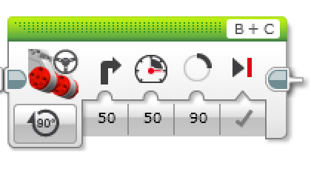
Line Follower challenge
Step 1: Write a program that follows the RIGHT edge of a line.
Hints: If your sensor sees black, turn left. If your sensor sees white, turn right. Use loops and switches!
Step 2: Try it out on different lines.
Did your line follower work the same on straight and curved lines?
Step 3: If not, instead of turn Steering = 50, try smaller values.
Is it better on the curved lines now?
B
B
C
C

Slide 10
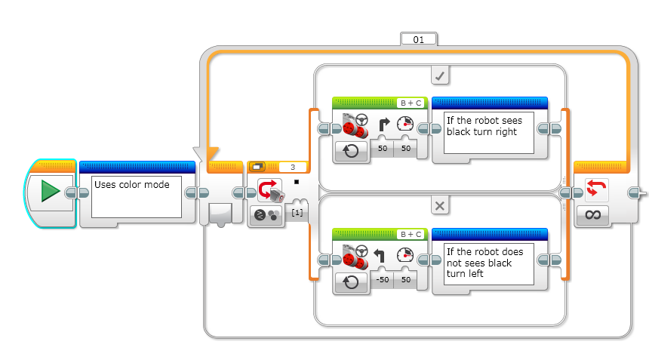

LINE FOLLOWING CHALLENGE SOLUTION
New Feature: Comment
Block in Blue Advanced Tab
Does this program follow the Right or Left side of a line?
Notes:
Right side

Slide 11
LINE FOLLOWING CHALLENGE SOLUTION
New Feature: Comment
Block in Blue Advanced Tab
How do we make this stop?
Notes:
Right side

Slide 12
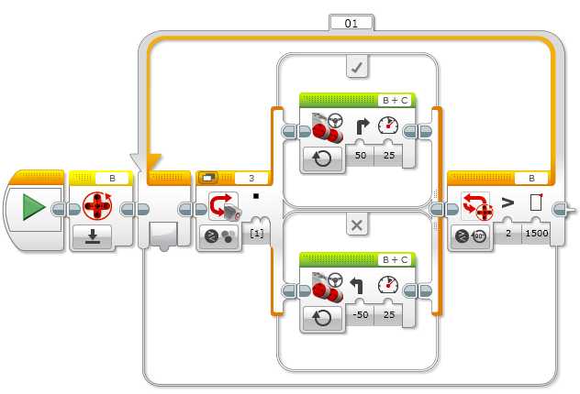
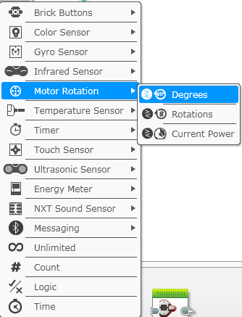
Line following for a Sensor or distance

Slide 13
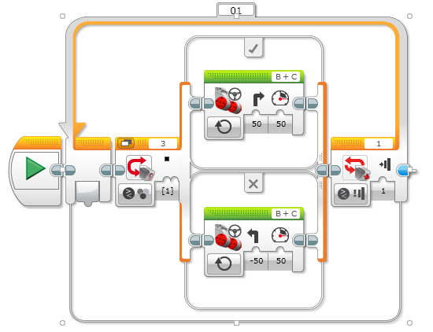
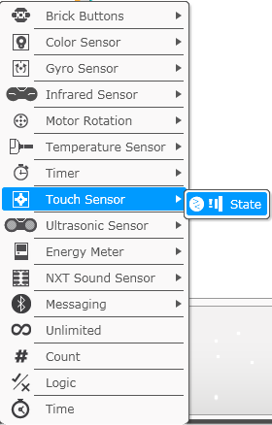
Line following for a Sensor or distance

Slide 14

CREDITS
This tutorial was created by Sanjay Seshan and Arvind Seshan from FLL Team Not the Droids You Are Looking For (Droids Robotics)
We have additional material for more advanced lessons available on request.
Useful tools for FLL teams and robot programmers are available at www.ev3lessons.com
The material is made available to you free of charge. However, we would greatly appreciate a letter indicating that you are using the materials and what you think of them.
Feedback and suggestions are encouraged.
Email: team@droidsrobotics.org

