Slide 1

Intermediate Programming Lesson: TURN DEGREES MY BLOCK
By Droids Robotics

Slide 2
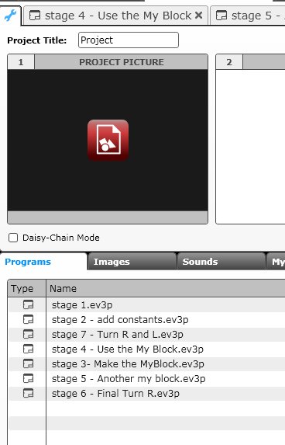
My blocks with inputs and outputs (TURN DEGREES)
See the attached EV3 Files for step-by-step instructions and the actual code for you to learn how to make a useful My Block to turn.
Start at the Stage 1 tab and read all the comments in each one. We also show you the final programs.
The project file has instructions for a Turn Degrees My Block. Some supplemental information is on the next few slides.

Slide 3
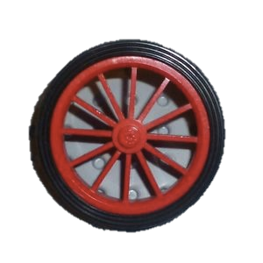
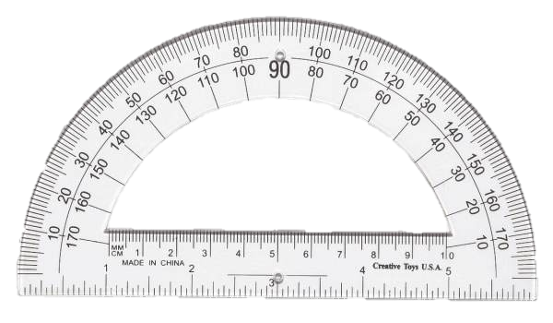
Making a Turn My Block
Just like Move Inches, you can also create a My Block for turns. In Move Inches, we had to figure out how much the robot wheels rotate for one inch on a ruler.
To make a Turn Degrees My Block, you have to figure out how much your rotation sensor on the motor turns for one degree on a protractor
A Turn My Block will be extremely useful to any FLL team because now you can measure your turns using a protractor!!!
You can use the EV3 to measure how much your wheel turns. We call this rotation degrees.
45 degree turn by the robot in the real world can be measured with a protractor. We call this protractor degrees.

Slide 4
Measuring the Rotation Sensor
The EV3 has a Port View Function which lets it display values measured by sensors
In this section, we will show you how to use the port view to measure turns.
Step 1: Go to Port View on your brick. On the EV3, it is on the third menu to the right. Look for the value for one of your drive motors (motors attached to your wheels)
Step 2: Turn the robot 90 degrees (Pivot Turn) yourself – using your hands to turn one wheel. Make sure the wheels don’t slip when you do this.
Step 3: Look at the rotation degrees value and write down the number of degrees (n)
Step 4: Divide the number from step 3 (n) by 90 (n/90)
This is the number of how many motor rotation degrees are in 1 protractor degree.
You can now use this information to make a Pivot Turn My Block called Turn Degrees. Please see my attached EV3 file. There are Phases marked for you to follow. Once you understand the code, you can modify this code to make a Spin Turn My Block as well.

Slide 5
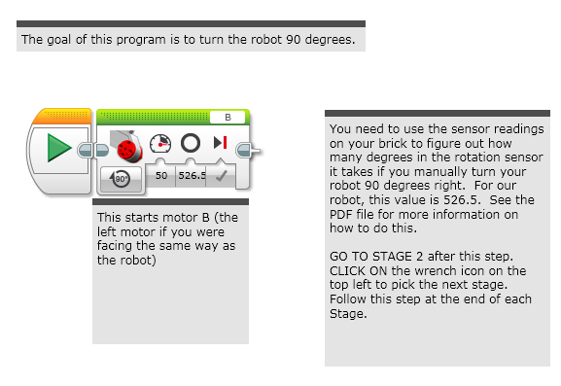
STAGE 1: MEASURE TURNS

Slide 6
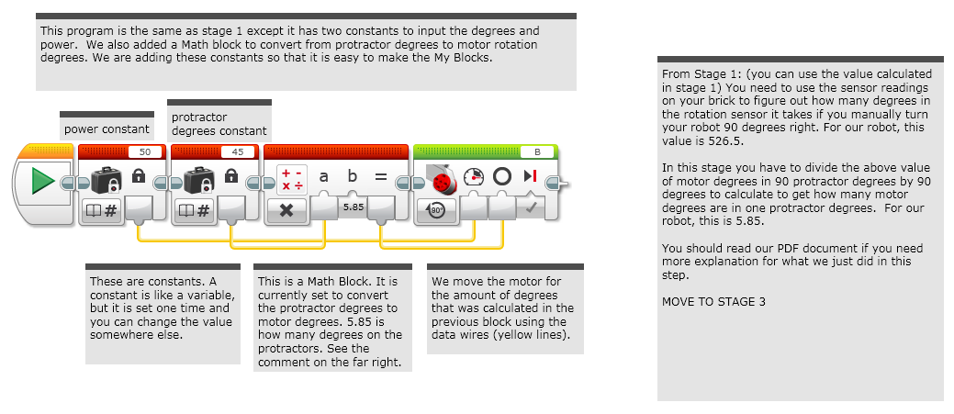
STAGE 2: ADD CONSTANTS

Slide 7
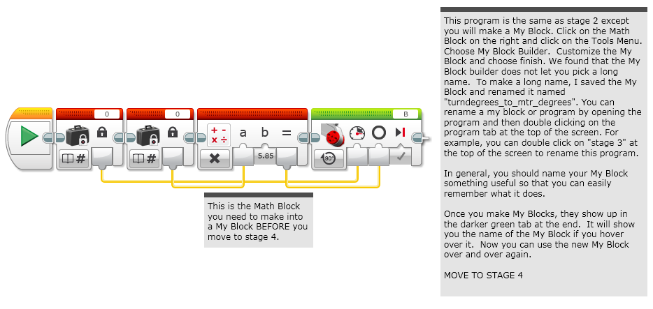
STAGE 3: MAKE My BLOCK

Slide 8
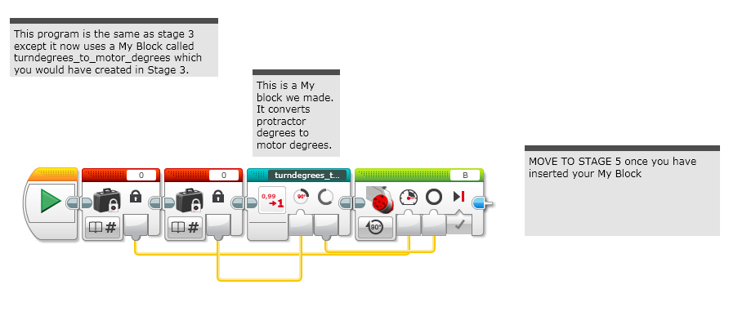
STAGE 4: USE My BLOCK

Slide 9
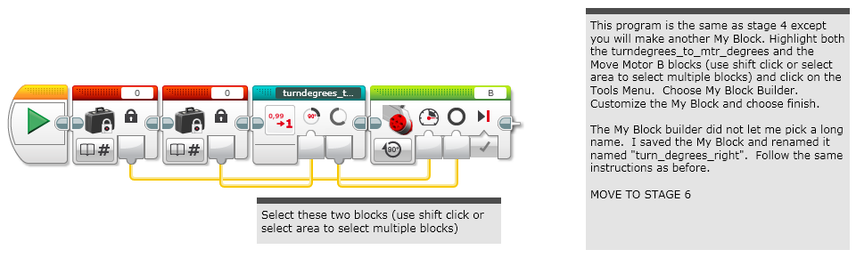
STAGE 5: ANOTHER MY BLOCK

Slide 10
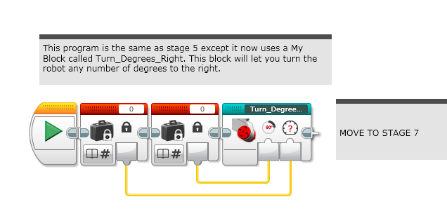
STAGE 6: TURN DEGREES Right

Slide 11
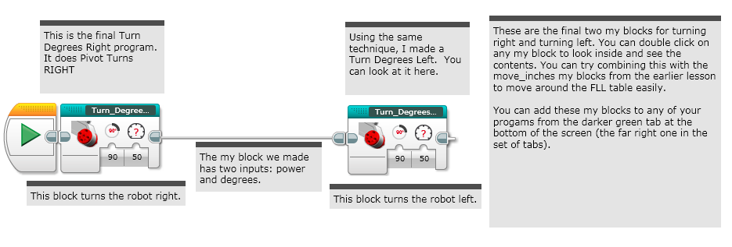
STAGE 7: Final Turn DEGREES

Slide 12
CREDITS
These slides and the corresponding EV3 project files were made by Sanjay Seshan and Arvind Seshan from FLL Team: Not the Droids You Are Looking For.
They are free to use and distribute. Please just give credit to the team and send a thank you note if you can.
You can reach the Droids at: team@droidsrobotics.org
Calculator for converting CM/IN into degrees: www.ev3lessons.com/resources.html
More lessons: www.ev3lessons.com

