Slide 1

INTERMEDIATE Ev3 programming LESSON Color Line Follower My Block with INputs
By Droids Robotics
www.EV3LESSONS.com

Slide 2
PART 1: COLOR FOLLOWER WITH INPUTS….MOVES FOR CERTAIN NUMBER OF DEGREES

Slide 3
LESSON OVERVIEW
Another team asked us how to create a line follower My Block that would allow you to take multiple inputs – power, degrees and color
This requires you to use your EV3 Color Sensor in Color Mode
You will not have to Calibrate your color sensor for this lesson
You will have to know how to make a basic My Block and use data wires (We show you in the comments, but you can check our My Blocks lesson in the Advanced section)
Follow along in the companion EV3 File. Always start at Stage 1
Note: We use a simple line follower in this lesson. You can combine these techniques with any line follower.
Next steps: Droids Robotics recommends that teams learn how to create a proportional line follower for light or a smooth line follower for color → check out our Advanced Lessons.

Slide 4
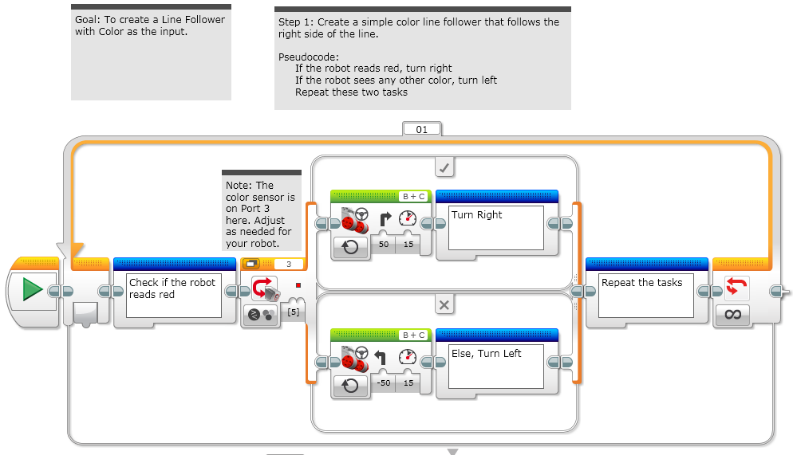
STAGE 1: Simple Color Line Follower

Slide 5
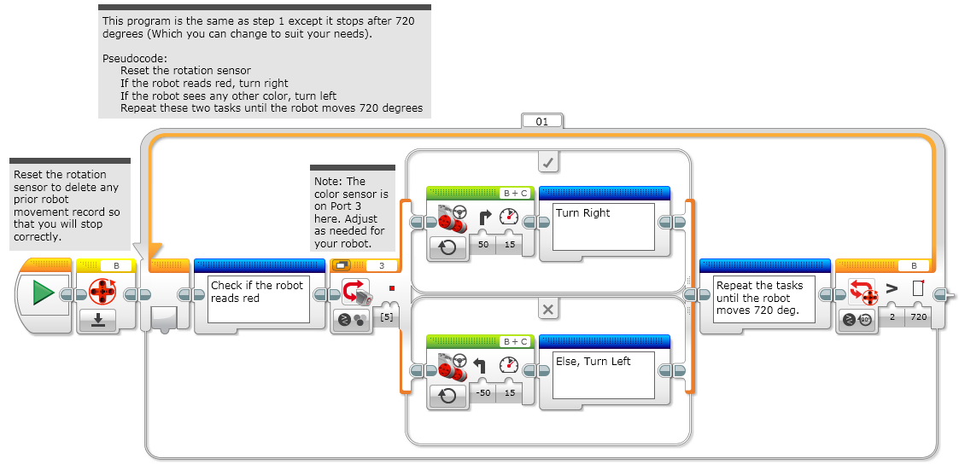
STAGE 2: RESET & DEGREES

Slide 6
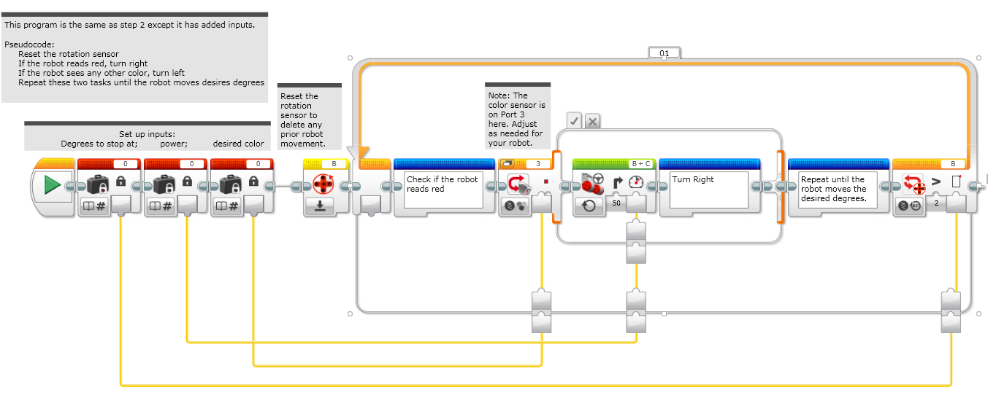
STAGE 3: ADDING INPUTS

Slide 7
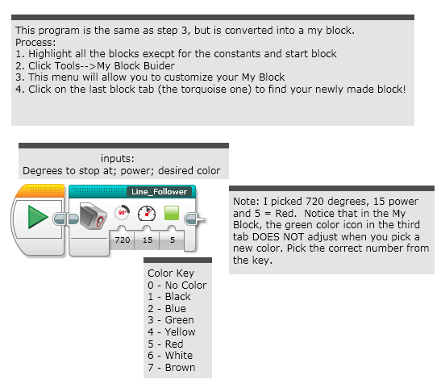
STAGE 4: MY BLock

Slide 8
PART 2: COLOR FOLLOWER WITH INPUTS….MOVES UNTIL IT SEES BLACK

Slide 9
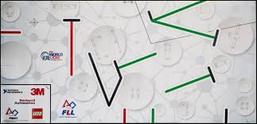
CoLOR LINE FOLLOWER THAT ENDS ON A BLACK LINE
In previous lessons we taught a simple color line follower and one that stops after a certain amount of degrees
A team in Ohio requested help with writing a color line follower that would stop when it sees black.
This is very useful because you will notice that even when FLL Mats have colored lines on them, the “T intersections” are always black
Follow along in the EV3 Code
Start at Step 1. By Step 2 you will have your code. Proceed to Steps 3 and 4 to make this code into a My Block with Inputs.

Slide 10
TIPS TO SUCCEED
Beginning Teams: You will need to know how to make a Simple Color Line Follower program
Intermediate and Advanced students should use the instructions and make a My Block with Inputs so you can reuse the code as needed.
Check which ports you have your color sensor connected to and adjust the code as needed
You may have to adjust the speed or direction to work for your robot. For example, our robot travel backwards for line following.
Make sure you place the robot on the side of the line that you are following. The most common mistake is placing the robot on the wrong side of the line to begin with.

Slide 11
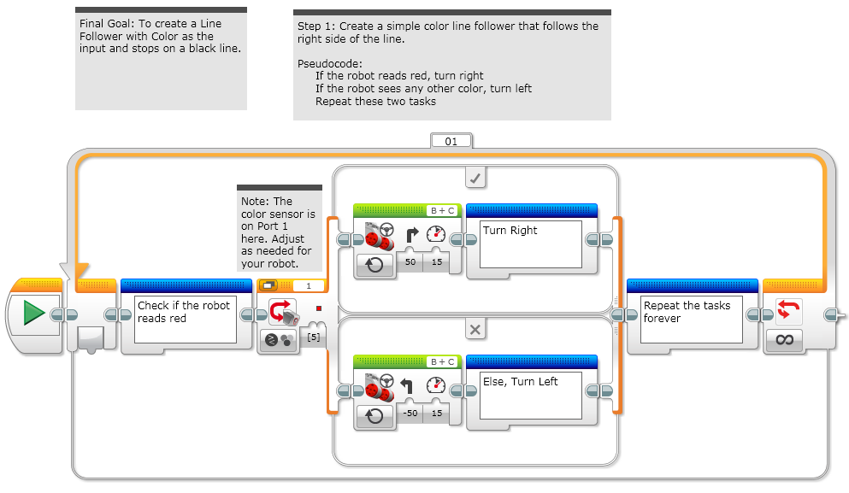
STEP 1: MAKE A SIMPLE LINE FOLLOWER

Slide 12
STEP 1: MAKE A SIMPLE LINE FOLLOWER

Slide 13
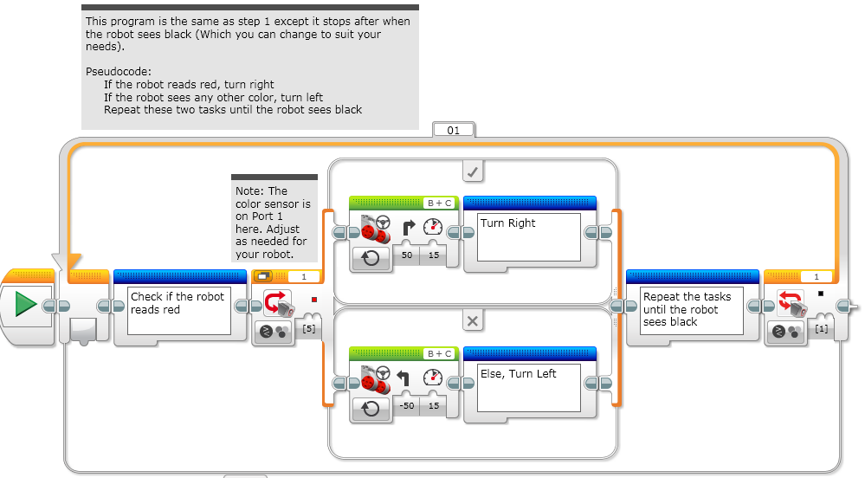
STEP 2: STOPS ON BLACK

Slide 14
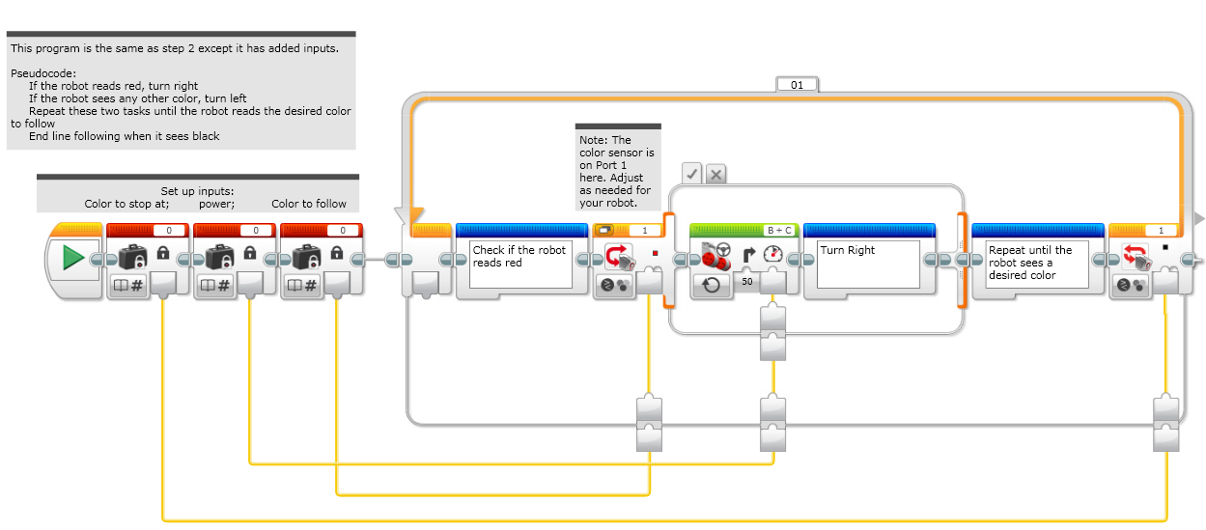
STEP 3: ADDING INPUTS

Slide 15
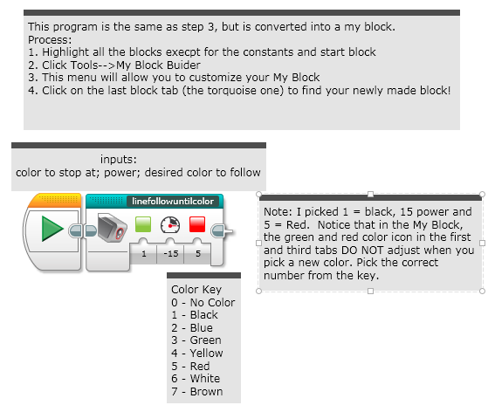
STEP 4: THE MYBLOCK

Slide 16
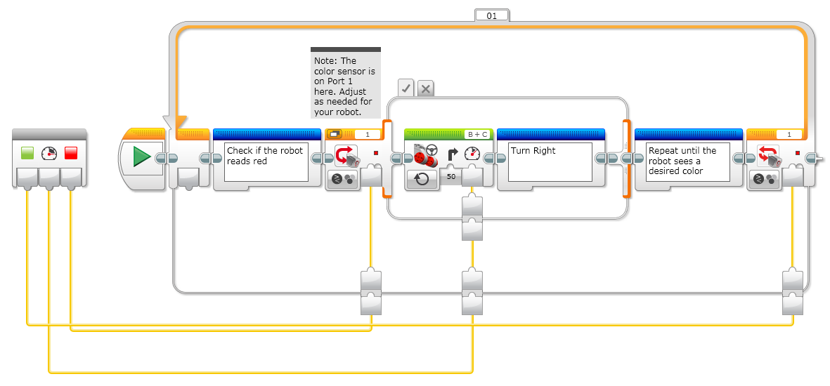
INSIDE THE MY BLOCK

Slide 17
CREDITS
This lesson was made by Sanjay and Arvind Seshan from FLL Team Not the Droids You are Looking For.
This material is free to use and distribute. Please credit Droids Robotics if you use it.
Please send us an email letting us know if you liked the material, how you used it, and if you have any corrections or suggestions for improvement.
team@droidsrobotics.org
More lessons at: www.ev3lessons.com

