Slide 1
Advanced Programming Lesson: Menu System
Ev3Lessons.com and Droids Robotics

Slide 2
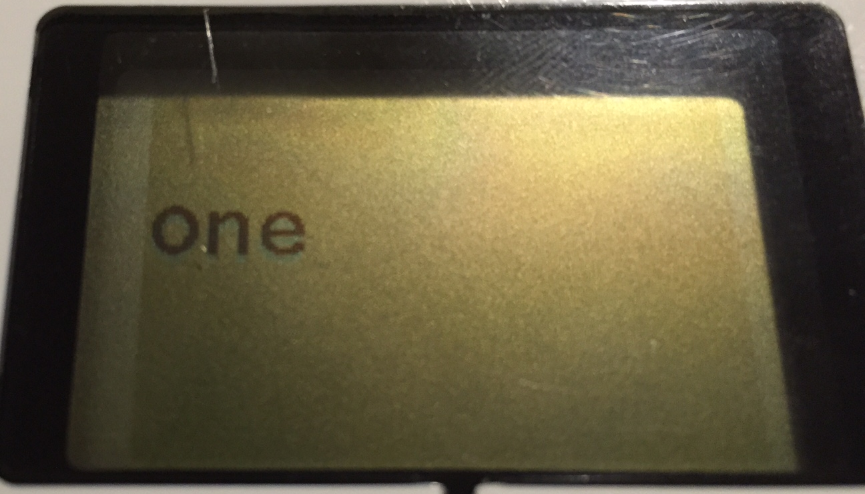
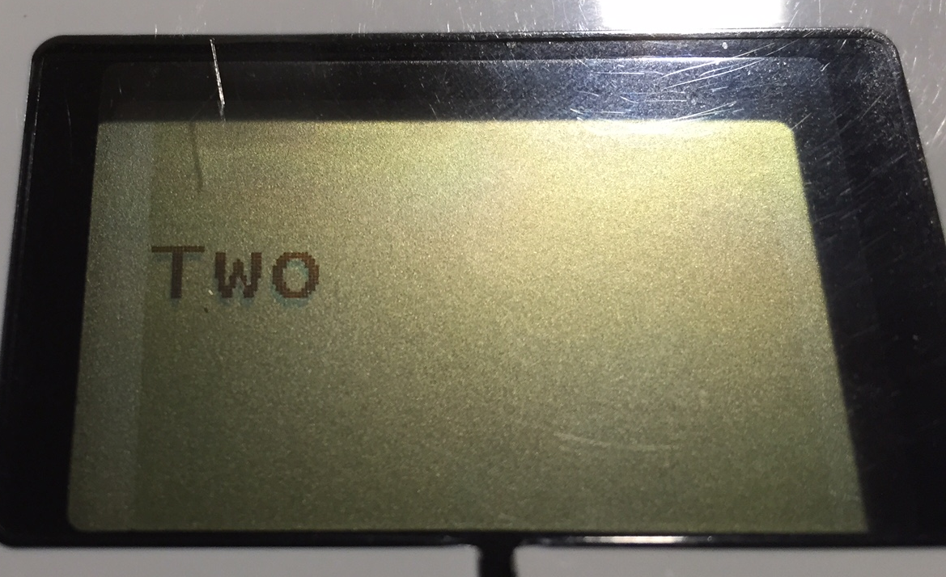
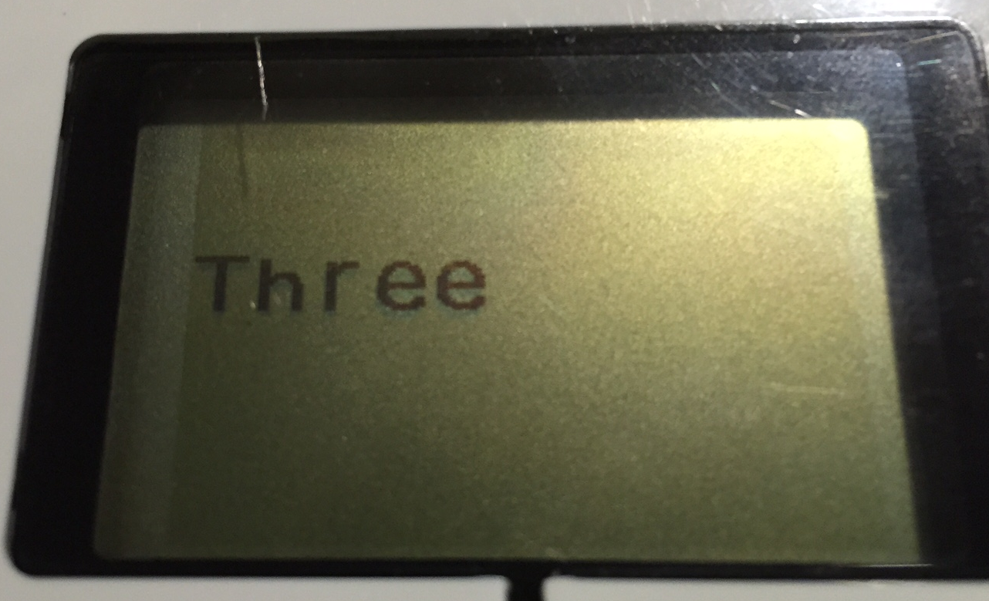
A Fancier Menu System
The Intermediate Menu System was limited to 4 choices and a single screen display for the entire menu
In this version, we build a menu system that updates the menu view each time you change your selection and lets you have a larger number of menu choices
To make this menu, you will need to learn how to use variables

Slide 3
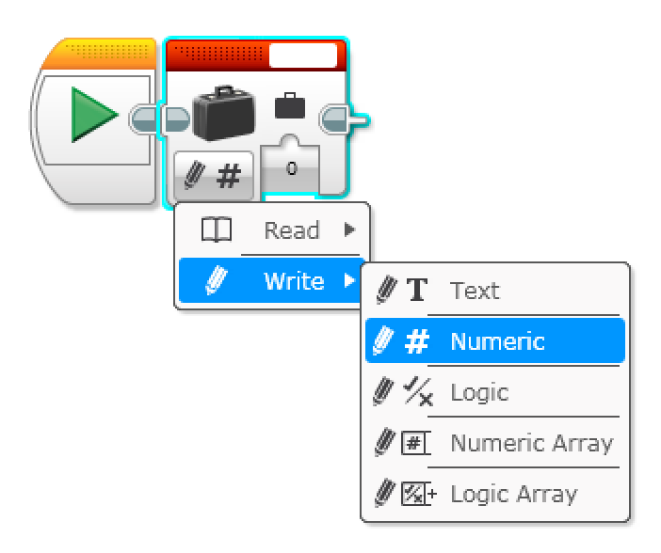
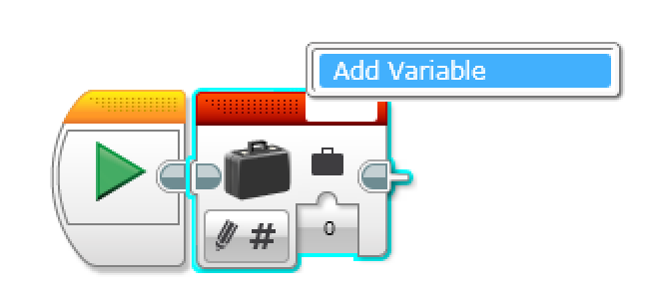
New Tool: Variables
Variables can store values for later use
There are different types of variables (described on next slide). You must chose the type of variable before creating one.
You must create a variable and give it a name before using it.
Once created, you can read and write values to the variable.

Slide 4
Variable Types
Different types of variables can store different types of information.
Text – any text, e.g.: “FLL is great” or ”Run 2”
Numeric – any number, e.g.: 5, 5.2 or -4.22
Logic – True or False
Numeric Array – a collection of numbers, e.g.: (5,2,2) or (3,4,5,6)
Logic Array – a collection of true/false values, e.g.: (T, F) or (F, F, T, F)
In this lesson, we only use numeric variables. Logic variables and arrays will be covered in another lesson.

Slide 5
Outline/Pseudocode
Use a variable to store the current menu choice.
Display the menu description for the current menu choice
Wait for the user to press a button
Based on the button press: run the code for the menu choice (for middle button), or increase/decrease the menu choice variable (for up/down buttons)
Go back to 2…
Now…Based on the above outline, try to make a menu system that lets you perform 4 actions based on the button pressed
The remainder of this presentation shows you how to do this. We recommend that you try to create the code yourself first.

Slide 6
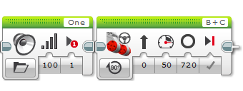
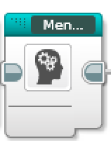
Step 1: Convert Menu Item Code to My Blocks
You need to convert long set of actions into its own My Block
If you don’t know how to make a My Block, see the Intermediate lesson on My Blocks
There is no Step 1 and 2 in the EV3 Code file. Learn Step 1 and 2 from the Powerpoint/PDF and then continue with Step 3 in the EV3 Code file.

Slide 7
Step 2: Add a Current Menu Choice Variable
Variables can be used to store information such as a sensor reading. In this program, we are going to use a variable to store the current menu choice.
To create a variable:
Add a variable block
Select the type of variable by changing the mode to “Write X” where X is one of Text, Numeric, Logic, Numeric Array or Logic Array. Since we are storing the menu choice number – chose Numeric.
Click on the box at the top right and select Add Variable. For this program, create a variable called “Menu Choice”

Slide 8
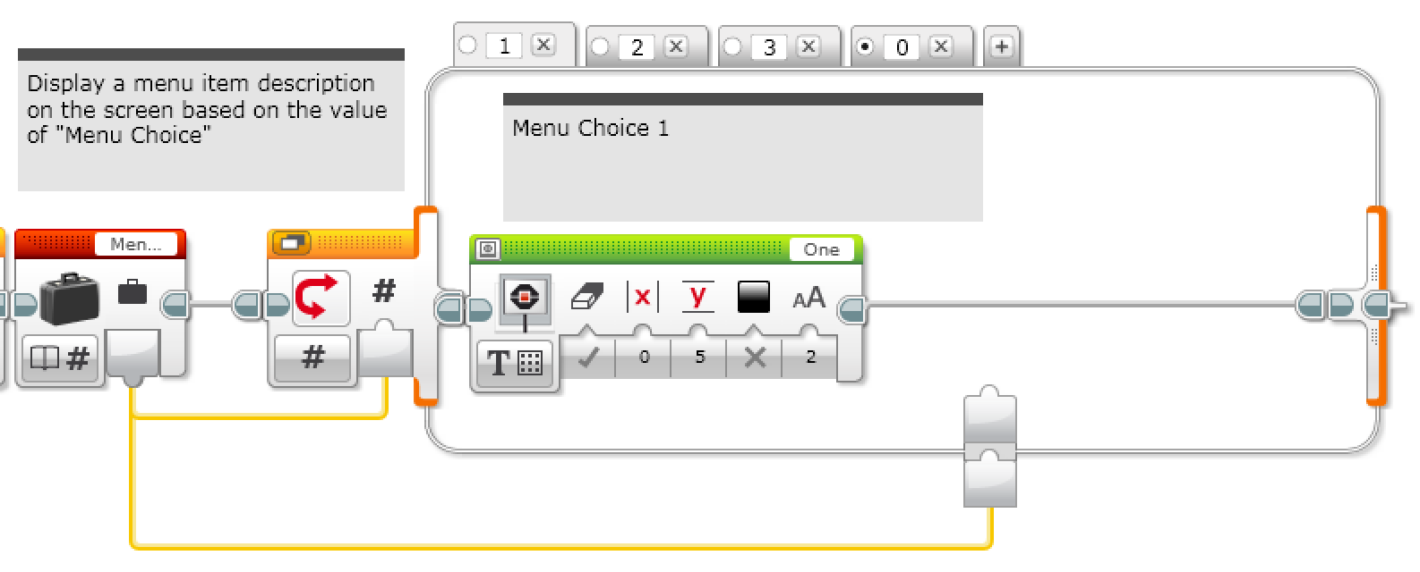
Step 3: Display Current Menu Choice
You can combine a switch block set to numeric mode and a variable block set to read to display the current menu choice
You should select just the switch block and create a My Block called Display_Menu.

Slide 9
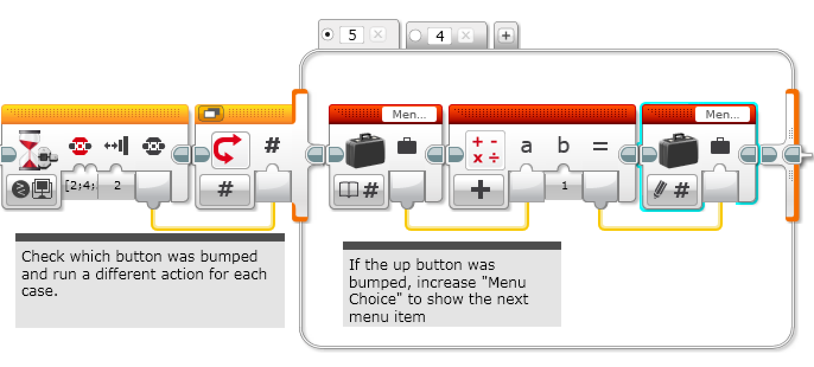
Step 4: Increasing/Decreasing Menu Choice
You can use a wait for menu button block and a switch to decrease the menu choice if you hit the up button. The down button (Tab 5) is similar but increases the menu choice.

Slide 10
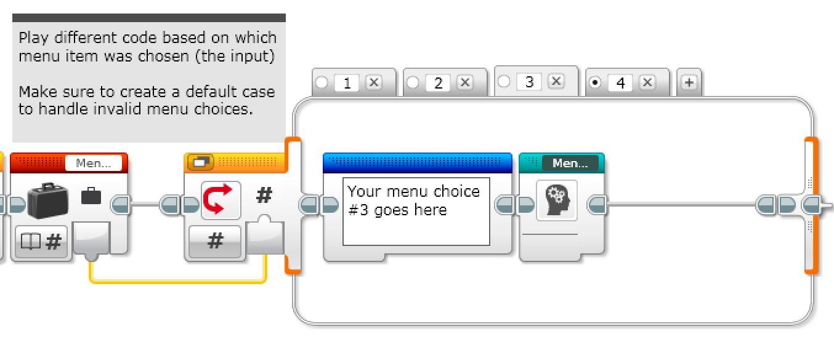
Step 5: Using a Variable to Run Menu Item Chosen
You can combine a switch block set to numeric mode and a variable block set to read to run the chosen menu item.
You should select just the switch block and create a My Block called Run_Menu_Item.

Slide 11
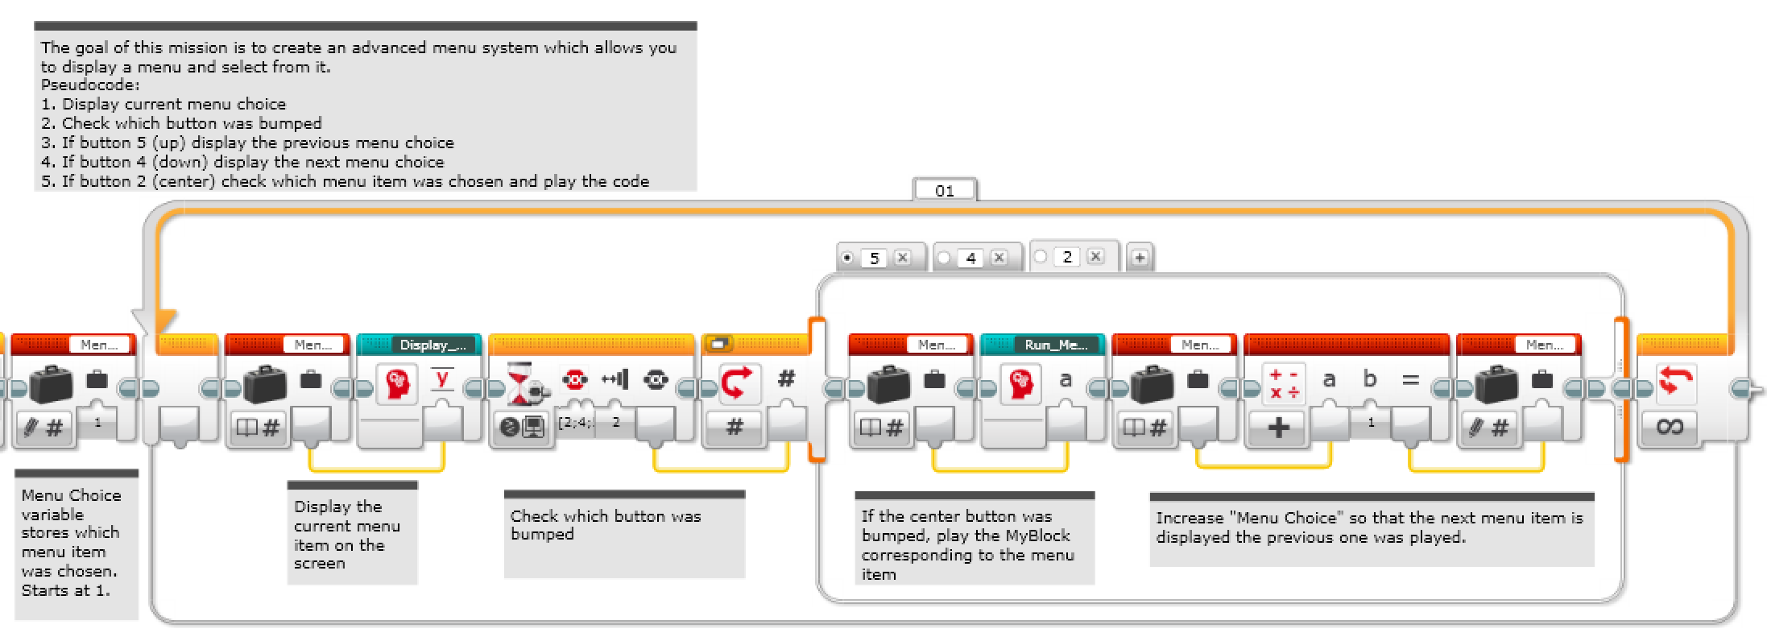
Code: Menu System
You can combine the previous steps to create a menu system that lets you select from a menu using the up and down arrows

Slide 12
Mission Sequencers
The ideas in this lesson can be adapted to help you build a mission sequencer for FLL. Sequencers are useful because they:
Allow you to skip missions if you are short of time
Allow you to repeat failed missions
Allow you access missions quickly (find them easily)

Slide 13
Credits
This lesson was written by Sanjay and Arvind Seshan from Droids Robotics.
Feel free to use and modify, but credit the original authors.
More lessons are available at www.ev3lessons.com

