Slide 1
Advanced Programming Lesson: Menu System
Ev3Lessons.com and Droids Robotics

Slide 2
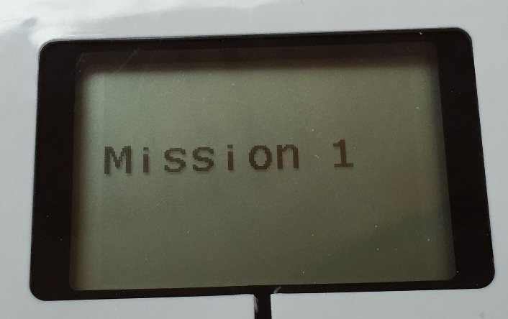
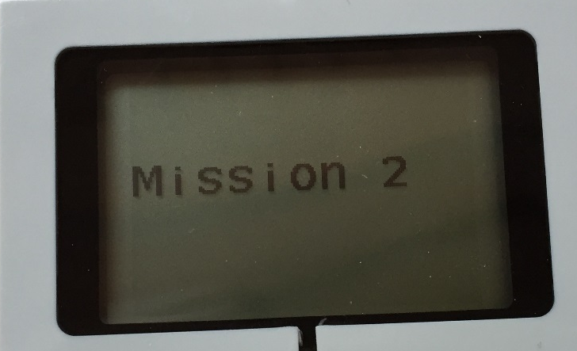
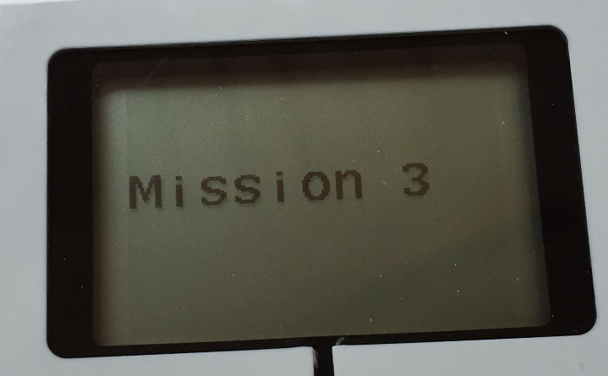
What is a Menu System and Why Use It?
A menu system (also called a Sequencer or Master Program) is an organized way to easily run programs without having to search for the code
Allows you to skip missions
This more advanced lesson allows you to repeat failed missions

Slide 3
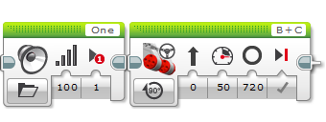
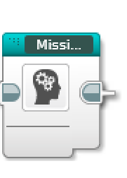
Step 1: Convert Missions to My Blocks
You need to convert each mission into its own My Block
If you don’t know how to make a My Block, see the Intermediate lesson on My Blocks
There is no Step 1 and 2 in the EV3 Code file. Learn Step 1 and 2 from the Powerpoint/PDF and then continue with Step 3 in the EV3 Code file.

Slide 4
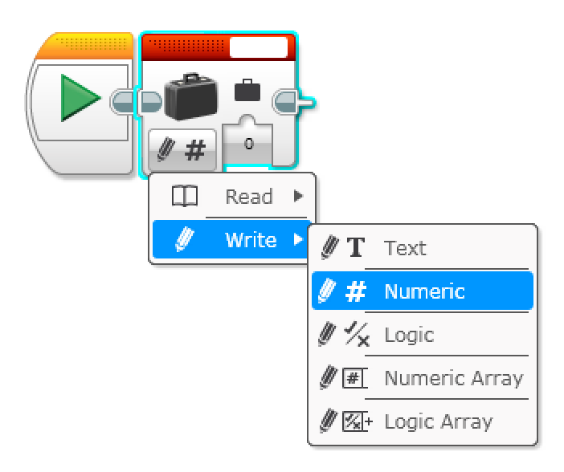
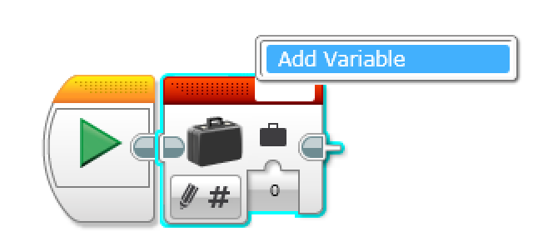
Step 2: Add a Current Mission Variable
Variables can be used to store information such as a sensor reading. In this program, we are going to use a variable to store the current mission that we are running.
To create a variable:
Add a variable block
Select the type of variable by changing the mode to “Write X” where X is one of Text, Numeric, Logic, Numeric Array or Logic Array. Since we are storing the mission number – chose Numeric.
Click on the box at the top right and select Add Variable. For this program, create a variable called “Mission Number”

Slide 5
Variable Types
Different types of variables can store different types of information.
Text – any text, e.g.: “FLL is great” or ”Run 2”
Numeric – any number, e.g.: 5, 5.2 or -4.22
Logic – True or False
Numeric Array – a collection of numbers, e.g.: (5,2,2) or (3,4,5,6)
Logic Array – a collection of true/false values, e.g.: (T, T, F) or (F, F, T, F)
In this lesson, we only use numeric variables. Logic variables and arrays will be covered in another lesson.

Slide 6
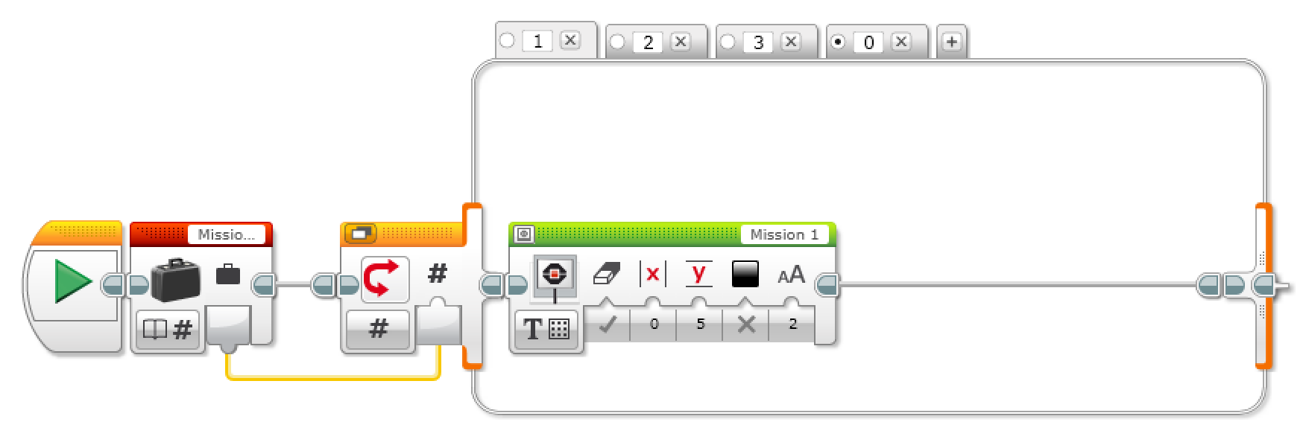
Step 3: Display Current Mission Choice
You can combine a switch block set to numeric mode and a variable block set to read to display the current mission name
You should select just the switch block and create a My Block called Display_Mission.

Slide 7
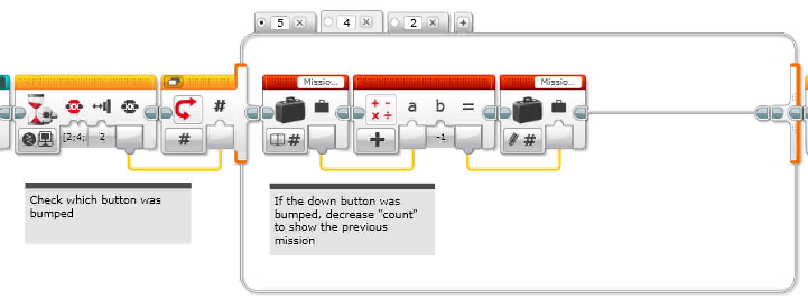
Step 4: Increasing/Decreasing Mission Choice
You can use a wait for menu button block and a switch to decrease the mission number if you hit the up button. The down button choice (Tab 5) is similar but increases the mission number.

Slide 8
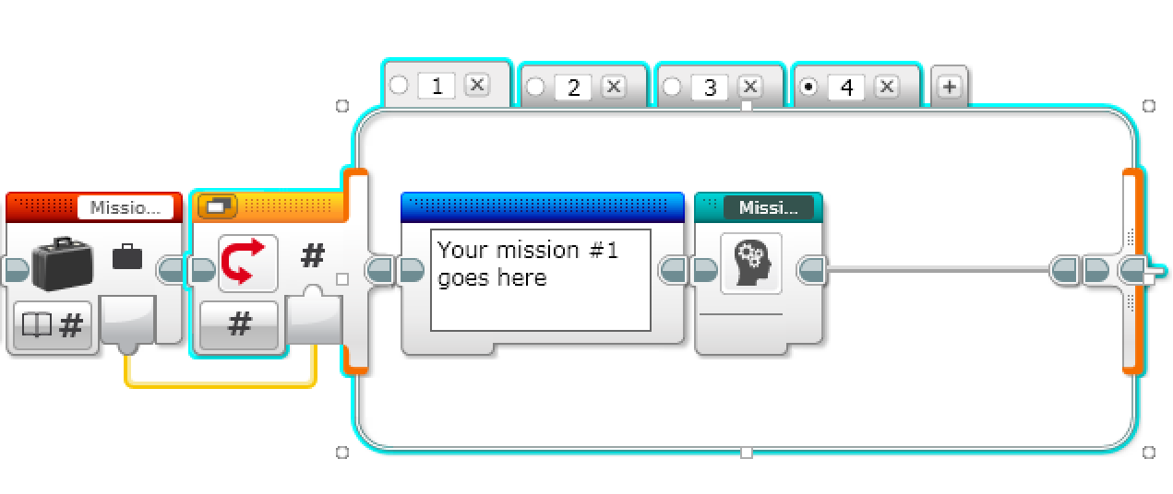
Step 5: Using a Variable to Run Chosen Mission
You can combine a switch block set to numeric mode and a variable block set to read to run a specific mission
You should select just the switch block and create a My Block called Run_Mission.

Slide 9
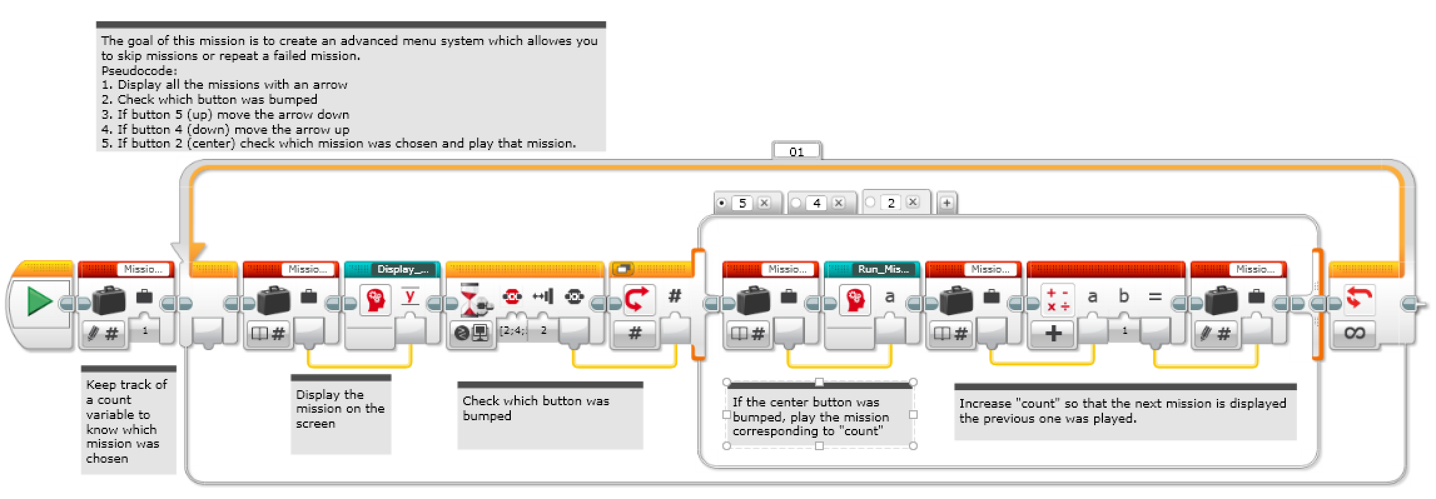
Code: Menu Sequencer
You can combine the previous steps to create a menu-based sequencer that lets you select the mission using the up and down arrows

Slide 10
Credits
This lesson was written by Sanjay and Arvind Seshan from Droids Robotics.
Feel free to use and modify, but credit the original authors.
More lessons are available at www.ev3lessons.com

