Slide 1

ADVANCED PROGRAMMING Lesson
Alternative Gyro Drift and Lag Strategies from other teams
The Construction Mavericks

Slide 2
GYRO DRIFT STRATEGY by Hoosier Girlz
Having a fixed time wait for the gyro to calibrate (as presented in the Gyro Turn Lesson) may not always work. This is Hoosier Girlz’ alternative method to re-calibrate the gyro
The gyro returns “Not a Number” (NaN) until it has actually reset and NaNs are not >, =, or < any number. This is because they are not numbers
The only way you can know when it is fully reset is to make sure you are getting back a real number, instead of a Not-a-Number value
STEP 1: Read both rate and angle in a single block
STEP 2: start a loop
STEP 3: read angle
STEP 4: check angle >= 0
STEP 5: check angle < 0
STEP 6: OR outputs of steps 4 & 5
STEP 7: If the output of step 6 is true, exit loop
At this point, the sensor drift should be gone.

Slide 3
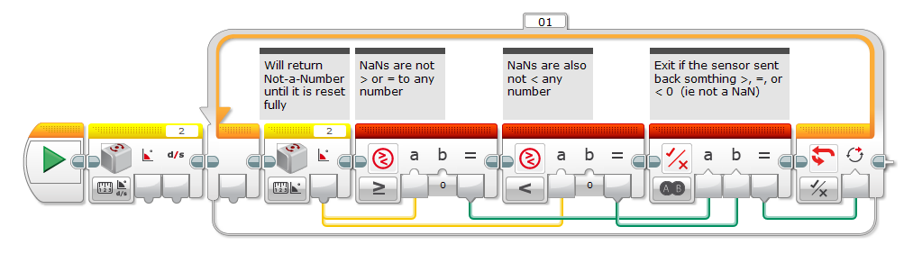
GYRO DRIFT CODE FROM HOOSIER GIRLZ
Code by Hoosier Girlz: http://www.fllhoosiergirlz.com/

Slide 4
GYRO LAG STRATEGY BY THE CONSTRUCTION MAVERICKS
Improvement over the simple overshoot correction mechanism used in the Gyro Turn lesson.
This method uses proportional control loop to actively steer the robot in the right direction
Uses the current gyro position and where it wants to point to determine how to set the motor power.
Note from Construction Mavericks: It's not perfect, but we have had much better success with these blocks than the overshoot-corrected ones.
Tip from Construction Mavericks: Try to set the outer loop to an infinite loop. Once the robot settles into place, pick it up and rotate it and watch it try to get back to where it wants to be.

Slide 5
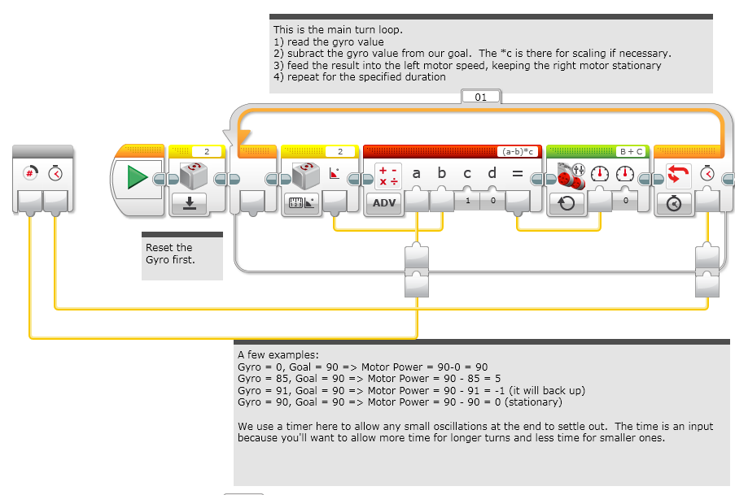
RIGHT PIVOT Code FROM CONSTRUCTION MAVERICKS

Slide 6
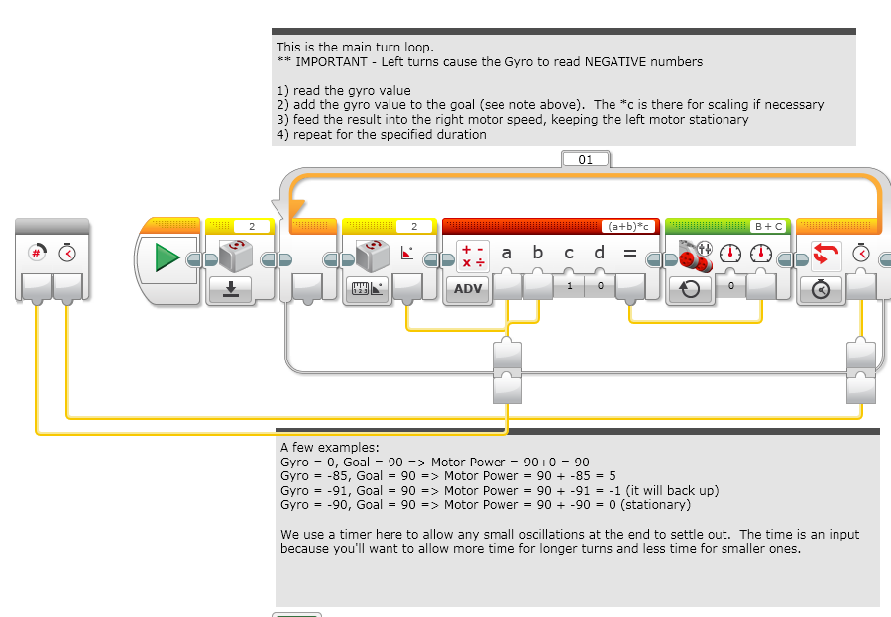
LEFT PIVOT Code FROM CONSTRUCTION MAVERICKS

Slide 7
CREDITS
This tutorial was compiled by Droids Robotics. The techniques presented are from 2 very awesome teams:
Hoosier Girlz: http://www.fllhoosiergirlz.com/
The Construction Mavericks: frank.levine@gmail.com
Please be sure to give them credit for their work
More lessons at ev3lessons.com
If you have code you want to contribute, please email us at team@droidsrobotics.org

