Slide 1
Advanced Programming Lesson: Parallel Beam Synchronization
EV3 Lessons AND Droids Robotics

Slide 2
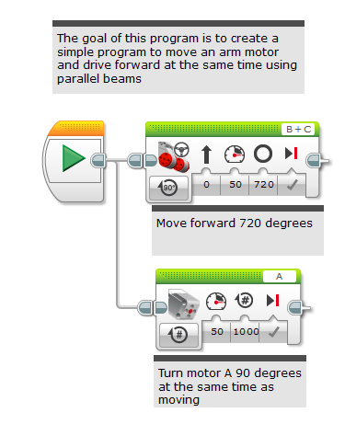
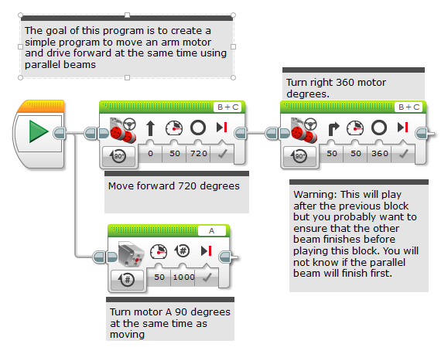
Using Parallel Beams Inside Programs
Parallel beams are great for doing two things at the same time
Often want to do something afterward
Hard to tell what order program will run
Will the turn start after motor A is done or before?
Need to synchronize the beams to make sure that blocks execute when you expect them to

Slide 3
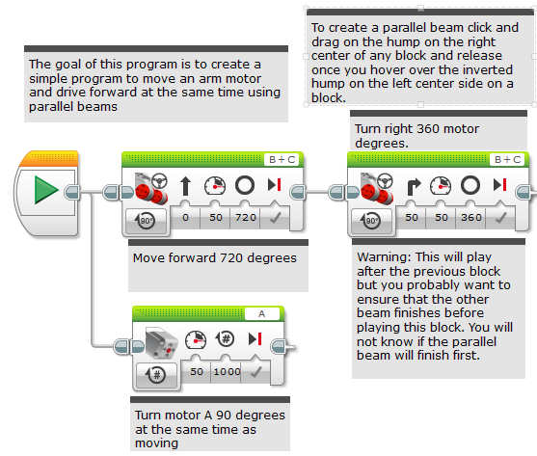
Different Styles to Ensure Both Beams Finished
In this example, we want both the 720 degree move steering (the move) and and the motor A move to finish before the 360 degree move steering (the turn)
There are several ways to do this:
Variables (see next slide)
Constants (see slide 4)
Loops (see slide 5)
My blocks (see slide 6)

Slide 4
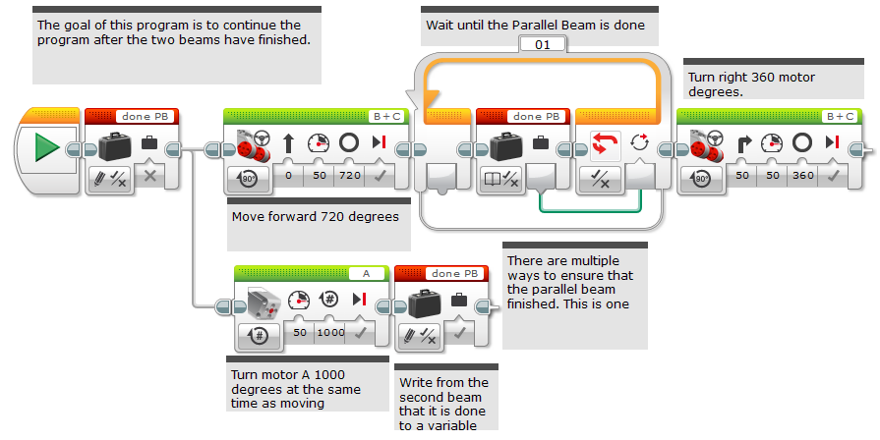
Use Variables To Synchronize

Slide 5
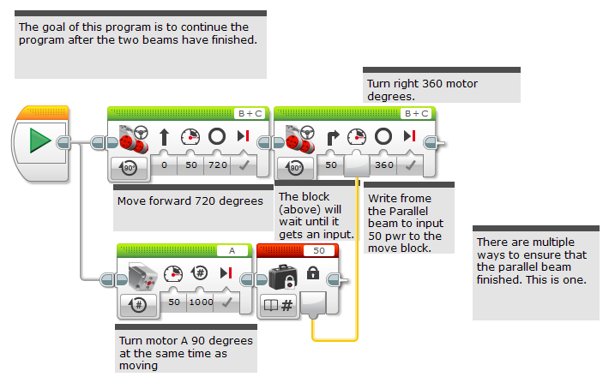
Use Wires to Synchronize

Slide 6
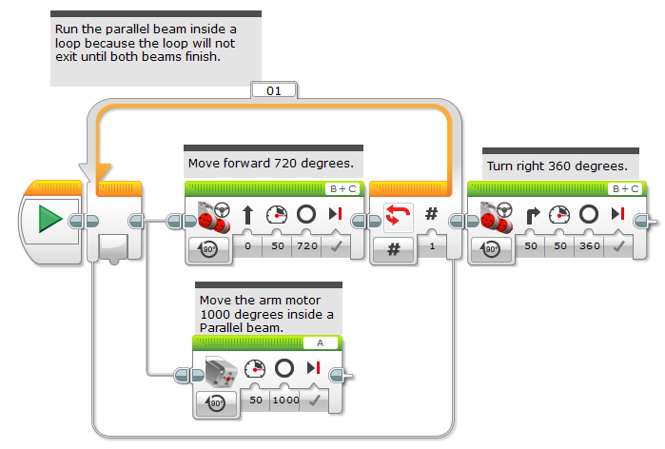
Use Loops to Synchronize

Slide 7
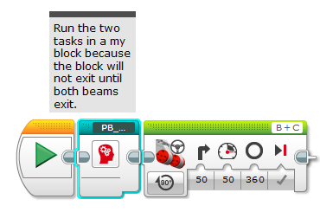
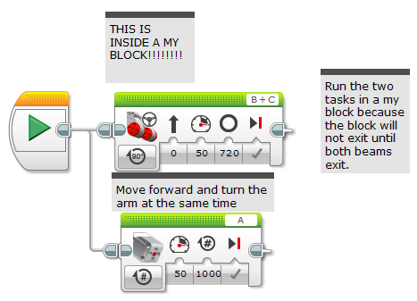
Use My Blocks to Synchronize
Inside the My Block

Slide 8
Another Example
Synchronization is critical for aligning on a line using parallel beams (see lesson…)
You must ensure that both beams in an align are completed before moving onto the next block
Otherwise, the robot will not be straight on a line
Any of the techniques from this lesson would work. We chose to use the My Block synchronization technique in the Squaring on a Line/Aligning lesson in the Advanced Tab.
Xxxxxxx need align picture here…

Slide 9
Credits
This lesson was written by Sanjay Seshan and Arvind Seshan on FLL Team Not the Droids You Are Looking For
All lessons are free to use and adapt. Please credit the original authors for their work
More lessons at: www.ev3lessons.com

