Slide 1
Advanced Programming Lesson: Parallel Beam Synchronization
EV3 Lessons AND Droids Robotics

Slide 2
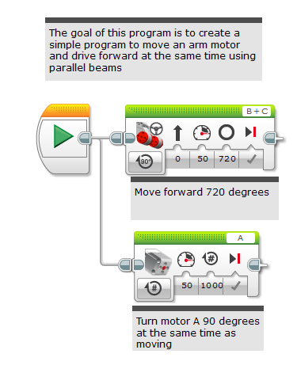
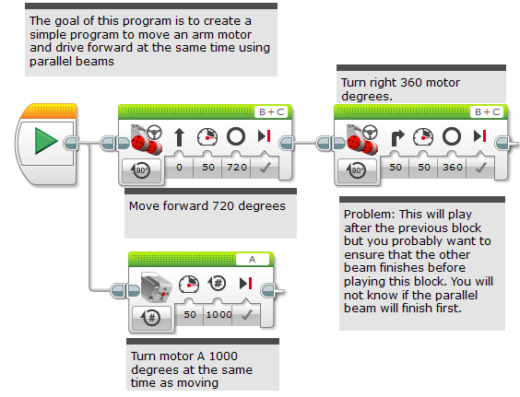
Using Parallel Beams Inside Programs
Parallel beams are great for doing two things at the same time
Often want to do something after you complete the Parallel Beam
Hard to tell what order program which beam will finish first.
Need to synchronize the beams to make sure that blocks execute when you expect them to
In the picture below will the turn start after motor A is done or before?
Answer: You do not know

Slide 3
Ensure That Both Beams Finished
In this example, we want both the 720 degree move steering (the move) and the motor A move to finish before the 360 degree move steering (the turn)
There are several ways to do this:
Variables (see slide 4)
Wires (see slide 5)
Loops (see slide 6)
My blocks (see slide 7)
This is labeled as “synch problem” in the corresponding EV3 code file

Slide 4
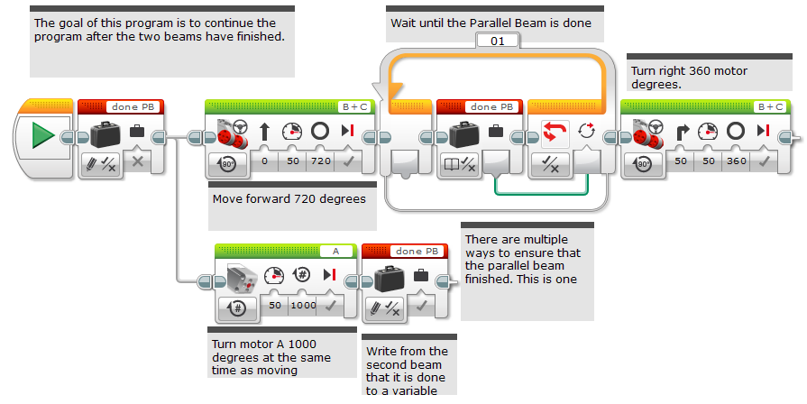
Use Variables To Synchronize
This is labeled as “variables” in the corresponding EV3 code file

Slide 5
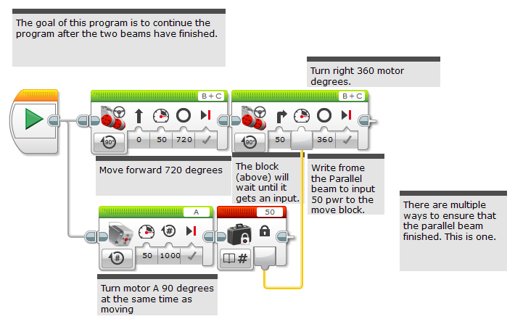
Use Wires to Synchronize
This is labeled as “wires” in the corresponding EV3 code file

Slide 6
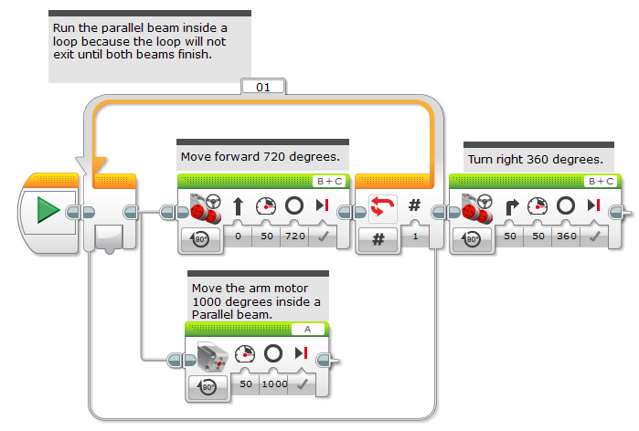
Use Loops to Synchronize
This is labeled as “loops” in the corresponding EV3 code file

Slide 7
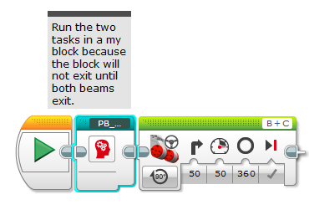
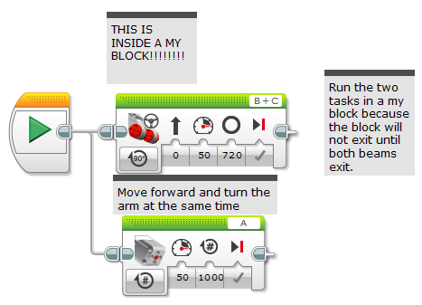
Use My Blocks to Synchronize
This is labeled as “My Blocks” in the corresponding EV3 code file
This is labeled as “Parallel_Beam_My_Blocks” in the corresponding EV3 code file
Inside the My Block

Slide 8
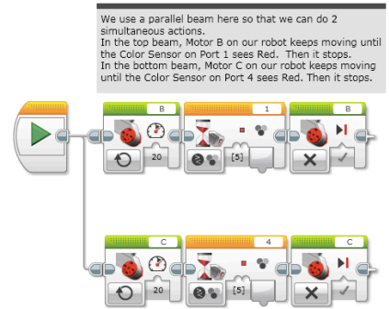
Another Example
Synchronization is critical for aligning on a line using parallel beams (see lesson…)
You must ensure that both beams in an align are completed before moving onto the next block
Otherwise, the robot will not be straight on a line
Any of the techniques from this lesson would work. We chose to use the My Block synchronization technique in the Squaring on a Line/Aligning lesson in the Advanced Tab.
This example is from the Squaring on a Line Lesson

Slide 9
Credits
This lesson was written by Sanjay Seshan and Arvind Seshan on FLL Team Not the Droids You Are Looking For
All lessons are free to use and adapt. Please credit the original authors for their work
More lessons at: www.ev3lessons.com

