Slide 1
Beginner Lesson: Sequencer
EV3Lessons.com
Droids Robotics

Slide 2
What and why use a sequencer
You do not need to search for the code in a jumble of programs
The sequencer has the missions in order
Jumble of code on brick image
Sequencer image

Slide 3
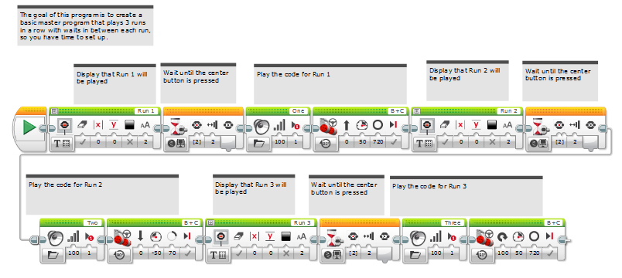
Code: Sequencer

