Slide 1
Beginner Programming Lesson: Basic Sequencer
BY
EV3Lessons.com AND Droids Robotics

Slide 2
Using EV3 Brick Buttons as a Sensor
All the EV3 brick buttons (except the OFF button) are like the touch sensor
You can use the buttons to make a game, run different actions based on each button, or make a sequencer (explained on slide 4).
You do not need to waste a sensor port on a touch sensor if you plan to use the touch sensor like a button.
The first step to making a Basic Sequencer is to learn how to use the “Wait for Button Press” feature. See next slide (slide 3)

Slide 3
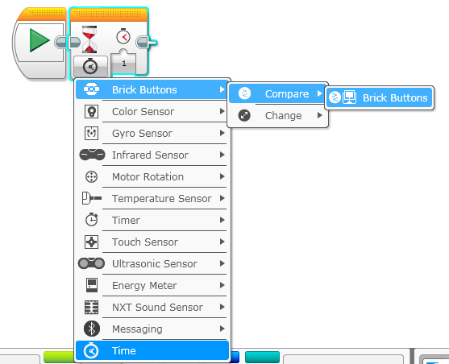
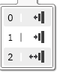
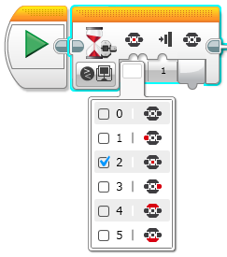
How to Use a “Wait for Button Press” Block
Wait Block – Click on the bottom left corner and select Brick Buttons – Compare – Brick Buttons
This slide is animated.
Droids recommend #2 (bumped) – most reliable
You can choose any button except the off button

Slide 4
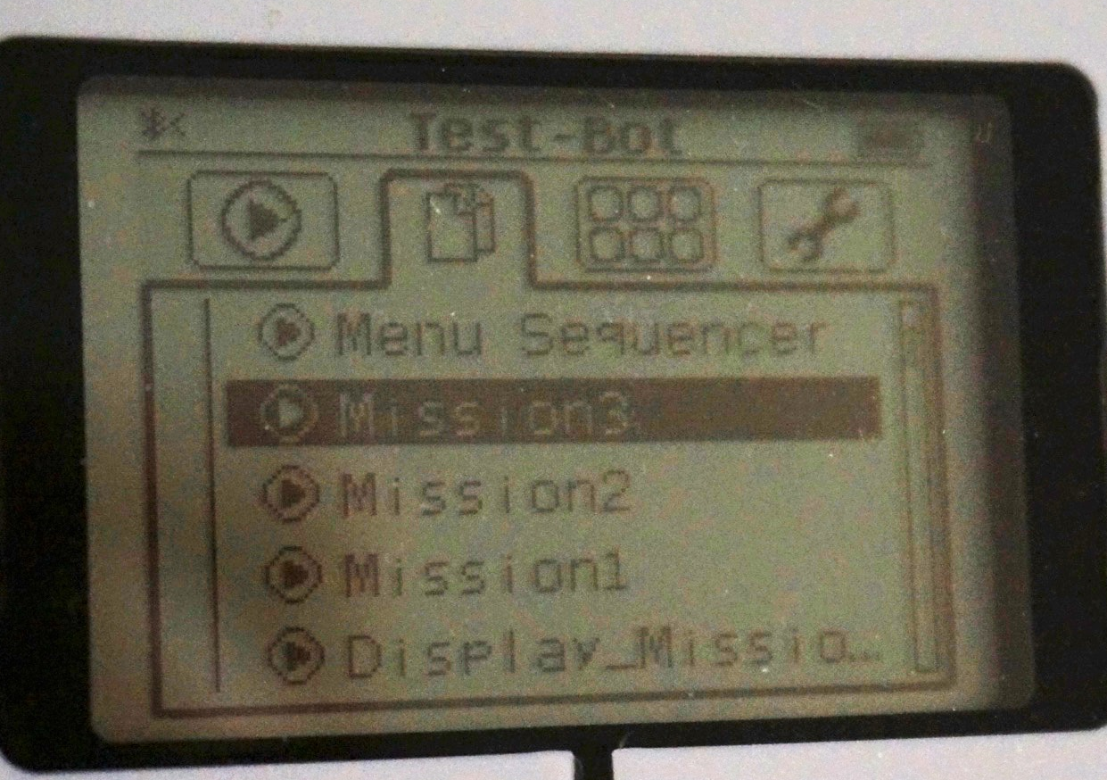
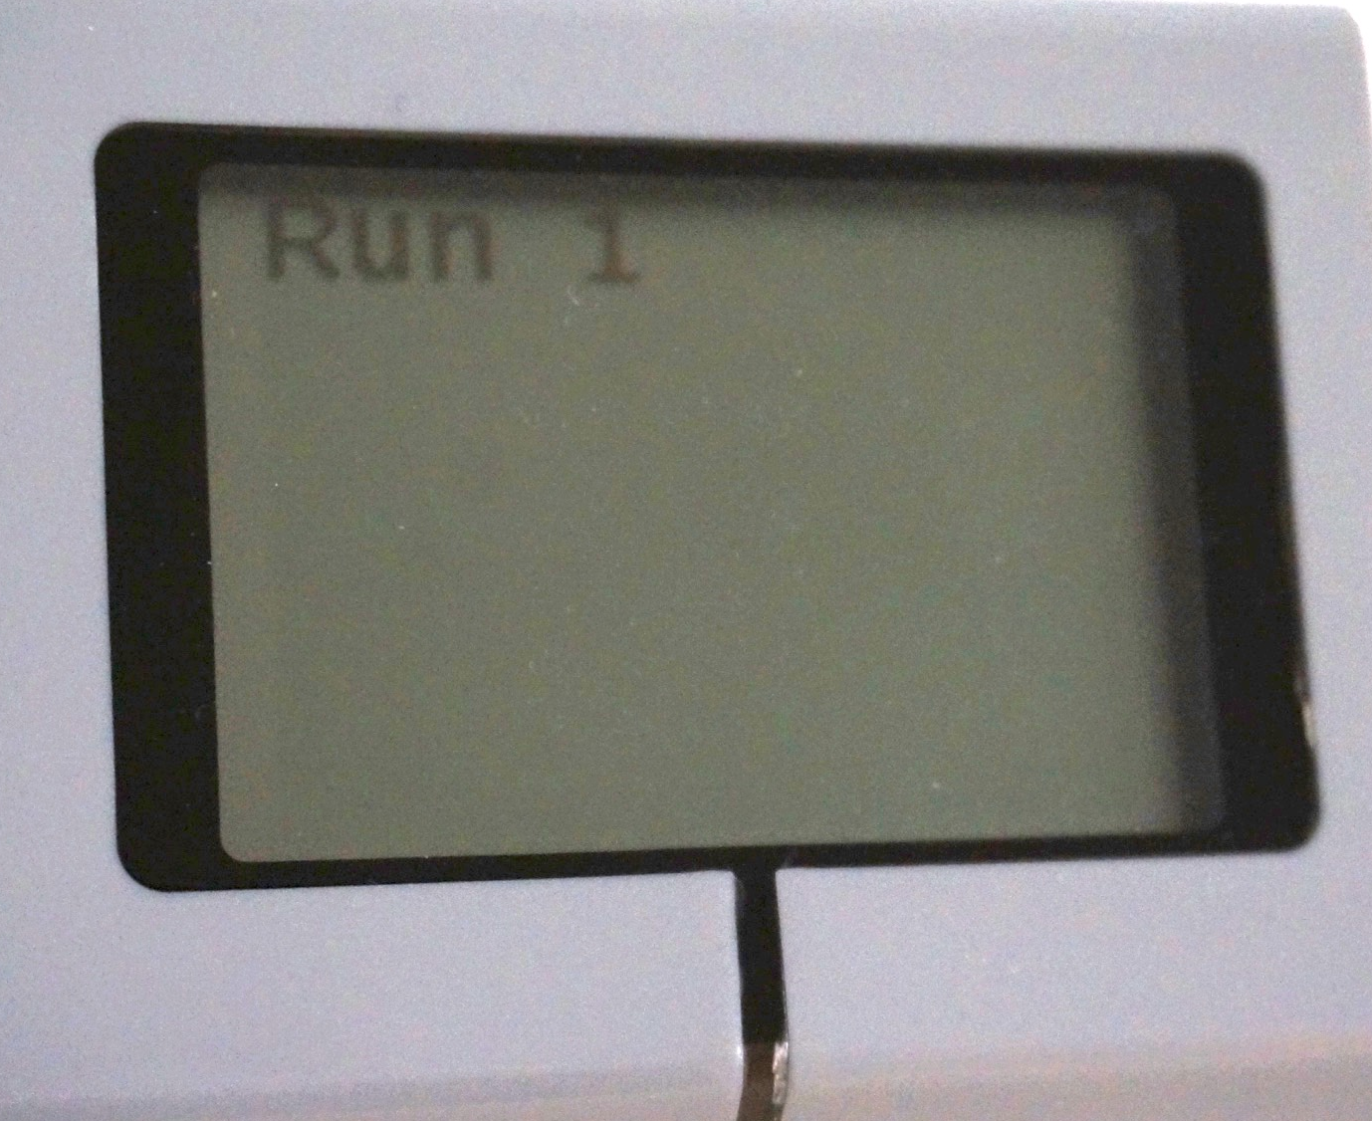
What is a Sequencer and and Why Use one?
A sequencer is a program that puts your missions in the order you choose. It is sometimes called a Master Program or a Menu System.
Advantages: You will not need to search for the program in a jumble of programs on the brick. This will save you time on your runs.
Disadvantages: You will not be able to re-run each program easily with a basic sequencer (check our more advanced Menu System lesson)
Programs on brick
Sequencer

Slide 5
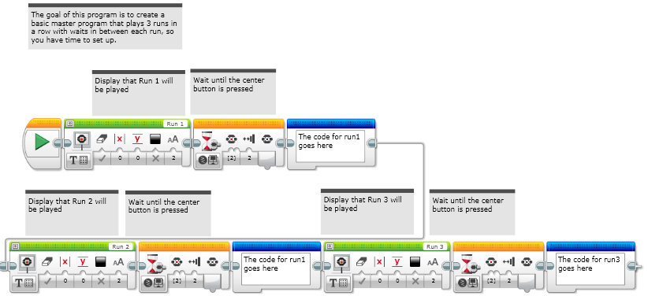
Step 1: Create A “Dummy” Sequencer
Create a Sequencer that waits until you press the button to play the (next) mission. This will also display which mission will be played next. “Dummy” just means that you don’t have your missions yet.

Slide 6
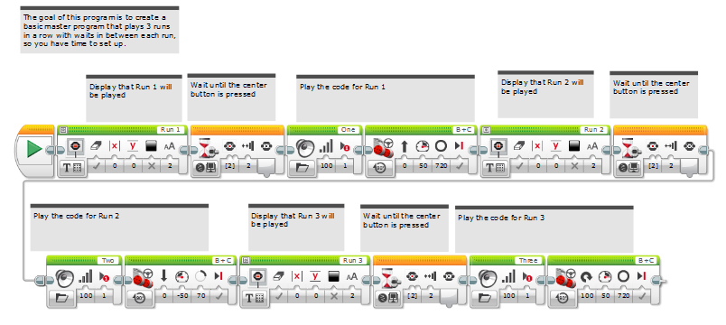
Step 2: Add missions
Copy and paste each of your missions after each button press. Note: these missions just move and turn (don’t really do much!). Replace with your own code.
This sequencer code is set up for only 3 runs…. You can add more to the program

Slide 7
Credits
This lesson was written by Sanjay Seshan and Arvind Seshan from Droids Robotics.
Feel free to use and adapt, but give credit to the original authors.
A more advanced Sequencer lesson can be found on ev3lessons.com
More lessons are available at www.ev3lessons.com

