Slide 1
Intermediate Lesson: Intermediate Menu System
By EV3Lessons.com and Droids Robotics

Slide 2
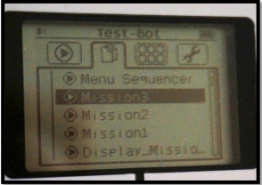
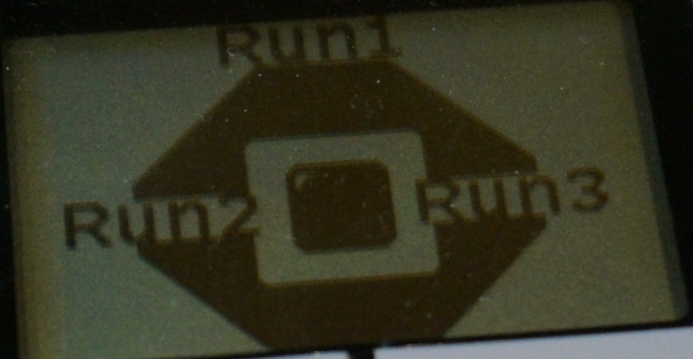
GOAL: A menu that lets us select a run
A menu system (also called a Sequencer or Master Program) is an organized way to easily run programs without having to search for the mission
Allows you to skip missions if you are short of time
Allows you to repeat failed missions
This version plays a different mission based on each button

Slide 3
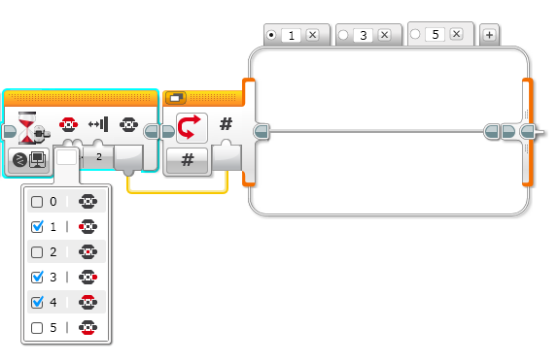
New Tool: Using the Button ID
It can also tell you which button was pressed and you can take different actions based on the
Wait for button press blocks will halt the program until one of the chosen buttons is pressed

Slide 4
Outline/Pseudocode
Display the missions on the screen so that the user knows which button runs which missions
Wait for the user to press a button
Based on the button press, run the code for the appropriate mission
Now…Based on the above outline, try to make a menu system that lets you run the mission based on the button pressed
The remainder of this presentation shows you how to do this. We recommend that you try to create the code yourself first.

Slide 5
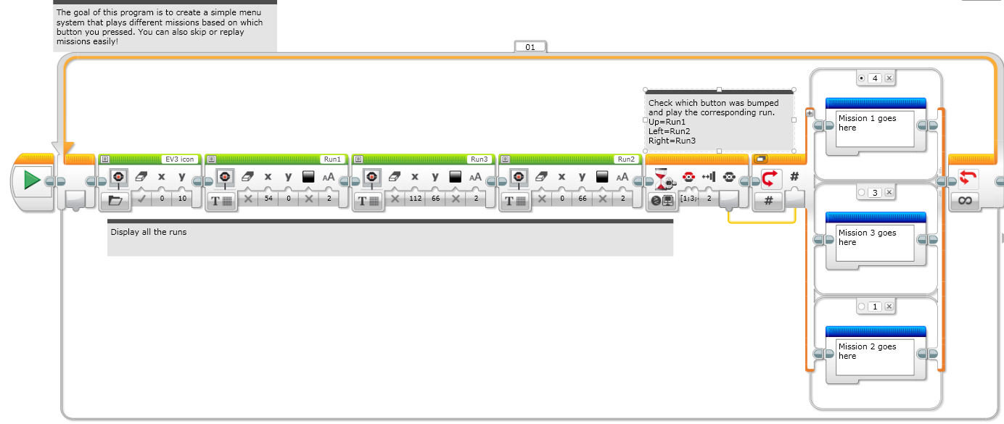
Step 1: Create a “Dummy” Menu System
Create a menu system without any code put in

Slide 6
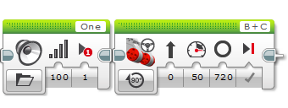
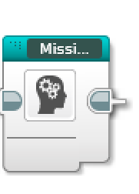
Step 2: Convert Missions
You need to convert each mission into its own My Block
If you don’t know how to make a My Block, see the Intermediate lesson on My Blocks
There is no Step 2 in the EV3 Code file. Learn Step 2 from the PowerPoint/PDF and then continue with Step 3 in the EV3 Code file.

Slide 7
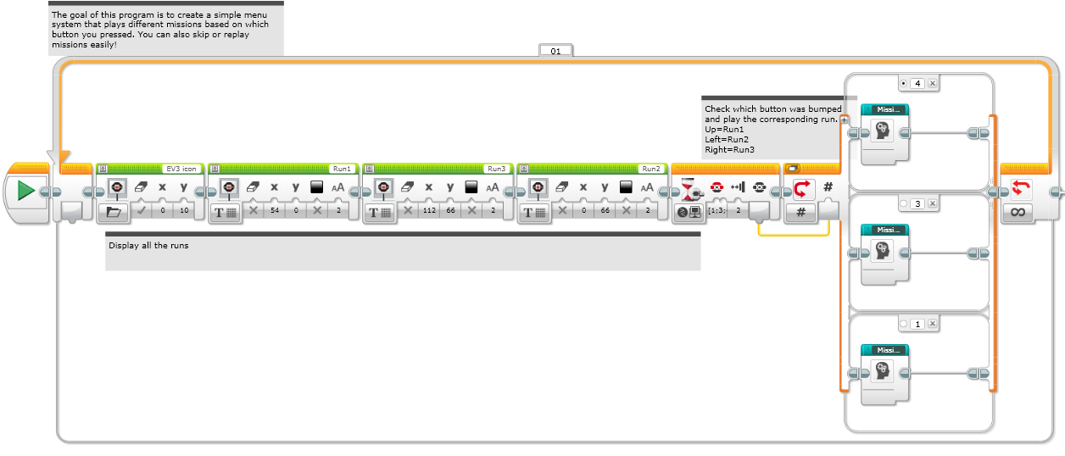
Step 3: Add Missions
Add each of your missions in each switch option.

Slide 8
Credits
These slides were written by Sanjay and Arvind Seshan
You can modify these lessons, but please give credit to the original authors of the lesson.
You can find more lessons at www.ev3lessons.com
A more advanced Menu System can be found at www.ev3lessons.com/advanced.html

