Slide 1

INTERMEDIATE programming LESSON My Blocks OVERVIEW
By Droids Robotics

Slide 2
What is a My Block?
A My Block is a combination of one or more blocks that you create that can be grouped into a single block
My Blocks are basically your own custom block in NXT or EV3
Once a My Block is created, you can use it in multiple programs
Just like any other block in EV3, My Blocks can have both inputs and outputs

Slide 3
Why should you bother?
Because of Move Inches and Turn Degrees My Blocks, your missions will look like this…
Instead of this….
This makes your code easier to read and easier to modify!!!

Slide 4

When do you use a my block
Whenever the robot is going to repeat an action inside your program
When code is repeated in a different program
Organize and simplify your code
Example: You have 2 different versions of a robot run in FLL and the first half of both of them are identical, then making the first half of the code into a My Block allows you to “clean up your code” in both programs.

Slide 5
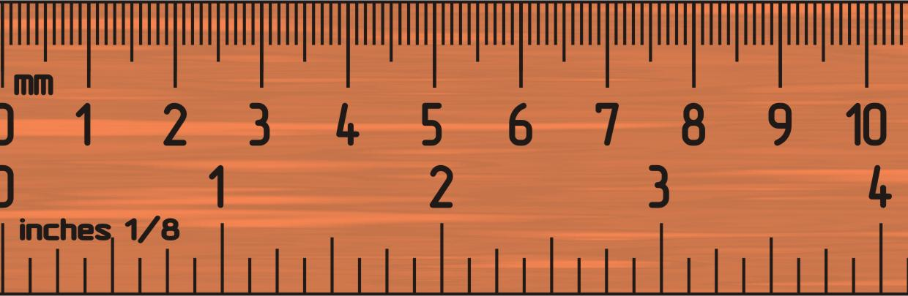
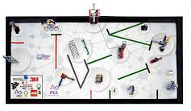
Why IS A Move InChes My Block a Good IDEA
Built-in move blocks will not take inputs (values) in centimeters or inches.
Much easier to measure distance with a ruler than degrees or rotations.
If you change your robot design to have bigger or smaller wheels late in the season you don’t have to re-measure every movement of your robot
Instead of changing distances in every single program you wrote, just go into your cool Move Inches Block and change the value for how many inches/cm one motor rotation would take.

Slide 6
What makes a useful my block
Note: Making My Blocks with inputs and outputs can make them far more useful. However, you need to be careful not to make the My Block too complicated.
Question: Look at the list of three My Blocks below. Which ones do you think are useful for a team to use?
1) Move2Inches (Moves the robot two inches)
2) MoveInches with an inches and power input
3) MoveInches with inches, power, angle, coast/brake, etc. inputs
Answer:
Move2Inches may be used often but you will be forced to make other My Blocks for other distances. This will be hard to update or fix later on.
MoveInches with inches, power, angle, coast/brake, etc. might look more useful but most of the inputs might never be used in any mission.
MoveInches with inches and power as inputs is probably the best choice for most teams.

Slide 7
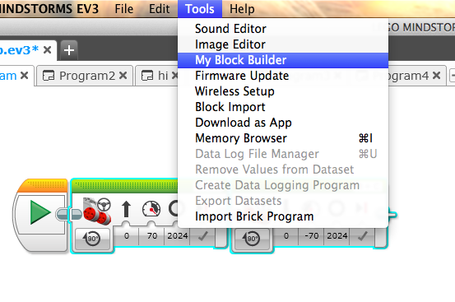
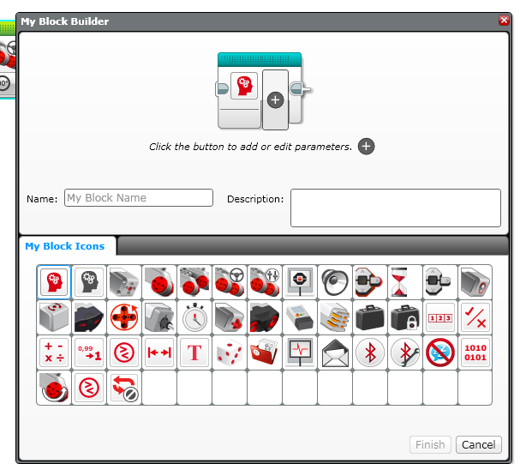
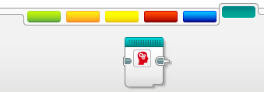
How to make a my block
Step 1: Select the blocks you think you will reuse. Go to Tools and Pick My Block Builder
Step 2: Pick a name and icon and set inputs & outputs
Step 3: You can use your block anytime – found in the turquoise tab

Slide 8
CREDITS
These slides and the corresponding EV3 project files were made by Sanjay Seshan and Arvind Seshan from FLL Team: Not the Droids You Are Looking For.
They are free to use and distribute. Please just give credit to the team and send a thank you note if you can.
You can reach the Droids at: team@droidsrobotics.org
Calculator for converting CM/IN into degrees: www.ev3lessons.com/resources.html
More lessons: www.ev3lessons.com

