Slide 1

BEGINNER PROGRAMMING LESSONS
Loops

Slide 2
Lesson Objectives
Learn how to repeat an action
Learn how to use Loop Blocks

Slide 3
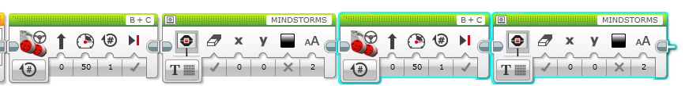

Repeating an Action
How can we play two different tasks multiple times (even forever)
You could do this and copy the two blocks several times:
But this will not work for running the two blocks forever
Is there a way to accomplish our goal?
Hint:

Slide 4

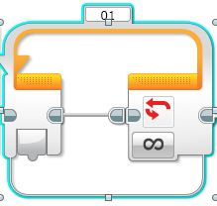
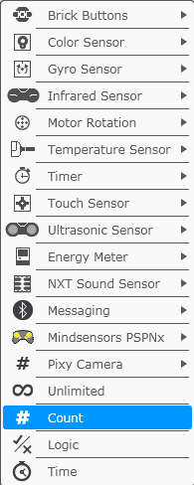
Loops
Loops make repeating a task multiple times easy
You can have a loop end whenever you want

Slide 5
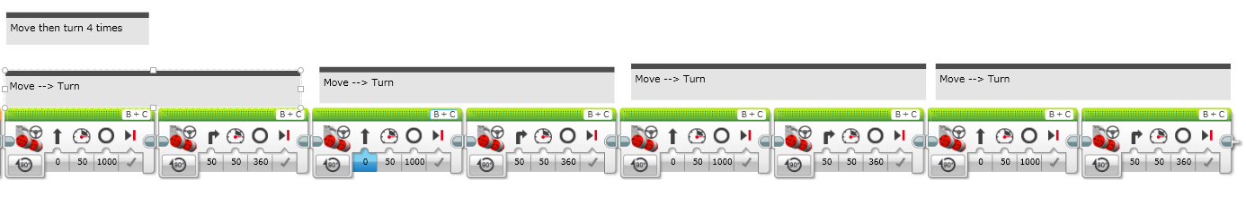
LOOP CHALLENGE
Challenge: Write a program to go around a box once.
The code should be an improvement on the code below (needs to use loops):

Slide 6
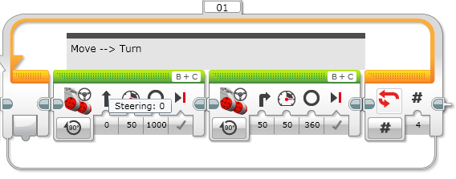
Loop CHALLENGE Solution
Run 4 times

Slide 7
CREDITS
This tutorial was created by Sanjay Seshan and Arvind Seshan
More lessons are available at www.ev3lessons.com
This work is licensed under a Creative Commons Attribution-NonCommercial-ShareAlike 4.0 International License.

