Slide 1

How to Use EV3 Lessons

Slide 2
OVERALL STRUCTURE
Beginner Lessons: These lessons will teach you to move and turn the robot, use the sensors, and use loops and switches.
Intermediate Lessons: These lessons introduce more advanced programming techniques such as My Blocks, variables, parallel beams, calibration and math/logic blocks.
Advanced Lessons: These lessons assume that you are comfortable using all the blocks in the EV3 environment. The advanced lessons teach you to more sophisticated programs such as menu systems, proportional line followers, squaring on lines and stall detection techniques.
Beginner Lessons are designed to be done in order. Intermediate and Advanced Lessons may be done out of order. Lessons usually mention specific pre-requisites when needed.

Slide 3
Lesson Structure
Each lesson starts with a list of objectives and ends with a challenge
In most lessons, we provide hints in the form of Pseudocode. Students who need a hint should look at the Pseudocode.
We provide a challenge solution as well (both as a screenshot as well as in EV3 Code)
A discussion guide is included after the challenge that will help understand the main objectives
Many lessons have companion worksheets for students. More will be added over time.

Slide 4



PROGRAMMING LESSONS
Beginner | Intermediate | Advanced
Build a Base Robot Introduction to Brick/Software Moving Straight Pseudocode Turning Displaying Text and Graphics Touch Sensor Color Sensor Loops Switches Ultrasonic Sensor Basic Line Follower Basic Sequencer Final Challenge | My Blocks with Inputs and Outputs Moving with My Blocks Turning with My Blocks Color Line Follower with My Blocks Infrared Sensor Debugging Move Blocks Reliability Intermediate Menu System Color Sensor Calibration Variables Parallel Beams | Parallel Beams Sync Arrays Proportional Control Proportional Line Follower Proportional 2 Color Line Follower Ramping Up Gyro Sensor Gyro Sensor Turns Squaring on Lines Gyro Sensor: Move Straight and Wall Follow Squaring on Lines Stall Detection Menu System

Slide 5
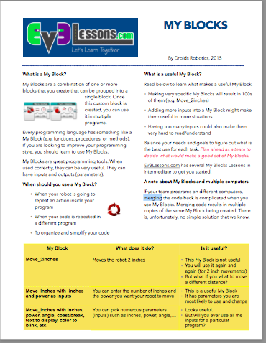
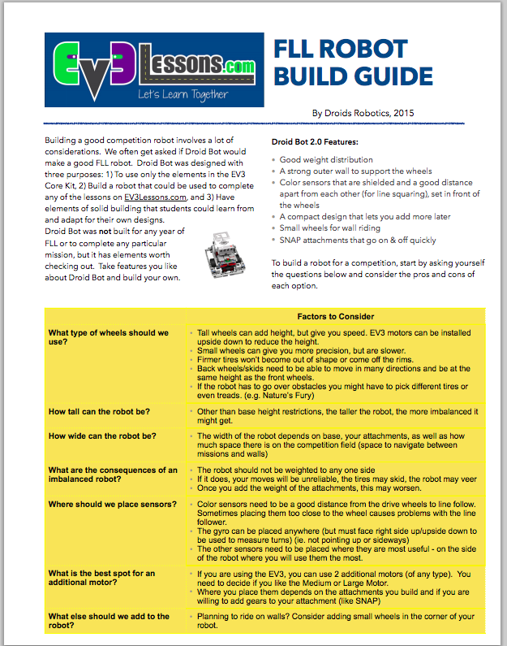
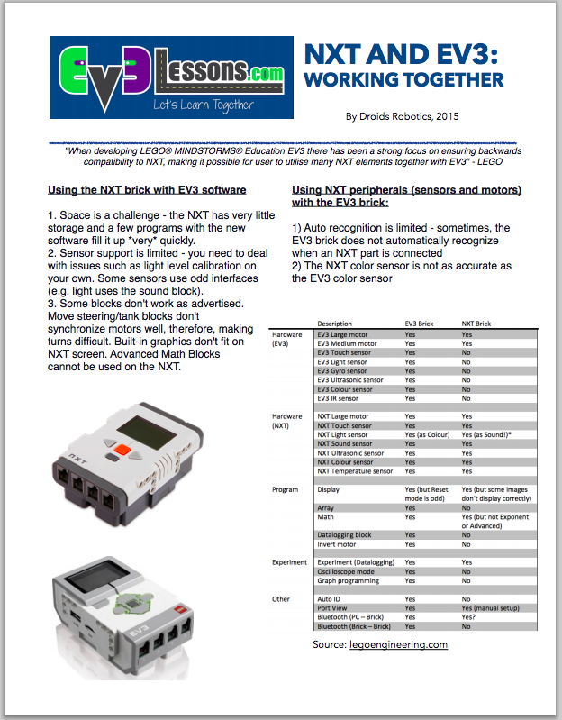
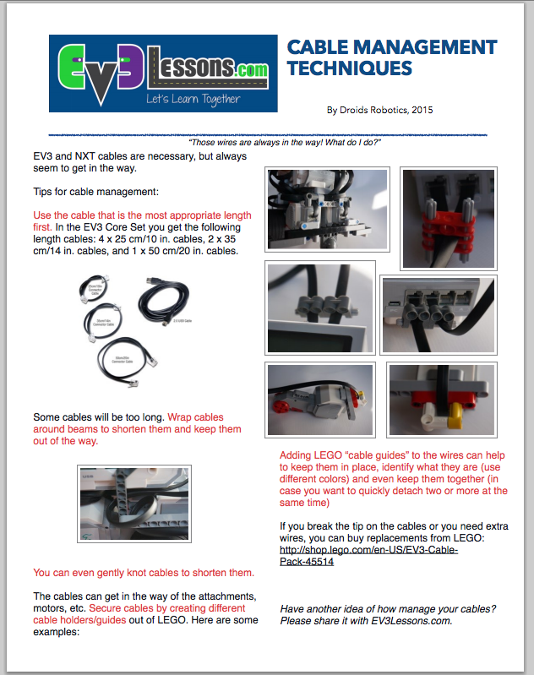
Quick guides IN RESOURCES
These provide quick responses to important topics and questions that are common.
Use them as you need – as handouts, as discussion guides

