Slide 1
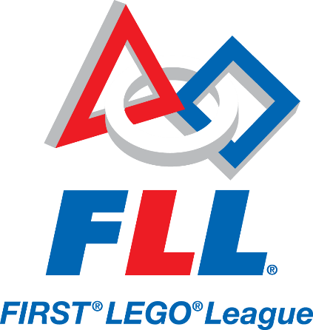
What is FIRST LEGO LEAGUE?

Slide 2



FLL Overview
International competition organized by FIRST
For kids ages 9-14 in North America and 9-16 elsewhere
Each year has a theme
About 27,000 students in over 80 countries participate in FLL
Runs approximately from September – December (or longer if you qualify for Sate and International-level Championships)

Slide 3

Three Parts to FLL
Robot Game
Research Project
Core Values

Slide 4
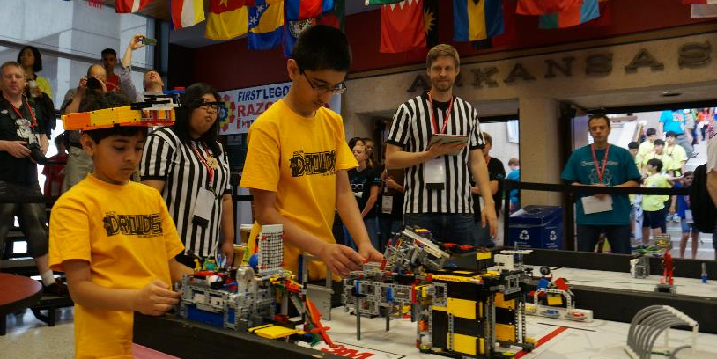
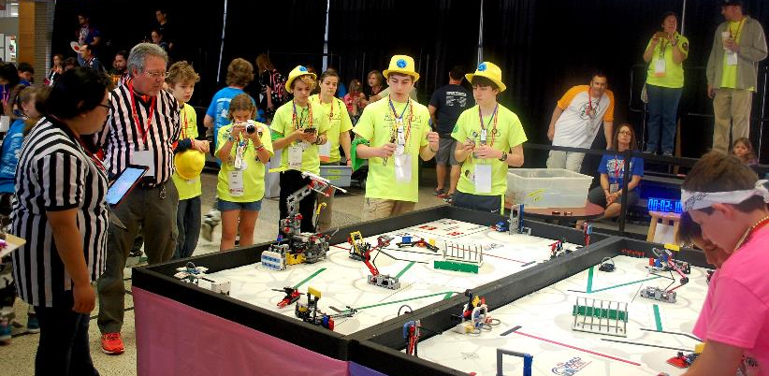
Robot Game
Goal:
Complete LEGO-based missions in 2.5minutes
Build a LEGO MINDSTORMS robot and program it to autonomously solve the missions
Teams are judged on the quality of their design and programming
Teams participate in timed matches

Slide 5
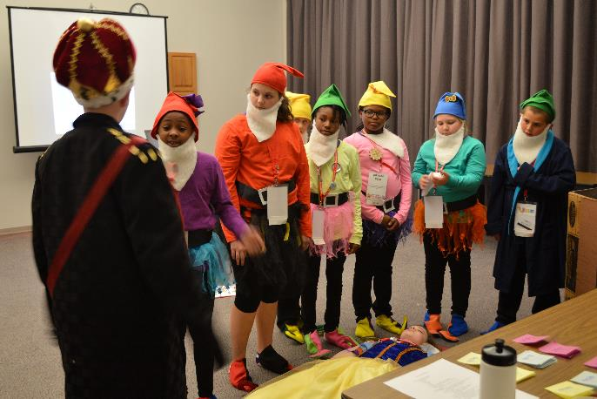
Research Project
Goal:
Identify a problem
Come up with an innovative solution
Share the solution with others
The topic is always related to the year’s theme
Teams are judged based on the quality of their research and solution, but also the creativity of their presentation to judges

Slide 6
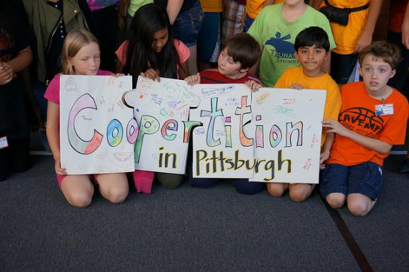
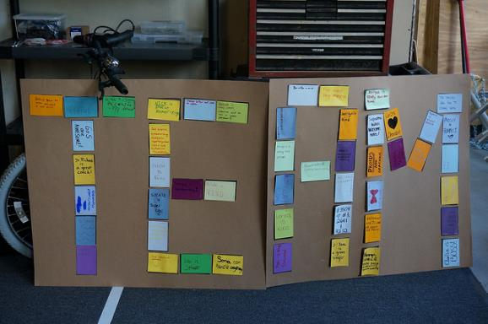
Core Values
Goal:
Helping and working with other teams (Gracious Professionalism and Coopertition)
Spreading STEM
Inspiring others
Many teams mentor other teams and do outreach events such as running camps or doing demos in public places
Teams are judged based on how students work together, and their understanding and application of the 8 FLL Core Values

Slide 7
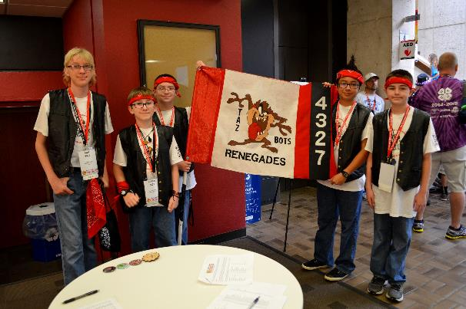
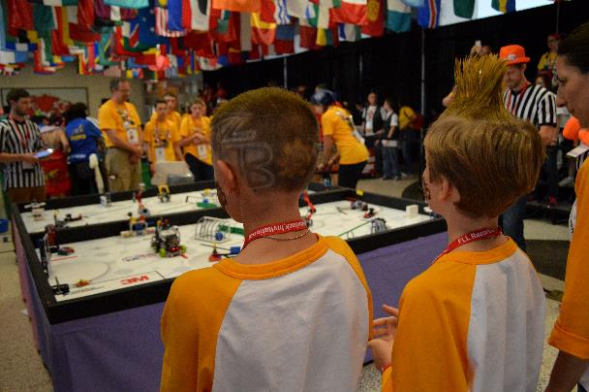
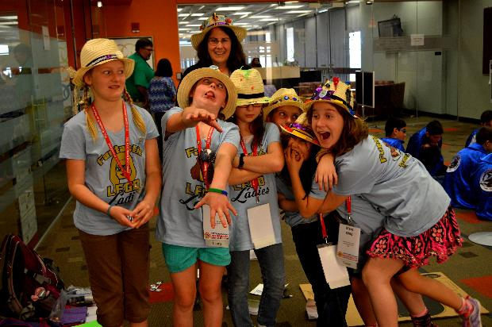
FLL is HARD FUN!
You learn STEM skills (Math, Science, Research…) and life skills (teamwork, presentation, interviewing, confidence…) while having fun!

