Slide 1


Squaring or Aligning on a Line
ADVANCED EV3 PROGRAMMING LESSON
By Droids Robotics

Slide 2
Lesson Objectives
Learn how to get your robot to Square (straighten out) when it comes to a line
Learn how Squaring (also known as Aligning on a Line) can help the robot navigate
Learn how to improve initial code for aligning by repeating a technique
Practice creating a useful My Block
Prerequisites: My Blocks with Inputs & Outputs, Data Wires, Parallel Beams, Parallel Beams Synchronization

Slide 3
Why Align on a Line?
Aligning on a line helps the robot navigate
Robots get angled as they travel farther or turn (the error accumulates)
Aligning on a line can straighten out a robot.
Aligning can tell a robot where it is when it has to travel far
Example Goal: Your robot must deliver an object only inside a small END area. The distance between start and end is 8 feet
Do you think your robot can travel 8 ft and continue to be straight?
End
8ft
Start

Slide 4
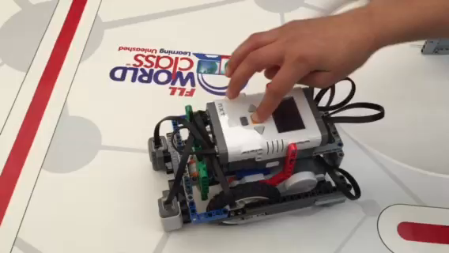
Challenge
Pseudocode:
Start both motors
Stop one motor when the sensor on the corresponding side sees the red line (use parallel beams)
Stop moving the second motor when the sensor on that side sees the red line (use parallel beams)
Add some inputs (constants) to the code for power and color so you can change what color you want to align to
Use data wires to connect the color constant to the wait for block and the power to the Move Block
Create an Align My Block
Challenge: Create a My Block to make the robot straighten out (align/square off) on a red line (see video)

Slide 5
Notes About Our Solution:
Our solution uses 2 Color Sensors (connected in Ports 1 and 4).
Our solution assumes that the color sensor on port 1 is next to the wheel on motor port B and color sensor on port 4 is next to the wheel on motor port C.
You should adjust the ports as needed
Your color sensors should NOT be placed right next to each other (see red box below in robot image)

Slide 6
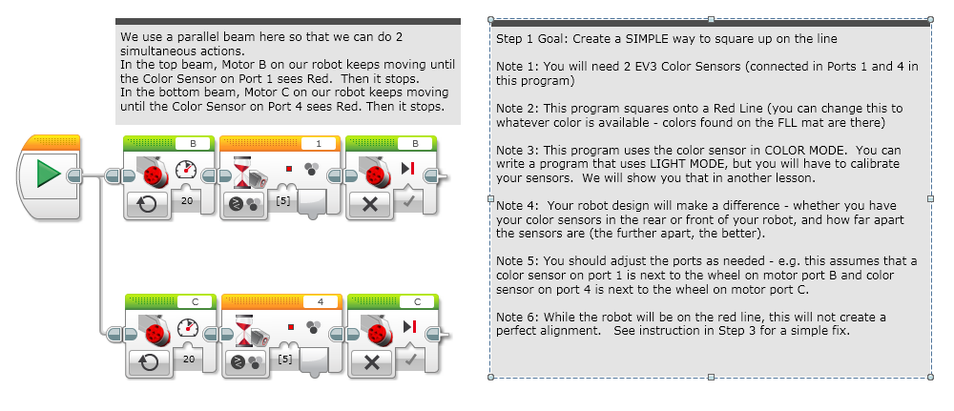
Solution Step 1: Moving Until Line

Slide 7
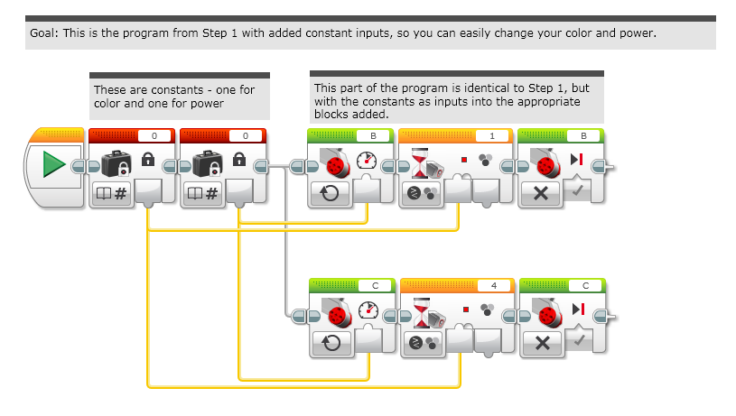
Solution Step 2: Adding Inputs

Slide 8
Repeating a Technique
What do you notice about the solution we just presented?
The robot isn’t quite straight (aligned) at the end of it.
Both color sensors are on the line, but the robot stops at an angle.
Challenge Continued: Think about how you can improve this code so that the robot ends straighter
Hint: Can you repeat the last process by looking for white?
This assumes that the red line we were straightening out on has white on both sides.

Slide 9
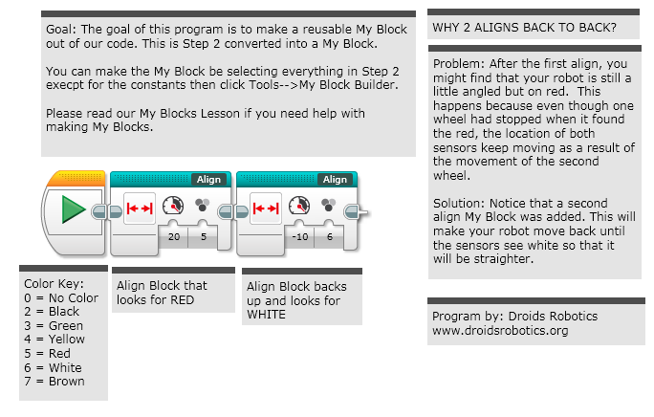
Step 3: My Block With Dual Stage Fix

Slide 10
Tips for Success and Next Steps
You will get better results
….if your color sensors are closer to the ground
….if you shield your color sensors
….if you don’t come at the line at steep angles
….if you keep your color sensors spread apart
Next Steps:
There are alternative ways to align on lines (even with one sensor).
An alternative approach can be found in the Contributed Lessons tab

Slide 11
Discussion Guide
What does Aligning on a Line/Squaring mean? Ans. It means when your robot comes at an angle, it can use a line to straighten out
Why does Squaring help when you travel long distances?
Ans. Robots do not move accurately/straight. Squaring can help you know where you are and straighten out.
Why might it be useful to repeat the alignment process multiple times?
Ans. Your robot will get straighter each time you repeat

Slide 12
Credits
This tutorial was created by Sanjay Seshan and Arvind Seshan from Droids Robotics.
Author’s Email: team@droidsrobotics.org
More lessons at www.ev3lessons.com
This work is licensed under a Creative Commons Attribution-NonCommercial-ShareAlike 4.0 International License.

