Slide 1


INTERMEDIATE PROGRAMMING Lesson
Color Line Follower My Blocks with Inputs:
Move for Distance
By: Droids Robotics

Slide 2
Lesson Objectives
Learn how to write a line follower that takes multiple inputs
Learn how to write a line follower that stops after a certain number of degrees
Practice making a useful My Block

Slide 3
Why a My Block Line Follower with inputs?
Making a My Block out of your line follower reduces the length of your code and makes it reusable
Learning to write a line follower that takes multiple inputs (power, degrees and color) can be very useful
Every time you want a line follower that goes a different distance, you just need to change the input!

Slide 4
TIPS TO SUCCEED
You will need to know how to make a Simple Color Line Follower program and how to make a My Block with inputs
Since you will use your EV3 Color Sensor in Color Mode, you will not have to Calibrate your color sensor for this lesson
Check which ports you have your color sensor connected to and adjust the code as needed
You may have to adjust the speed or direction to work for your robot. Make sure that the the color sensor is in front of the wheels in the direction of travel.
Make sure you place the robot on the side of the line that you are following. The most common mistake is placing the robot on the wrong side of the line to begin with.
Follow along in the companion EV3 File. Always start at Stage 1

Slide 5
Challenge with TIPS
Challenge: Write a line follower My Block that follows a colored line and stops after moving a certain number of degrees. The line follower should take three inputs (degrees, power and color to follow)
Goal: Stop after 720 degrees
Create a simple color line follower program
Include a “reset the rotation” sensor block to delete any prior readings
Exit the line follower loop when the robot has moved certain degrees
Set up the the following inputs before the loop: degrees, power and color using constants.
Using data wires, connect the degrees to the exit condition for the loop. Connect the power to the move block. Connect the color to the color sensor block.
Make this line follower into a My Block

Slide 6
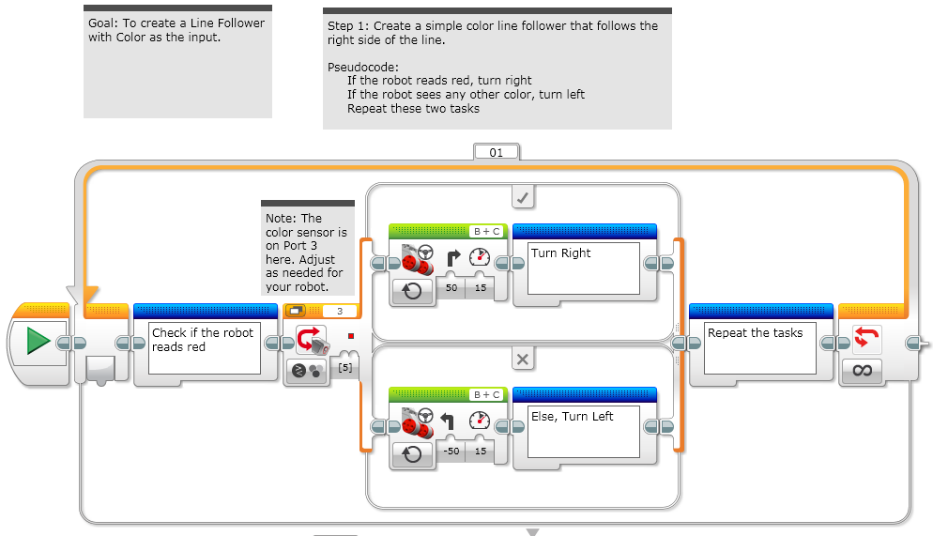
STAGE 1: Simple Color Line Follower

Slide 7
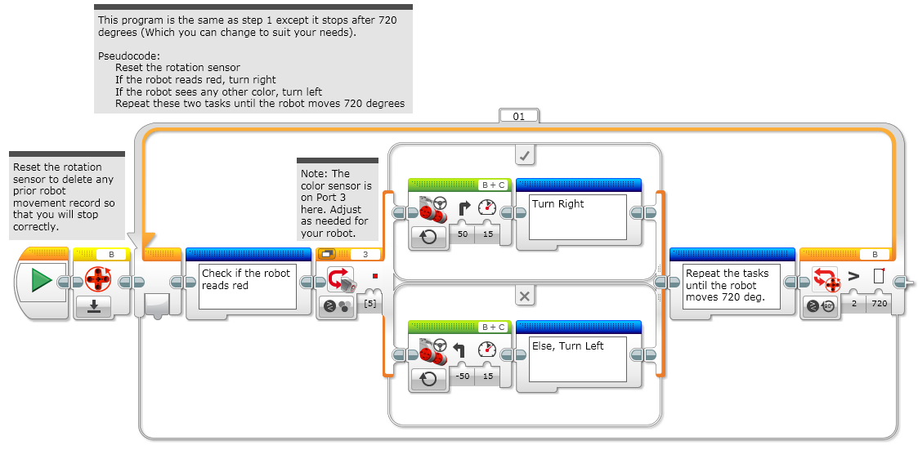
STAGE 2: RESET & DEGREES

Slide 8
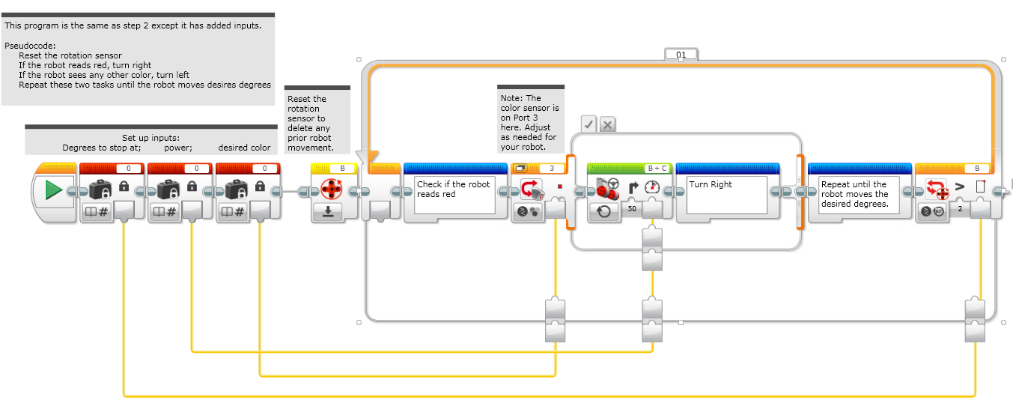
STAGE 3: ADDING INPUTS

Slide 9
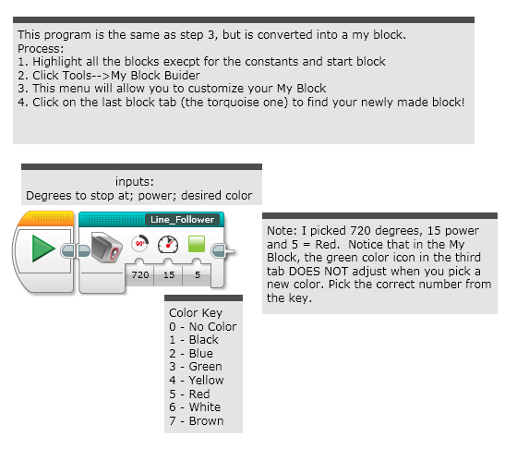
STAGE 4: MY BLock

Slide 10
Next steps
We use a simple line follower in this lesson. You can combine these techniques with any line follower.
Learn how to create a proportional line follower for light or a smooth line follower for color → check out our Advanced: Proportional Line Follower lesson.

Slide 11
CREDITS
This tutorial was created by Sanjay Seshan and Arvind Seshan from Droids Robotics.
More lessons are available at www.ev3lessons.com
Author’s Email: team@droidsrobotics.org
This work is licensed under a Creative Commons Attribution-NonCommercial-ShareAlike 4.0 International License.

