Slide 1


Building a Base Robot & Attachments
ROBOT DESIGN LESSON
DROID BOT
By Droids Robotics

Slide 2
Base Robot Design 101
Take your time to build your base robot – try out multiple designs before you invest time in attachments (it might take a few weeks, but do not worry)
Some issues to consider in your base robot design:
What sensors do you need to add to accomplish your goals?
Is your robot well balanced and have good traction?
Can it align well by bumping into walls or mission models?
Do the wheels stay in place and not flex out?
Did you consider size restrictions: height limitations set by the rules, height limitations because of a mission models, width restrictions caused by the narrow openings?
As a result, you will notice that Droid Bot has the following features: balanced, outer wall, compact, uses parts in the base education kit + 1 additional color sensor

Slide 3
Powered and Passive Attachments
Passive vs. Powered
Passive attachments are sometimes more reliable (KISS principle)
Powered attachments may be more complicated to attach
Power sources
Pneumatics – relatively powerful, but need to pump up in advance and be careful regarding pressure and leaks
Rubberbands – compact and easy to use but can get lost/wear out over time
Motors – can control in software and reusable across many missions but physically large

Slide 4
Attachment Tips
Reduce errors/time wasted by avoiding adding/removing attachments. Design attachments that can stay on for entire time.
See Droids Robotics Food Factor run on YouTube for example of very few additions across multiple runs
Removing attachments may be easier, less error-prone than adding them
See Droids Robotics Senior Solution run on You Tube for example of removing most complex attachments, but not adding more
Reduce space and complexity of attachments by building attachments that can work for multiple missions
See forklift attachment used in Droids Robotics Nature’s Fury run (You Tube) for its use in multiple missions

Slide 5
Attachment Tips Continued
Use reliable and easy-to-add mechanisms to connect to motors/robot
Avoid hard to add/remove pins
Connecting directly to motor can be more reliable (avoids gear slip, etc.) but takes longer
Using gearing mechanisms to connect to motor can make it easy to add attachment but the connection may not be as reliable
Use gears to deliver power to where you need it on the robot and in the direction that you need it
Look at various LEGO sets for inspiration on how to connect gears
Look at books by Isogawa to learn about gearing

Slide 6
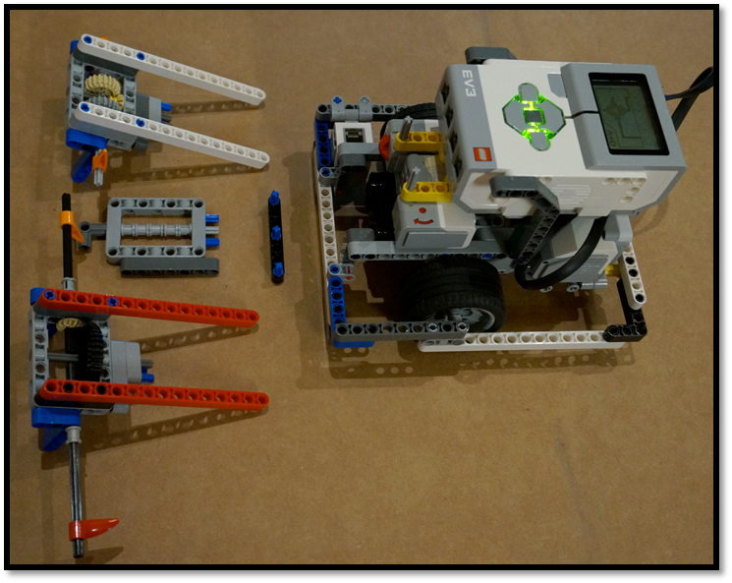
S.N.A.P Attachments for Droid Bot
Some features to notice:
Swappable: Easy to put on and take off
No Problem: Strong, reliable connection to motor (hard to remove accidently)
Attachments with Power: Reliable gearing mechanisms to increase or decrease the power of the attachment
Gearing mechanisms to deliver power to either side of the robot

Slide 7
Credits
This tutorial was created by Sanjay Seshan and Arvind Seshan from Droids Robotics.
Author’s Email: team@droidsrobotics.org
More lessons at www.ev3lessons.com
This work is licensed under a Creative Commons Attribution-NonCommercial-ShareAlike 4.0 International License.

