Slide 1


BEGINNER EV3 PROGRAMMING Lesson
Topics Covered:
Repeating Actions (Loops)
By: Droids Robotics

Slide 2
Lesson Objectives
Learn how to repeat an action
Learn how to use Loop Blocks

Slide 3
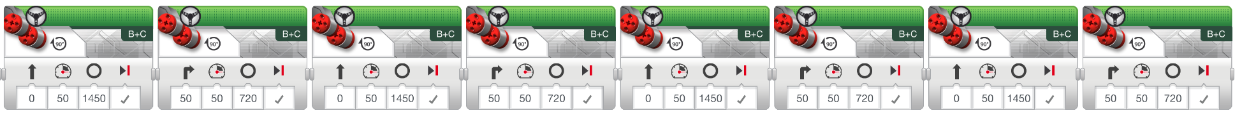

Repeating an Action
How can we move around a box using the commands we already know?
(move + turn) + (move + turn) + (move + turn) …
Is there an easier way?
Hint:

Slide 4

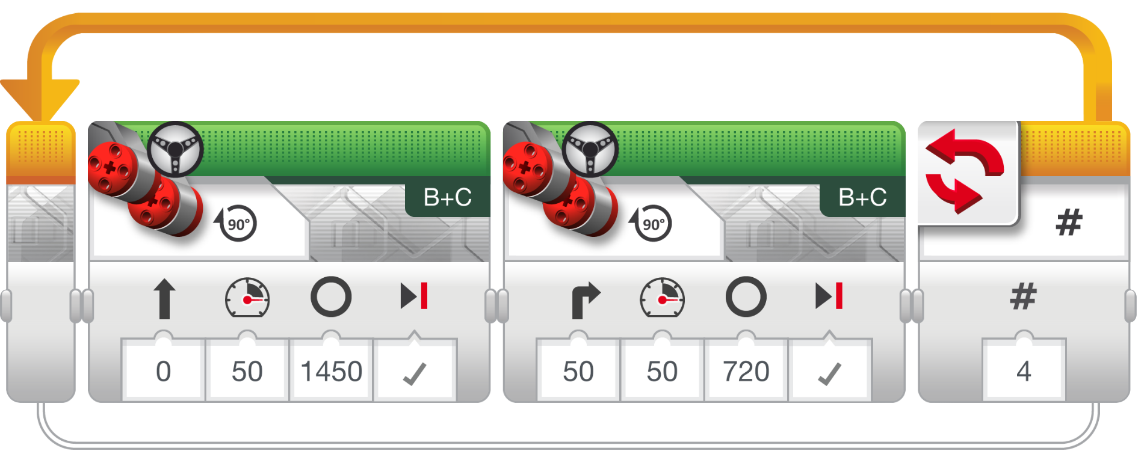
Loops
Loops make repeating a task multiple times easy
KEEP GOING….Forever, for a Count, Until touch (or something else)

Slide 5
LOOP CHALLENGE
Challenge: Write a program to go around a box until touched. You must use a LOOP

Slide 6
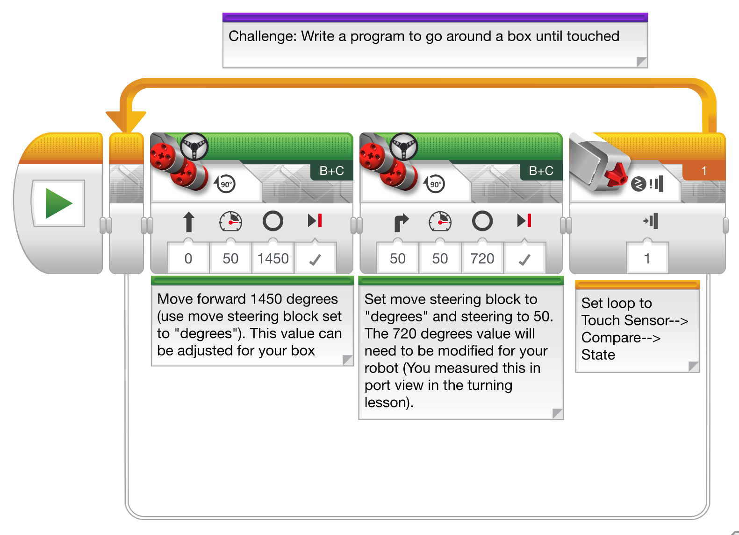
Loop CHALLENGE Solution

Slide 7
CREDITS
This tutorial was created by Sanjay Seshan and Arvind Seshan from Droids Robotics.
More lessons are available at www.ev3lessons.com
Author’s Email: team@droidsrobotics.org
This work is licensed under a Creative Commons Attribution-NonCommercial-ShareAlike 4.0 International License.

