Slide 1


BEGINNER EV3 PROGRAMMING Lesson
Topics Covered:
Ultrasonic Sensor
By: Droids Robotics

Slide 2
LESSON OBJECTIVES
Learn about the Ultrasonic Sensor
Learn how to use Wait Until Ultrasonic Block
Learn the difference between the Wait Until Ultrasonic Block and the Ultrasonic Block

Slide 3
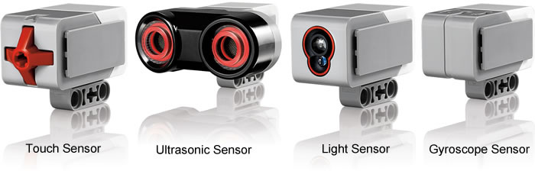
What is a sensor?
A sensor lets an EV3 program measure and collect data about is surroundings
The EV3 sensors include:
Colour – measures color and darkness
Gyro – measures rotation of robot
Ultrasonic – measures distance to nearby surfaces
Touch – measures contact with surface
Infrared – measures IR remote’s signals
Our lessons will cover the all the sensors
Image from: http://www.ucalgary.ca/IOSTEM/files/IOSTEM/media_crop/44/public/sensors.jpg

Slide 4
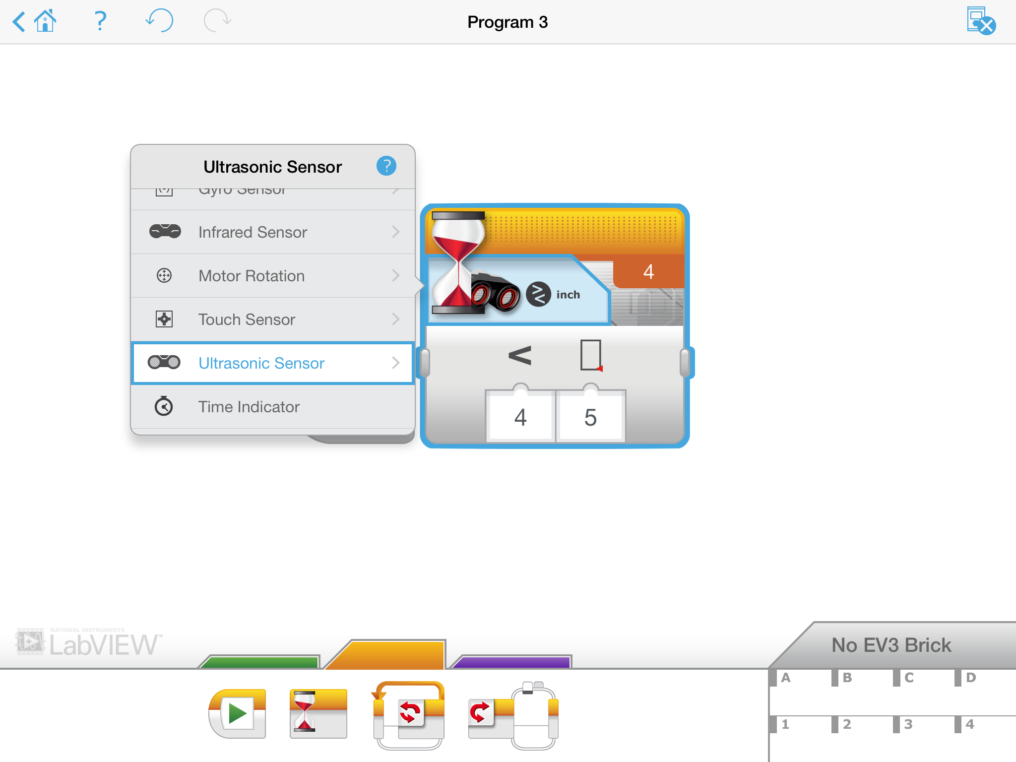
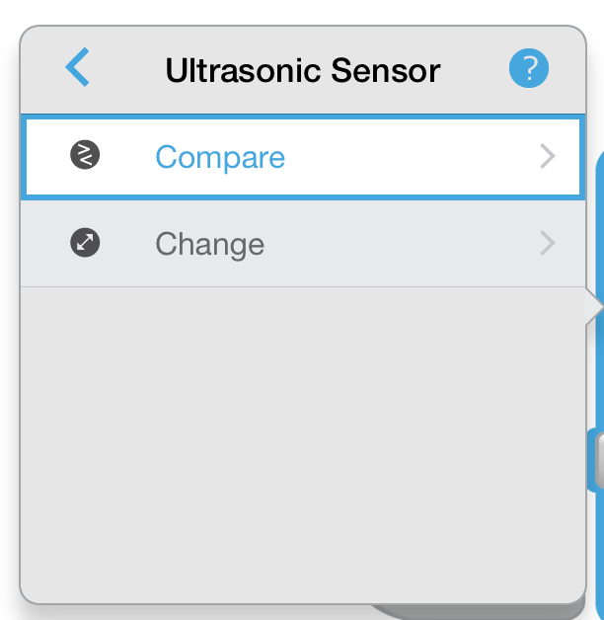

Ultrasonic CHALLENGE 1
Challenge: Make the robot move until it is 5 inches away from the wall.
Step 1: Make a new program
Step 2: Set move to “on”
Step 3: Set wait block to use the Ultrasonic
Step 4: Set move block to “off”

Slide 5
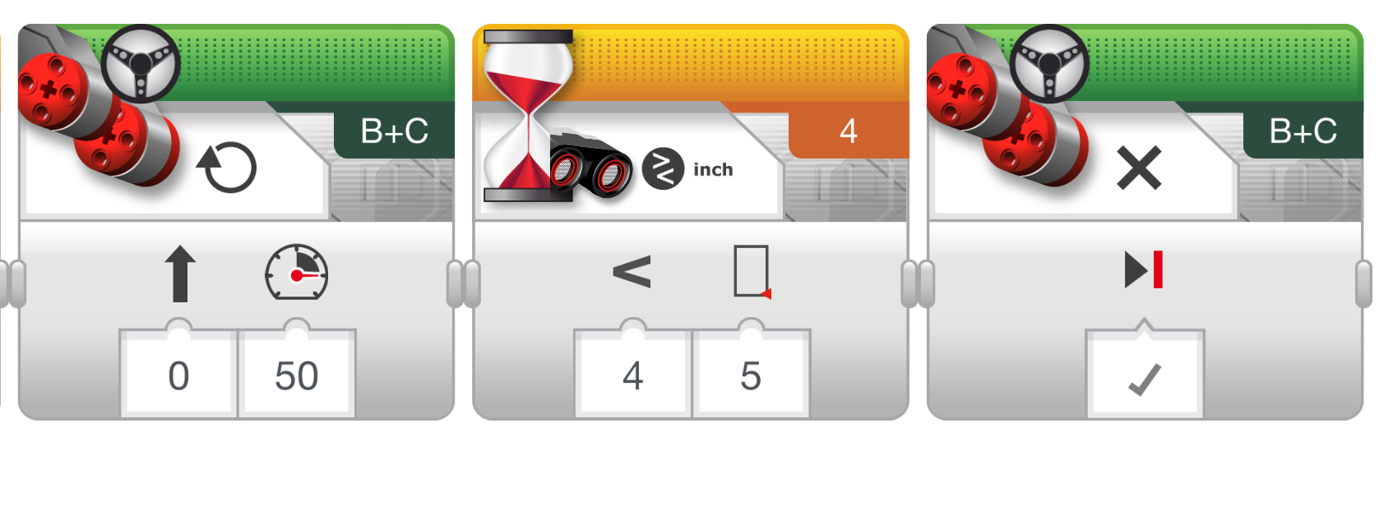
Challenge 1 solution

Slide 6
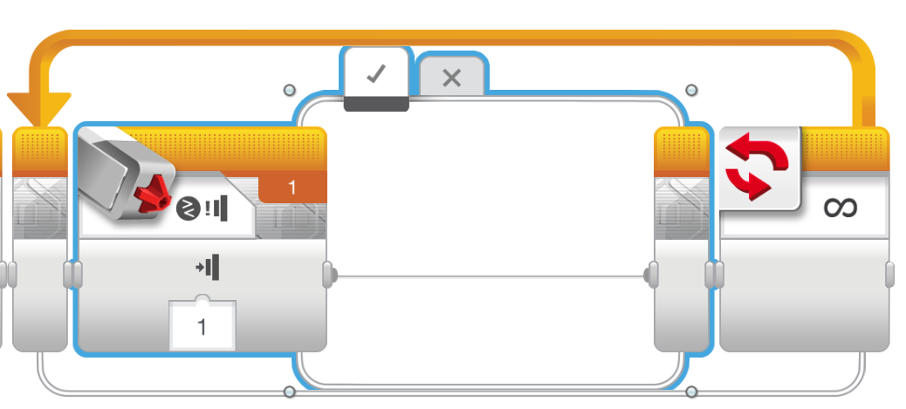
Challenge 2: Dog Follower
If the robot is closer than 5 inches away from your hand move backward, otherwise move forward.
Step 1: Drag a loop from the orange tab
Step 2: Drag switch inside loop
Step 3: Set switch to Ultrasonic
Step 4: Set move steering block to ON and place in TRUE
Step 4: Set move steering block to OFF and place in FALSE

Slide 7
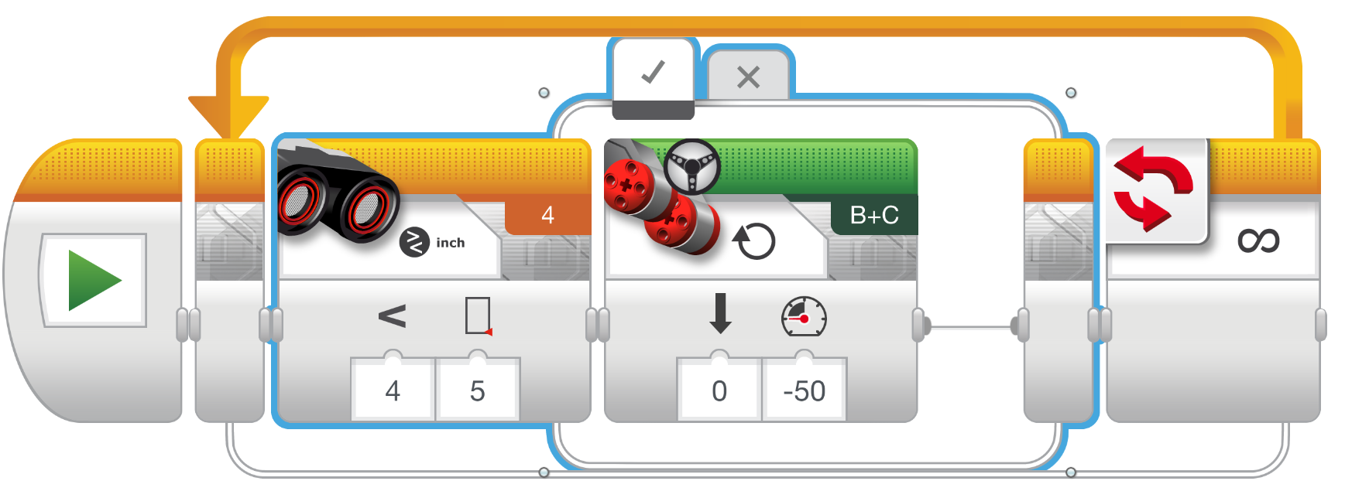
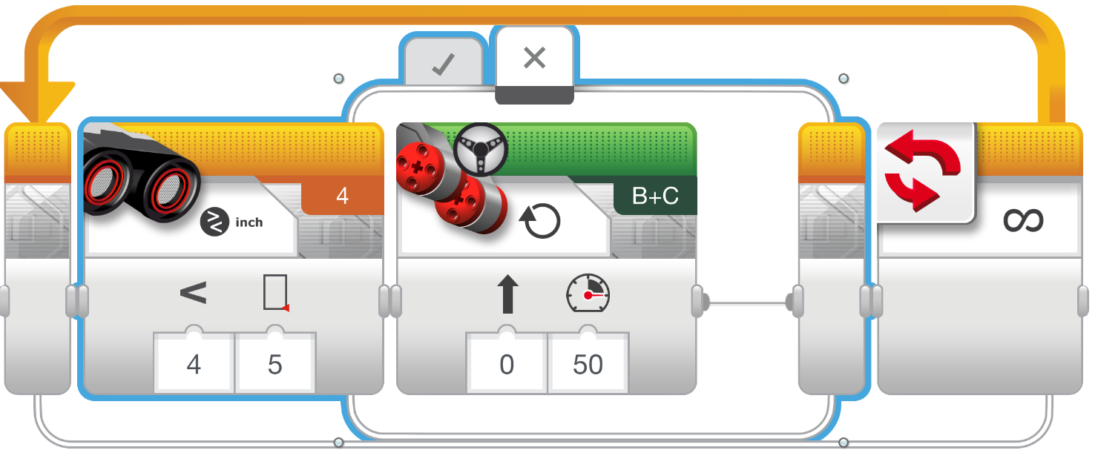
Challenge 2 solution

Slide 8
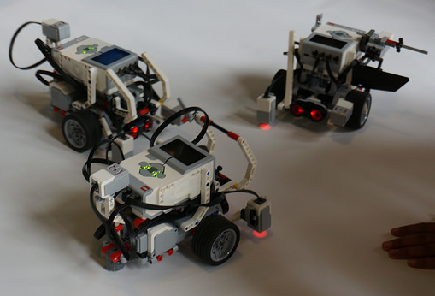
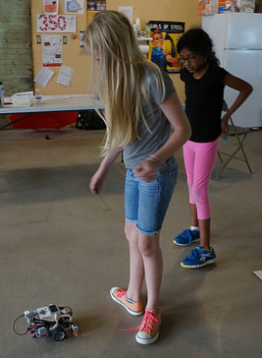
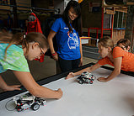
Robots can follow you & even dance with this code!

Slide 9
CREDITS
This tutorial was created by Sanjay Seshan and Arvind Seshan from Droids Robotics.
More lessons are available at www.ev3lessons.com
Author’s Email: team@droidsrobotics.org
This work is licensed under a Creative Commons Attribution-NonCommercial-ShareAlike 4.0 International License.

