Slide 1

BEGINNER PROGRAMMING LESSON
Custom Images and Sounds

Slide 2
LESSON OBJECTIVES
Learn to use the Display Block and Sound Block to add your custom images and sounds to the EV3

Slide 3
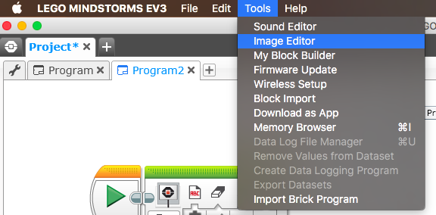
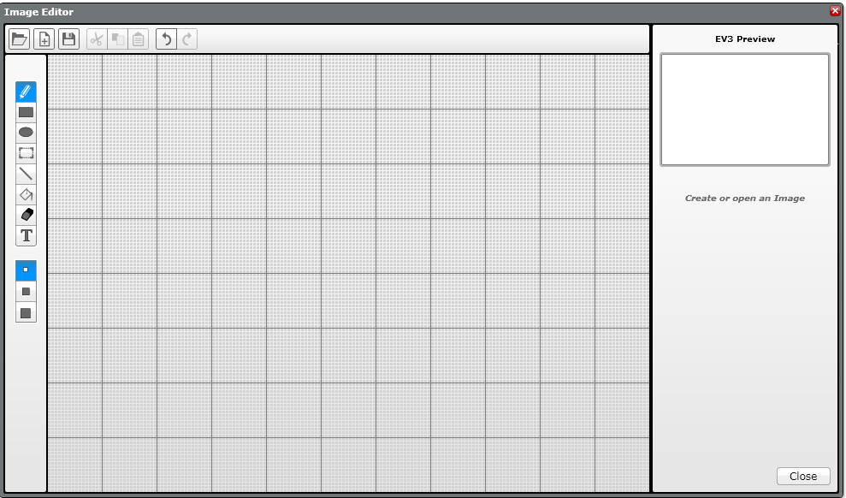
ADDING CUSTOM IMAGES
STEP 1: Select Image Editor from the EV3 Menu Note:
The Image Editor can open .rgf, .jpg, .png, and .bmp files. Color images are automatically converted to monochrome images. The .rgf file extension is what LEGO uses.
STEP 2: Open your image

Slide 4
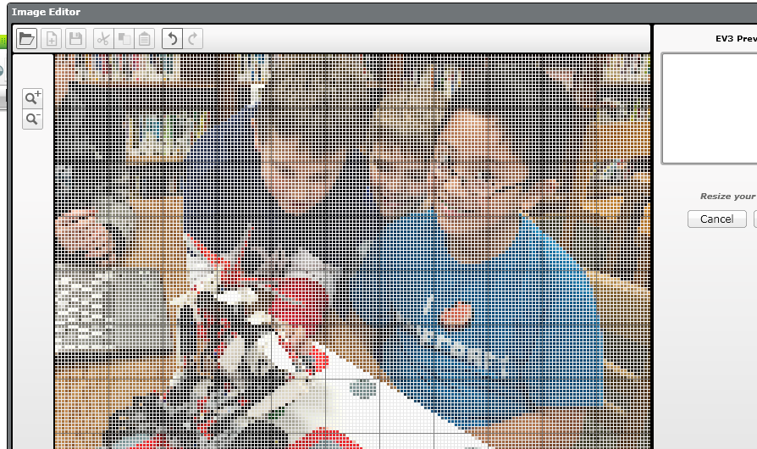
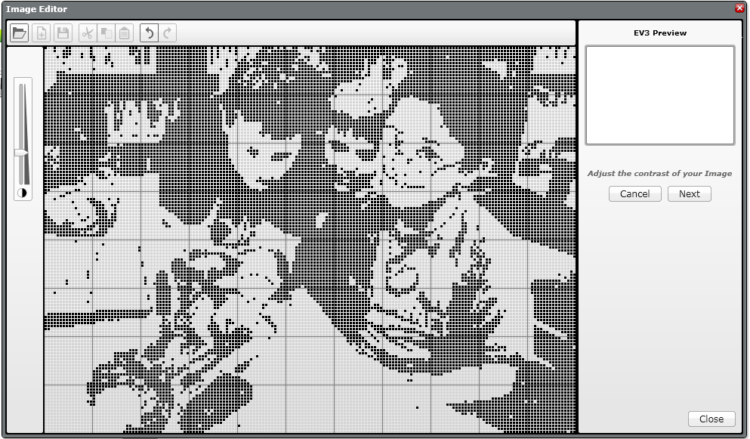
ADDING CUSTOM IMAGES
STEP 3: Change its size using the buttons and change the placement by selecting and moving the entire image around
STEP 4: Adjust the contrast

Slide 5
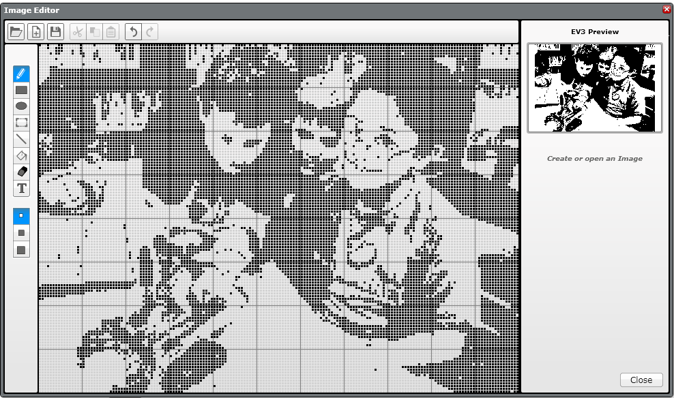
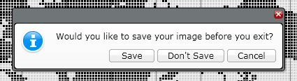
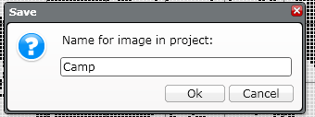
Adding CUSTOM IMAGES
STEP 5: Edit the image, using the tool palette to the left of the editing screen.
STEP 6: Save the image

Slide 6
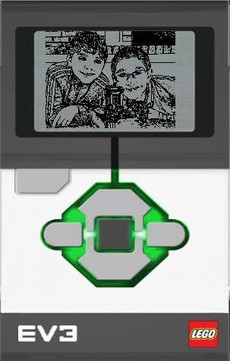
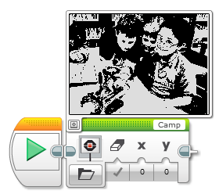
Adding CUSTOM IMAGES
STEP 7: This image is now ready to use in your display block

Slide 7
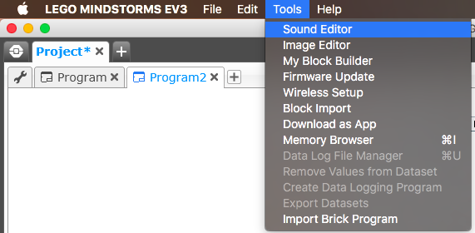
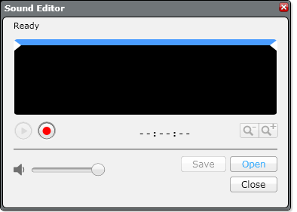

ADDING CUSTOM SOUNDS
STEP 1: Select Sound Editor from the Tools Menu
STEP 2: Click on Open and select a sound file or record your own using the red button

Slide 8
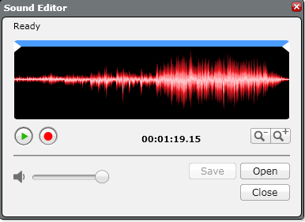
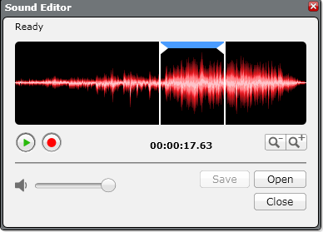
ADDING CUSTOM SOUNDS
STEP 3: The sound you selected will appear in the editor
STEP 4: Move the blue bar to change the size of the clip

Slide 9

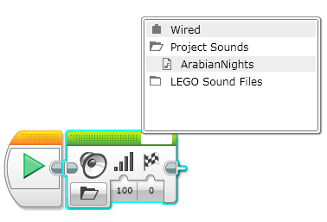
ADDING CUSTOM SOUNDS
STEP 5: Save the file
STEP 6: The sound will appear in the sound block

Slide 10
CREDITS
This tutorial was created by Sanjay Seshan and Arvind Seshan
More lessons are available at www.ev3lessons.com
This work is licensed under a Creative Commons Attribution-NonCommercial-ShareAlike 4.0 International License.

