Slide 1
Adding Additional Blocks (Including Third Party Blocks)

Slide 2
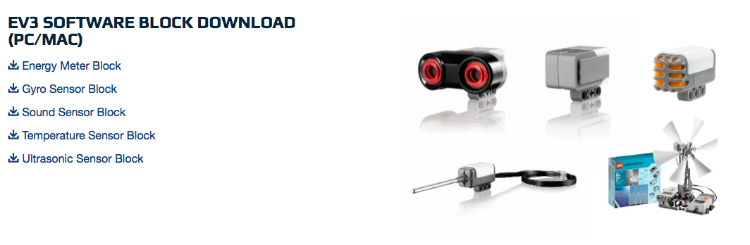
Adding Official LEGO Blocks
If you installed the Home Edition of the EV3 Software and later want to add the Gyro and Ultrasonic or other Blocks you should follow the steps on pages 4 and 5
The link to find the blocks: http://www.lego.com/en-us/mindstorms/downloads

Slide 3
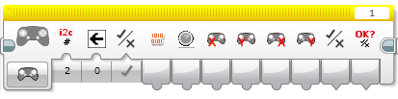

Adding Third Party Blocks
Third Party Blocks are non-LEGO blocks to control non-LEGO sensors and other electrical elements such as the PixyCam and the PSP-Nx Combo with Wireless Controller
This will allow you to use the new sensor in wait blocks, switches, loops, and more
These blocks are found on the individual manufacturers’ site (e.g. Mindsensors, Dexter Industries, etc.)

Slide 4
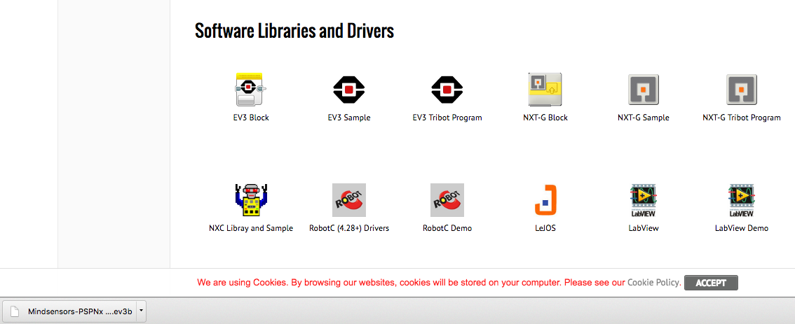
Step 1: Download Block
Download the necessary block online from the correct location (either from LEGO or the Manufacturer of the third party sensor)
Sometimes the file will be zipped. You will need to unzip the file before proceeding
Example from Mindsensors.com

Slide 5
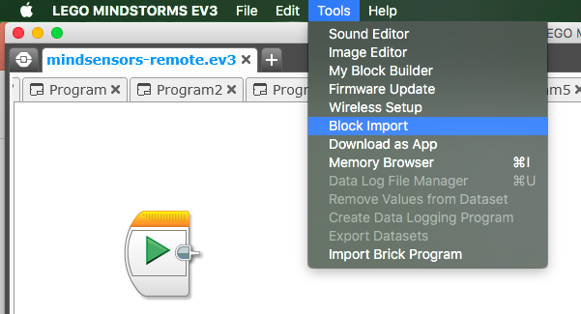
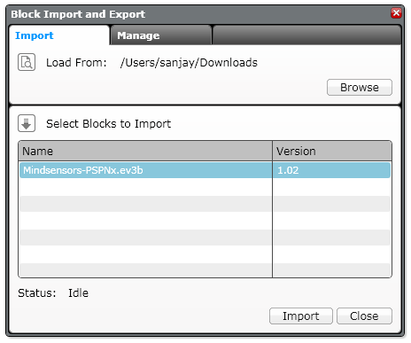
Step 2: Import Block
Open your EV3 software
Go to Tools → Block Import
Browse through your files and find the file you downloaded in Step 1
Select the block and click Import
You will have to restart your software before using the block

Slide 6
CREDITS
This tutorial was created by Sanjay Seshan and Arvind Seshan
More lessons are available at www.ev3lessons.com
This work is licensed under a Creative Commons Attribution-NonCommercial-ShareAlike 4.0 International License.

