Slide 1
LEGO MINDSTORMS and Raspberry Pi IR Light controller

Slide 2
Objectives
Program a Raspberry Pi to control a string of LED lights using an IR sensor
Learn how to make the EV3 communicate with a Raspberry Pi
Learn to use an IR sensor and IR LED to emulate remote signals
Prerequisites:
Must have basic Python programming knowledge
Must be comfortable using a Raspberry Pi (Unix/Linux commands & GPIO)
Must be familiar with EV3 Bluetooth Messaging
Must have done EV3 Raspberry PI Communicator lesson on EV3Lessons.com

Slide 3
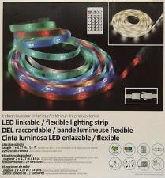
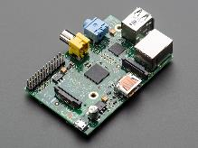


Materials
Raspberry Pi (Tested on Model B Edition 1 using Raspbian)
EV3 brick
USB Bluetooth (for the Raspberry Pi)
IR Sensor (for the Raspberry Pi)
IR LED (for the Raspberry Pi)
LED Strip with IR receiver and remote
E.g. Intertek flexible lighting strips
GPIO compatible wires (for Raspberry Pi)
Breadboard (optional)

Slide 4
Step 1: Pi Setup
Setup the IR sensor and IR LED on the GPIO (see next slide).
Make sure you arrange the wires correctly based on the sensor you own. (You can use a volt meter to arrange the wires correctly – to identify ground, voltage and ground)
Install packages on the Raspberry Pi
sudo apt-get update
sudo apt-get upgrade
sudo reboot
sudo apt-get install lirc
Make sure you have completed all the steps in the EV3-RPi Communicator Lesson

Slide 5
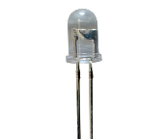
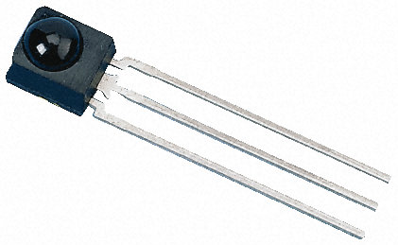
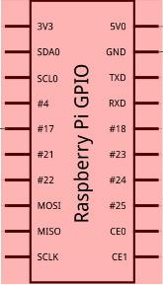
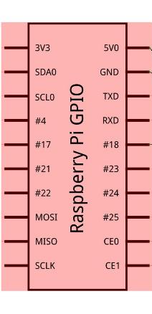
GPIO Setup
IR LED
Configuration based on IR sensor available on Adafruit (Product link)

Slide 6
Step 2: Edit System Files
sudo nano/etc/modules
add these lines at the end to make LIRC start up on boot and set the IR sensor pin to Pin-18 and IR LED pin(for later) to Pin-17:
lirc_dev
lirc_rpi gpio_in_pin=18 gpio_out_pin=17
Now we need to edit the LIRC hardware configuration file. Open it using: sudo nano /etc/lirc/hardware.conf
Change the following lines:
DRIVER="default"
DEVICE="/dev/lirc0"
MODULES="lirc_rpi"
sudo nano /boot/config.txt
add the following line to the file:
dtoverlay=lirc-rpi,gpio_in_pin=18,gpio_out_pin=17,gpio_in_pull=up
Reboot: sudo reboot

Slide 7
Step 3: Record All Remote Buttons
Stop LIRC: sudo /etc/init.d/lirc stop
To make sure you setup the IR sensor correctly, use: mode2 -d /dev/lirc0 (press buttons on a remote to get the readings)
Record all the buttons to the raspberry pi: irrecord –n -d /dev/lirc0 ~/lircd.conf -- It will take you through some detailed instructions.
sudo nano lircd.conf Find the line that says "name /home/pi/lircd.conf" and change it to "name remote"
Copy the new configuration -- sudo cp lircd.conf /etc/lirc/lircd.conf
Start LIRC: sudo /etc/init.d/lirc start
Reboot: sudo reboot
To test the configuration run the commmand irw
Every time you press a button on the remote, you will get the name of the button.

Slide 8
Step 4: Send IR signals with Pi
Connect the IR Led to the GPIO (See image on right)
To send an IR signal use
irsend SEND_ONCE remote ONE_OF_THE_BUTTONS_NAME
We use SEND_ONCE to only sent the light signal once
Now in python you can send a signal using
import os
os.system("irsend SEND_ONCE remote ONE_OF_THE_BUTTONS_NAME")
Replace ONE_OF_THE_BUTTONS_NAME with one of the names you assigned to a button in step 3
In a terminal you can use
irsend SEND_ONCE remote ONE_OF_THE_BUTTONS_NAME

Slide 9
Step 5: Bluetooth EV3 to Pi (If you are not already connected)
Run hcitool scan to find the mac address of EV3 (will look something like this: 00:16:53:3F:2F:C3)
Run bluetooth-agent 1234 & :proxy for entering passcode for ev3
Run sudo rfcomm connect /dev/rfcomm0 MAC_ADDRESS & :to connect the ev3 (press enter if any message(s) appears on the screen)
If you are not returned to a terminal, try pressing “Return/Enter”. If that did not work you probably forgot the & symbol.

Slide 10
Step 6: Base Code
Open RPi code you made in the EV3-RPi Communicator Lesson
Open EV3 code you made in the EV3-RPi Communicator Lesson

Slide 11
Challenge 1: Change the LED’s Color Using the EV3
Make the LED strip change color/change mode when the EV3 sends “color_change”
You will need to use os.system("irsend SEND_ONCE remote ONE_OF_THE_BUTTONS_NAME") in python
Download solution code from EV3Lessons.com

Slide 12
Challenge 2: Change the LED’s Colors At Different Rates Using the Ultrasonic Sensor
Make the LED strip change color/change mode when the EV3 sends “color_change”
Download solution code from EV3Lessons.com

Slide 13
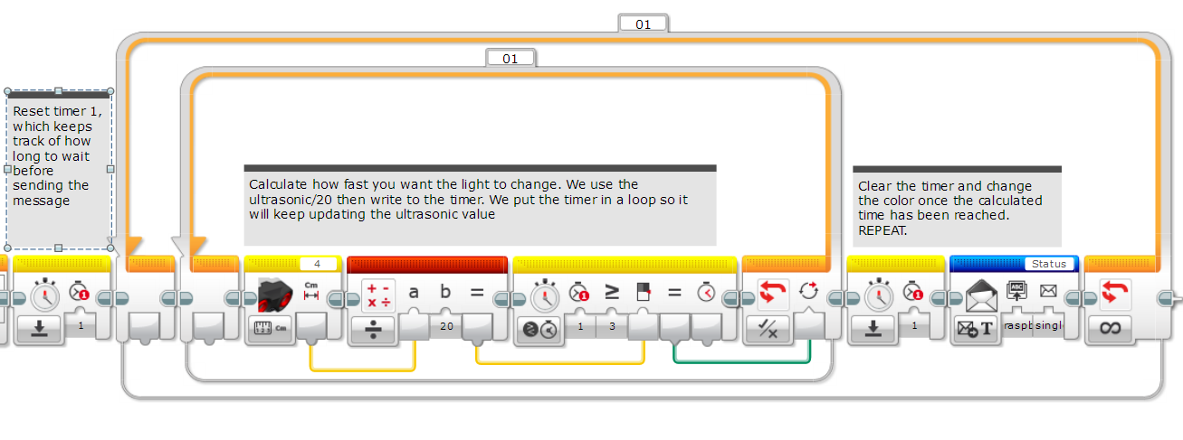
Challenge 2 Solution

Slide 14
CREDITS
This tutorial was created by Sanjay Seshan and Arvind Seshan from Droids Robotics.
More lessons are available at www.ev3lessons.com
Author’s Email: team@droidsrobotics.org
Credits: Antzy Carmasaic for the IR remote recorder & gipprojects for the code to connect a Raspberry Pi to an EV3
This work is licensed under a Creative Commons Attribution-NonCommercial-ShareAlike 4.0 International License.

