Slide 1
INTERMEDIATE PROGRAMMING LESSON
SENSOR BLOCKS

Slide 2
Lesson Objectives
Learn about Sensor Blocks and how to use them
Prerequisites: None
Image Credits: Sensor Block images from EV3 Help, Sensor Images from LEGO Education

Slide 3
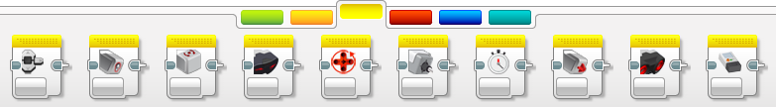
What Are Sensor Blocks?
Sensor Blocks can be found in the Yellow Sensor Pallet
They are different from the Wait For Block from the Orange Flow Pallet that have we used so far in the Beginner Lessons on EV3Lessons.com
The Wait For Block block tells the robot to wait until a particular sensor reading
vs.
The Sensor Blocks are used to read and compare sensor values. Using data wires, this data can be used in other programming blocks. You can also use the block to reset the readings on the sensor.
This makes Sensor Blocks very useful as you learn more advanced programming techniques

Slide 4
Threshold Value
Compare
Read
Reset

Slide 5
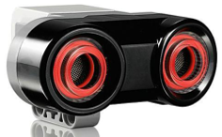
Ultrasonic Sensor Block
The Ultrasonic Sensor block receives data from the Ultrasonic Sensor
Uses:
Measure the distance in either inches or centimeters and get a Numeric output
Compare the distance to a Threshold Value to get a Logic (True or False) output
Port
Mode
Inputs
Outputs

Slide 6
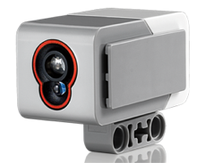
Color Sensor Block
The Color Sensor block received data from the Color Sensor
Uses:
Measure the color or intensity of light and get a Numeric output
Compare sensor data to an input value and get a Logic (True or False) output.
Port
Mode
Inputs
Outputs

Slide 7
Rotation Sensor Block
The Motor Rotation block receives data from the Motor Rotation inside each of the motors
Uses:
Measure how far a motor has turned in degrees or rotation
Get the current power level that a motor is running at
Compare the rotation amount or power level to a Threshold Value to get a Logic (True or False) output
Port
Mode
Inputs
Outputs

Slide 8
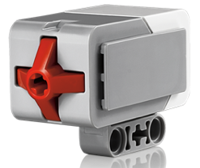
Touch Sensor Block
The Touch Sensor block receives data from the Touch Sensor.
Uses:
Test whether the Touch Sensor is Pressed, Released, or Bumped, and get a Logic (True or False) output
Port
Mode
Inputs
Outputs

Slide 9
Brick Button Block
The Brick Buttons block receives data from the Brick Buttons
There are five buttons (Left, Center, Right, Up, and Down) you can use
Uses:
Find out which button is pressed and get a Numeric output
Test any of the buttons to check if one is Pressed, Released, or Bumped, and get a Logic (True or False) output
Mode
Inputs
Outputs

Slide 10
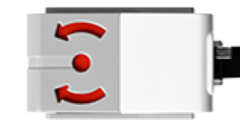
Gyro Sensor Block
The Gyro Sensor block receives data from the Gyro Sensor
Uses:
Measure the rotation rate or rotation angle and get a Numeric output
Compare the sensor data to a Threshold Value to get a Logic (True or False) output.
Port
Mode
Inputs
Outputs

Slide 11
Credits
This tutorial was written by Sanjay and Arvind Seshan from Droids Robotics. To contact the authors, email team@droidsrobotics.org
More lessons at www.ev3lessons.com
This work is licensed under a Creative Commons Attribution-NonCommercial-ShareAlike 4.0 International License.

