Slide 1


Proportional Control
ADVANCED EV3 PROGRAMMING LESSON
By Droids Robotics
Code contributed by The Construction Mavericks

Slide 2
Lesson Objectives
Learn what proportional control means and why to use it
Learn to apply proportional control to the Gyro, Color, and Ultrasonic Sensors
Prerequisites: Math Blocks, Color Sensor Calibration, Data Wires

Slide 3
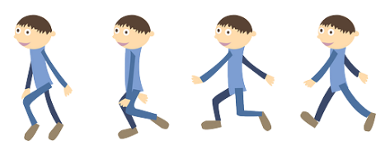
Learn and Discuss Proportional Control
On our team, we discuss “proportional” as a game.
Blindfold one teammate. He or She has to get across the room as quickly as they can and stop exactly on a line drawn on the ground (use masking tape to draw a line on the floor).
The rest of the team has to give the commands.
When your teammate is far away, the blindfolded person must move fast and take big steps. But as he gets closer to the line, if he keeps running, he will overshoot. So, you have to tell the blindfolded teammate to go slower and take smaller steps.
You have to program the robot in the same way!

Slide 4
Why Proportional Control?
What does proportional mean?
The robot moves proportionally – moving more or less based on how far the robot is from the target distance
For a line follower, the robot may make a sharper turn if it is further away from the line
Proportional Control can be more accurate and faster
The Pseudocode for every proportional control program consists of two stages:
Computing an error → how far is the robot from a target
Making a correction → make the robot take an action that is proportional to the error (this is why it is called proportional control). You must multiply the error by a scaling factor to determine the correction.

Slide 5
What Proportional Control Looks Like
The Pseudocode for every proportional control program consists of two stages:
Computing an error → how far is the robot from a target
Making a correction → make the robot take an action that is proportional to the error (this is why it is called proportional control). You must multiply the error by a scaling factor to determine the correction.
Compute Error
Make Correction

Slide 6
How Far Is the Robot From The Line?
Reflected light sensor readings show how “dark” the measured area is on average
Calibrated readings should range from 100 (on just white) to 0 (on just black)
Light Sensor Measured Area:
Reading = 100
Reading = 50
Reading = 75
Reading = 0
Reading = 25
Line

Slide 7
Line Following
Computing an error → how far is the robot from a target
Robots follow the edge of line → target should be a sensor reading of 50
Error should indicate how far the sensor’s value is from a reading of 50
Making a correction → make the robot take an action that is proportional to the error. You must multiply the error by a scaling factor to determine the correction.
To follow a line a robot must turn towards the edge of the line
The robot must turn more sharply if it is far from a line
How do you do this: You must adjust steering input on move block

Slide 8
Challenges
To learn how to use proportional control, we give you three different Challenges:
Dog Follower: Use proportional control with the ultrasonic sensor to get the robot to stay 15cm away from the human at all times (even when the human moves)
Line Follower: Use proportional control with the light sensor to get the robot to follow a line smoothly. (Greater detail is in the Proportional Line Follower lesson)
Gyro Turn: Use proportional control and the gyro sensor to get the robot to accurately turn to a target angle

Slide 9
Pseudocode/Hints
Application | Objective | Error | Correction
Dog Follower | Get to a target distance from wall | How many inches from target location (current_distance – target_distance) | Move faster based on distance
Line Follower | Stay on the edge of the line | How far are our light readings from those at line edge (current_light – target_light) | Turn sharper based on distance from line
Gyro Turn | Turn to a target angle | How many degrees are we from target turn | Turn faster based on degrees remaining

Slide 10
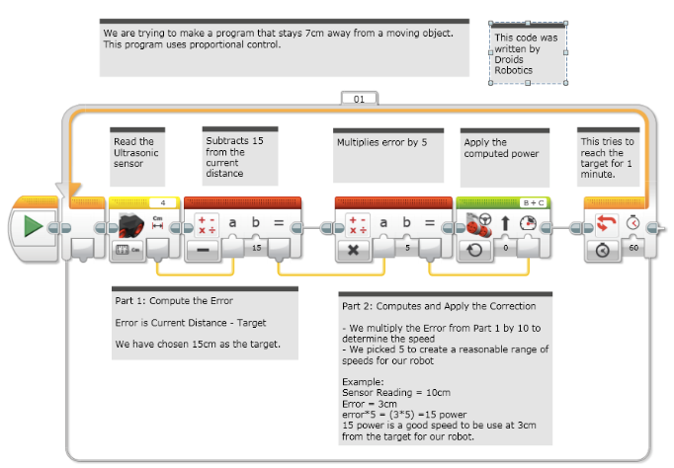
Solution: Ultrasonic Dog Follower

Slide 11
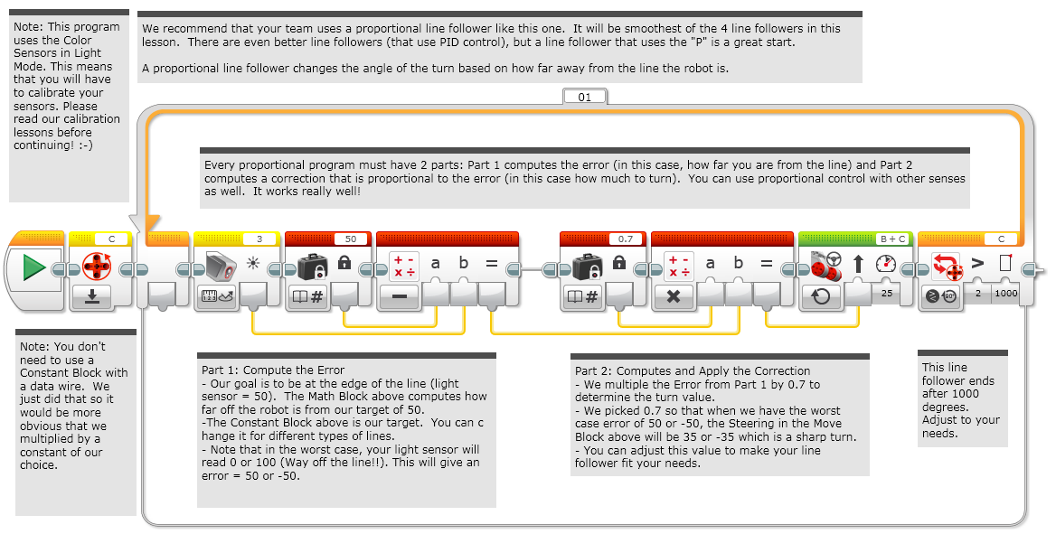
Solution: Proportional Line Follower

Slide 12
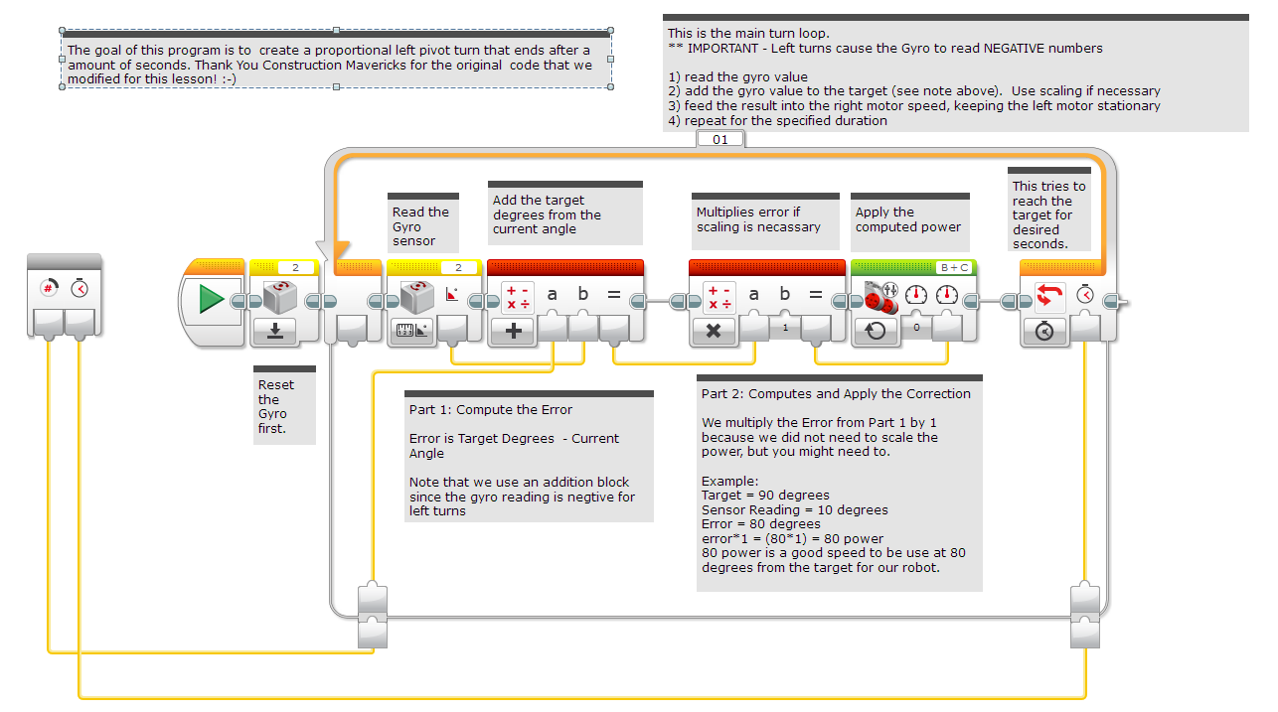
Solution: Gyr0 Left Turn
What is going on with the math block in Left Pivot Turn? You always calculate TARGET/GOAL MINUS CURRENT VALUE. So why an Addition Math Block? When you make a Left turn, the gyro always returns negative degrees. From math, we know that adding a negative number is the same as subtracting the number. So, that is why we use the Addition Math block in a Left Gyro Turn.

Slide 13
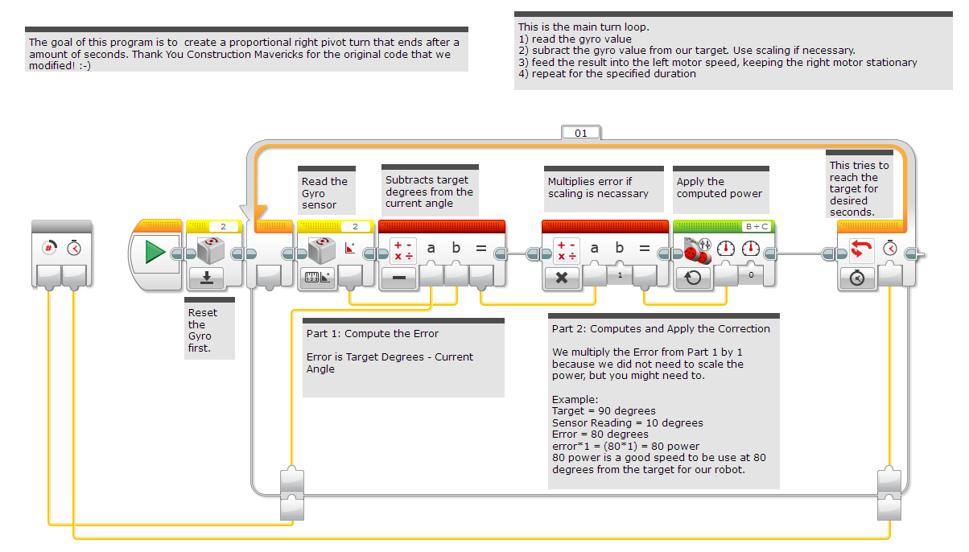
Solution: Gyro Right Turn

Slide 14
Discussion Guide
What does proportional control mean? Ans. Moving more or less based on how far the robot is from the target distance
What do all proportional control code have in common? Ans. Computing an error and making a correction

Slide 15
Credits
This tutorial was created by Sanjay Seshan and Arvind Seshan from Droids Robotics (team@droidsrobotics.org).
Original Gyro Turn code was provided by the Construction Mavericks (frank.levine@gmail.com)
More lessons at www.ev3lessons.com
This work is licensed under a Creative Commons Attribution-NonCommercial-ShareAlike 4.0 International License.

