Slide 1


Alternative Squaring on a Line
ADVANCED EV3 PROGRAMMING LESSON
By The Gnome it Alls

Slide 2
Notes
This lesson is a little bit more complicated than others on ev3lessons.com. We will try to simplify over time and add additional companion lessons to help understand the code.
We are releasing the code as is because we felt it was useful for teams to see alternative methods for aligning and an example of how a team took a lesson and improved the technique presented.
RLI means Reflected Light Intensity (Color Sensor Light mode)
You will need two light sensors fairly spaced apart

Slide 3
Goal: Iterative Align Program
Each iteration is designed to be more precise than the last. It does this by narrowing the range of reflected light intensity (RLI) it is looking for and decreasing the speed.
For example, the first time it looks for RLI 20 going forward and backs up .5 rotations. It backs up .5 rotations in case the angle is too acute and it overshoots the line the first time. The second time it looks for RLI 20 going forwards and greater than or equal to RLI 44 going backwards. It repeats this loop five times, subtracting six from the RLI going backwards each time the loop runs. It also decreases the speed after each loop.
The first time it divides by two, the second time it divides by three, and so on. This all repeats until it is going a very small speed and goes forward looking for RLI 20 and comes backward for RLI 20. It only runs the loop five times.
Positives: This program works for blue, black, and green lines. This program works at a very acute angle to the line. It always works and you can easily change the sensitivity of the RLI.
Negatives: A negative is that it is complicated to program and hard to understand.

Slide 4
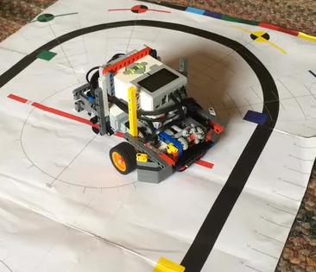
Video of Robot Aligning
This video shows the robot align to the black line. Even when the robot comes in at a steep angle, it is still able to align well.

Slide 5
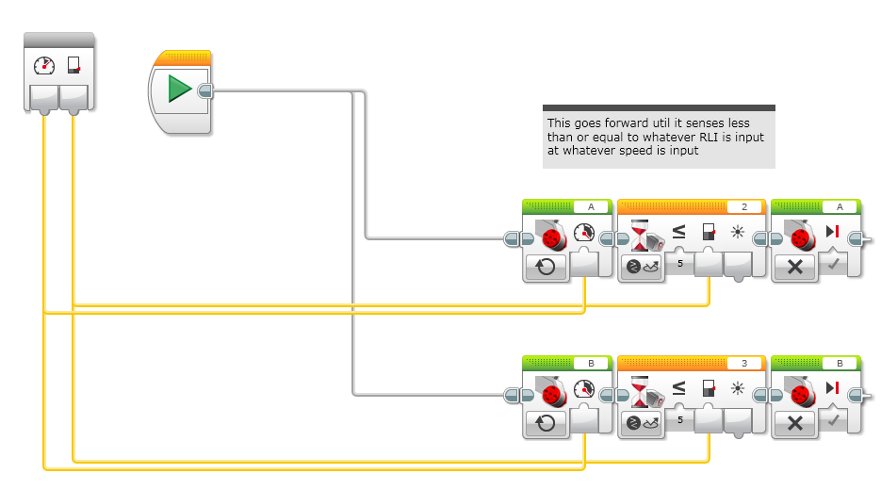
Step 1: Create the Dark My Block

Slide 6
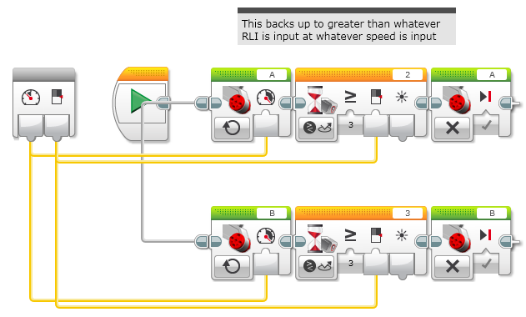
Step 2: Create the Light My Block

Slide 7
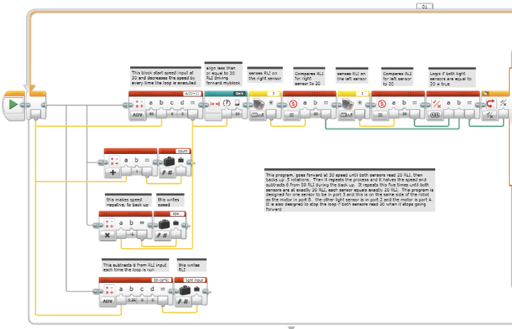
Step 3: Create Code (Page 1)
Continued on the next slide. Split in half for space reasons

Slide 8
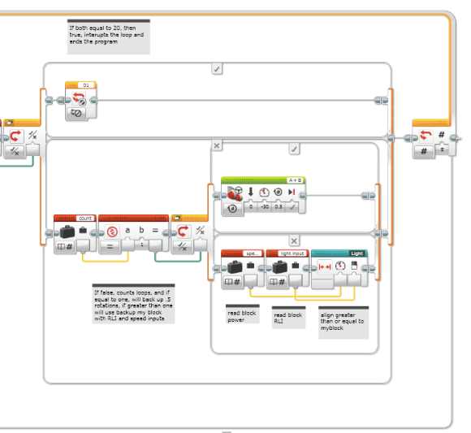
Step 3: Create Code (Page 2)

Slide 9
Credits
This tutorial was created by Sanjay Seshan and Arvind Seshan from Droids Robotics.
The EV3 Code, video and explanations were provided by FLL Team, The Gnome it Alls from Wisconsin
More lessons at www.ev3lessons.com
This work is licensed under a Creative Commons Attribution-NonCommercial-ShareAlike 4.0 International License.

