Slide 1

Droids Robotics Workshop
Intermediate Ohio Workshop

Slide 2
Overview
Introduction
Improving Programming Quality – My Blocks
Improving Robot Reliability - Squaring on a Line
Improving Line Following - Proportional Control
Robot Design, Planning, Tools

Slide 3


Improving Code Quality Making a Move Distance My Block (Move_Inches)
In
By Droids Robotics

Slide 4

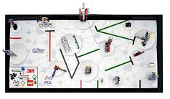
Why is a Move Distance My Block a good idea
Built-in move blocks will not take inputs (values) in centimeters or inches.
Much easier to measure distance with a ruler than degrees or rotations.
If you change your robot design to have bigger or smaller wheels late in the season you don’t have to re-measure every movement of your robot
Instead of changing distances in every single program you wrote, just go into your cool Move Distance Block and change the value for how many inches/cm one motor rotation would take.

Slide 5
Making My Blocks
During our workshop we showed how to make a My Block with Inputs using the EV3 Software
Please view our Intermediate EV3Lessons.com lesson on making My Blocks for detailed instructions: PPTX, PDF

Slide 6
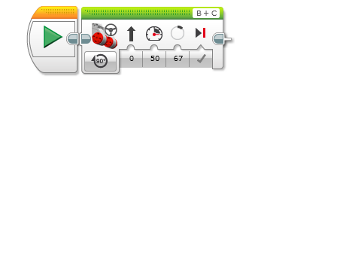
PHASE 1: MEASURE WHEELS
EV3 Base Kit Wheel =
56mm diameter ÷ 25.4 (mm/inch) =
2.2 inch
2.2 inches × π = 6.93 inches in each rotation
360 degrees ÷ 6.93 inches = 52 degrees/inch
52
52

Slide 7
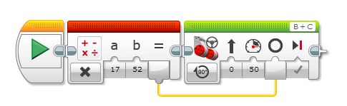
PHASE 2: Math Blocks

Slide 8
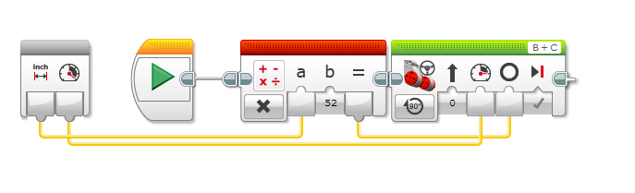
Connecting Wires in Move Inches

Slide 9
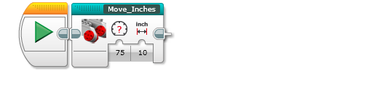
PHASE 3: COMPLETED Move Inches MY BLOCK
You can find the completed block in the blue tab at the bottom
You can double click on the block to view/edit its details

Slide 10
Improving Robot Reliability in FLL
In
By Droids Robotics

Slide 11
Common Sources of Problems in FLL
Problem | Impact
Alignment in base varies from run to run | Each run is different and missions sometimes work.
Robots don’t travel straight or turn exactly the same amount | It is hard to predict the robot location exactly.
Errors accumulate as you travel | Missions far from base fail often. It is hard to do many missions on the same run.

Slide 12
Starting Points in Base are Critical
FLL teams need to figure out where to start in base
Jigs: a LEGO ruler/wall that your robot can align against them in base
Same start each time: pick one spot and start there no matter what the mission for easy starts
Tick marks: Use the inch marks to pick a starting spot for each run
Words: Base has words. If you aren’t near an inch mark, pick a word or letter to start on.
Even better, try to find a way to align the robot using other techniques
Use a jig
Use marks

Slide 13
Robot Doesn’t Travel Straight & Errors Accumulate Over Time
By the time you get to the far side of the table, you are no longer in the right position
Solution: Repeat alignment techniques multiple times in a run for better reliability (see next slide)
Mission Model 1
Mission Model 2

Slide 14
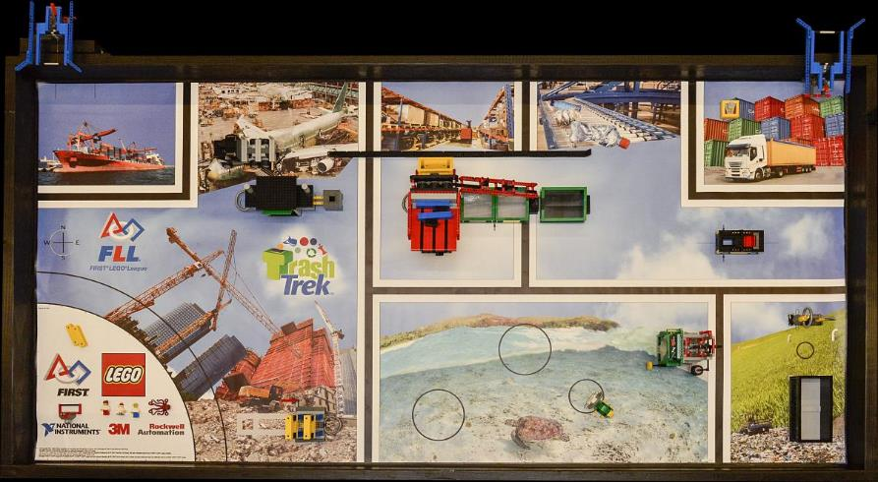
Navigation on the Trash Trek Mat
Square on lines
Ride walls
Follow lines
Move until you see black
Align on a mission model

Slide 15
Other Factors in Reliability
Battery level
If you program your robot when the battery level is low, it won’t run the same when fully charged
Motors behave differently with low battery
Using sensors makes you not as dependent on battery
Motors and sensors don’t always match
Some teams test motors, sensors and wheels to make sure that they match
You will never get a perfect match so we recommend use other techniques and accept that they will be different

Slide 16


Parallel Beams for Squaring on Lines
INTERMEDIATE EV3 PROGRAMMING LESSON
By Droids Robotics

Slide 17
What are Parallel Beams?
Parallel beams allow you to run two or more blocks at the same time.
In First Lego League, they are mostly often used when you have one of more attachment arms connected to motors and you want to turn these arms while the robot is moving to complete a mission
Robot lifting up hoops and driving forward.

Slide 18
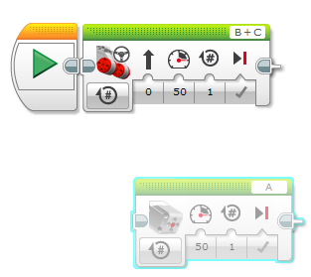
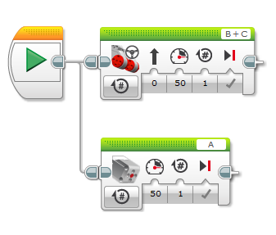
How Do I Make a Parallel Beam?
To create a parallel beam click and drag on the bump on the right center of any block and release once you hover over the inverted bump on the left center side on a block.
Note: Blocks before the split will run one at a time. After the split blocks on the two “beams” will run at the same time

Slide 19
Want to learn more?
To learn about Parallel Beams and their limitations/uses, please visit the Intermediate EV3Lessons.com on Parallel Beams.

Slide 20

Squaring or Aligning on a Line
ADVANCED EV3 PROGRAMMING LESSON
By Droids Robotics

Slide 21
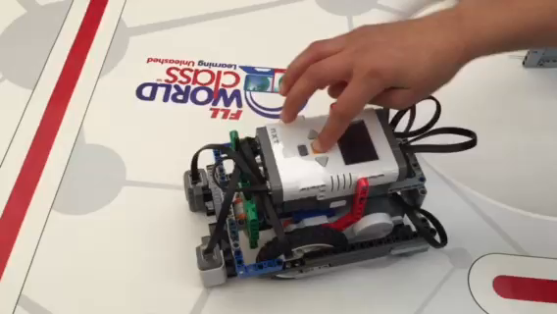
What is Squaring?

Slide 22
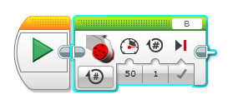
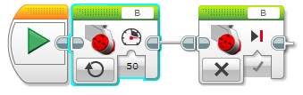
Moving Each Motor Independently
Move Steering lets you control both motors at the same time
What if you want to move or stop one motor at a time?
Use the Large Motor Block
Large Motor Block
Large motor block in ON mode / OFF mode

Slide 23
Challenge
Challenge: Make the robot straighten out (align/square off)
Pseudocode:
Start both motors
Stop one motor when the sensor on the corresponding side sees the line
Stop moving the second motor when the sensor on that side sees the line
Hints: Use a Large Motor Block, Use Parallel Beams

Slide 24
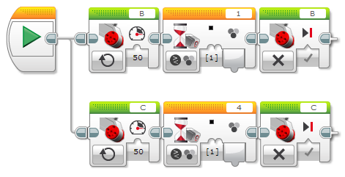
Solution: Align On Line

Slide 25
Repeating a Technique
What do you notice about the solution we just presented?
The robot isn’t quite straight (aligned) at the end of it.
Both color sensors are on the line, but the robot stops at an angle.
Challenge Continued: Think about how you can improve this code so that the robot ends straighter
Hint: Can you repeat the last process by looking for white?
This assumes that the line we were straightening out on has white on both sides.

Slide 26
Synchronization errors with parallel beams
When you have two or more beams you do not know when each beam will finish.
If you wanted to move after the align finishes you might try to add a move block at the end of one of the beams.
Note: This will not work because EV3 code will play your move block without waiting for the other beam to finish.
Solution: You need to synchronize your beams. To learn more about synchronization and solutions go to the Advanced EV3Lessons.com Lesson on Sync Beams: PPTX, PDF , EV3 Code
In this Workshop, we solved the problem of synchronization by making a My Block out of the align code.
My Blocks always wait for both beams to finish before exiting
You will have 2 inputs: Color and Power

Slide 27
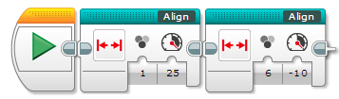
Step 2: My Block With Dual Stage Fix

Slide 28
Calibrating Color Sensors for better line followers
INTERMEDIATE EV3 PROGRAMMING LESSON
By Droids Robotics

Slide 29
Why Calibrate?
When you use your EV3 Color Sensor in Light Sensor Mode (e.g., reflected light mode), you should calibrate it
Calibration means “teaching” the sensor what is “Black” and what is “White”
This makes White read as 100 and Black read as 0
Run your Calibrate Program whenever light or table conditions change
If you are in First Lego League, it is probably a good idea to run it before you start a table run where you use your EV3 Sensors in Light Mode
If you have 2 Color Sensors, the same calibration will apply to BOTH sensors. You don’t have to make a different calibration program for each color sensor. Make it using 1 sensor on one of the ports and the values will apply to both.
If you have sensors that are very different from each other, you will need to write your own custom calibration.

Slide 30
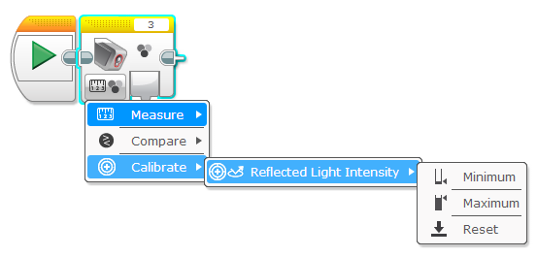
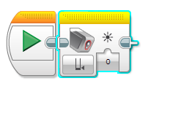
Color Sensor Block: Calibrate Mode
Minimum: Calibrate for black
Maximum: Calibrate for white
Reset: Delete previous calibration values
Input the value you want to calibrate to

Slide 31
Steps/Pseudocode for Calibration
Challenge: Write a program that will calibrate your EV3 Color Sensors for black and white.
Pseudocode:
Reset the existing calibration values
Display that the user should place the robot on “black” and press ok
Wait for button press
Read the Color Sensor Block in Light mode and save it to the Color Sensor Block in Calibrate mode.
Repeat above three steps for calibrating “white”.

Slide 32
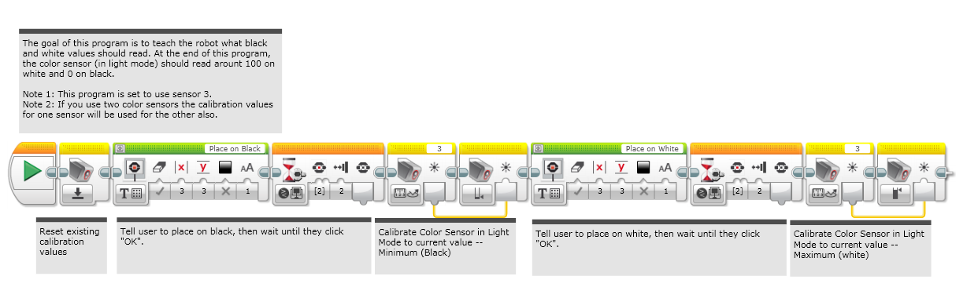
Calibrate Program Solution
When you run the above Calibrate Program, you will be asked to place the robot on a BLACK section of the mat and then hit center EV3 button.
Then you will be asked to place the robot on WHITE and hit center EV3 button.

Slide 33
Proportional Line Follower
ADVANCED EV3 PROGRAMMING LESSON
By Droids Robotics

Slide 34
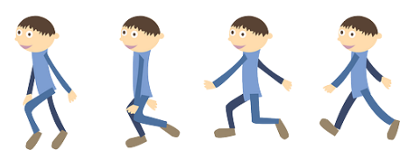
Learn and Discuss Proportional Control
On our team, we discuss “proportional” as a game.
Blindfold one teammate. He or She has to get across the room as quickly as they can and stop exactly on a line drawn on the ground (use masking tape to draw a line on the floor).
The rest of the team has to give the commands.
When your teammate is far away, the blindfolded person must move fast and take big steps. But as he gets closer to the line, if he keeps running, he will overshoot. So, you have to tell the blindfolded teammate to go slower and take smaller steps.
You have to program the robot in the same way!

Slide 35
Why Proportional Control?
What does proportional mean?
The robot moves proportionally – moving more or less based on how far the robot is from the target distance
For a line follower, the robot may make a sharper turn if it is further away from the line
Proportional Control can be more accurate and faster

Slide 36
What Proportional Control Looks Like
The Pseudocode for every proportional control program consists of two stages:
Computing an error → how far is the robot from a target
Making a correction → make the robot take an action that is proportional to the error (this is why it is called proportional control). You must multiply the error by a scaling factor to determine the correction.
Compute Error
Make Correction

Slide 37
How Far Is the Robot From The Line?
Reflected light sensor readings show how “dark” the measured area is on average
Calibrated readings should range from 100 (on just white) to 0 (on just black)
Light Sensor Measured Area:
Reading = 100
Reading = 50
Reading = 75
Reading = 0
Reading = 25
Line

Slide 38
Line Following
Computing an error → how far is the robot from a target
Robots follow the edge of line → target should be a sensor reading of 50
Error should indicate how far the sensor’s value is from a reading of 50
Making a correction → make the robot take an action that is proportional to the error. You must multiply the error by a scaling factor to determine the correction.
To follow a line a robot must turn towards the edge of the line
The robot must turn more sharply if it is far from a line
How do you do this: You must adjust steering input on move block

Slide 39
Pseudocode
Application | Objective | Error | Correction
Line Follower | Stay on the edge of the line | How far are our light readings from those at line edge (current_light – target_light) | Turn sharper (steering) based on distance from line
Gyro Turn | Turn to a target angle | How many degrees are we from target turn | Turn faster based on degrees remaining
Dog Follower | Get to a target distance from wall | How many inches from target location (current_distance – target_distance) | Move faster based on distance
Gyro Turn and Dog Follower are in the Advanced EV3Lessons.com lesson on Proportional Control

Slide 40
Challenge: Proportional Line Follower
Challenge: Can you write a proportional line follower that changes the angle of the turn depending on how far away from the line the robot is?
Pseudocode:
Reset the Rotation sensor (Only required for line following for a total distance)
Compute the error = Distance from line = (Light sensor reading – Target Reading)
Scale the error to determine a correction amount. Adjust your scaling factor to make you robot follow the line more smoothly.
Use the Correction value (computed in Step 3) to adjust the robot’s turn (steering) towards the line.

Slide 41
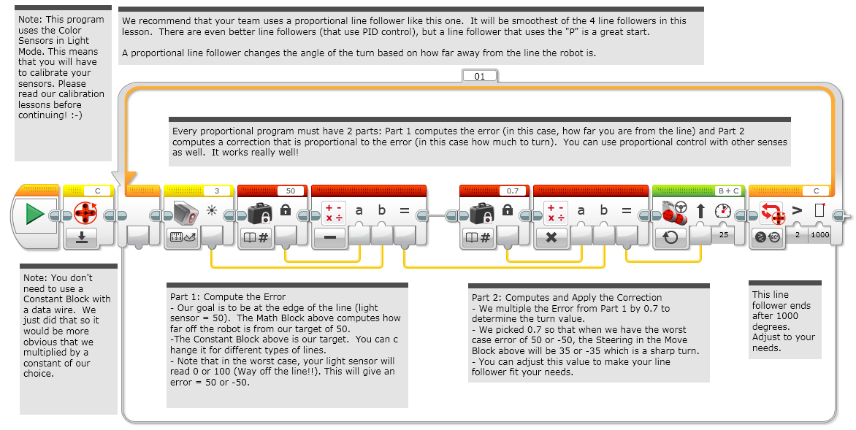
Solution: Proportional Line Follower

Slide 42
Credits
This tutorial was created by Sanjay Seshan and Arvind Seshan from Droids Robotics.
Author’s Email: team@droidsrobotics.org
More lessons at www.ev3lessons.com
This work is licensed under a Creative Commons Attribution-NonCommercial-ShareAlike 4.0 International License.

