Slide 1


INTERMEDIATE PROGRAMMING Lesson
Color Line Follower My Blocks with Inputs:
Move Until Black
By: Droids Robotics

Slide 2
Lesson Objectives
Learn how to write a line follower that takes multiple inputs
Learn how to write a line follower that stops when it sees a another line
Practice making useful My Blocks

Slide 3
CoLOR LINE FOLLOWER THAT ENDS ON A BLACK LINE
You may want to follow one line until the robot sees another line
In First Lego League, a common application is to line follow until a “T” junction.
Follow along in the EV3 Code
Start at Step 1. By Step 2 you will have your code. Proceed to Steps 3 and 4 to make this code into a My Block with Inputs.

Slide 4
TIPS TO SUCCEED
You will need to know how to make a Simple Color Line Follower program and how to make a My Block with inputs
Since you will use your EV3 Color Sensor in Color Mode, you will not have to Calibrate your color sensor for this lesson
Check which ports you have your color sensor connected to and adjust the code as needed
You may have to adjust the speed or direction to work for your robot. Make sure that the the color sensor is in front of the wheels in the direction of travel.
Make sure you place the robot on the side of the line that you are following. The most common mistake is placing the robot on the wrong side of the line to begin with.
Follow along in the companion EV3 File. Always start at Stage 1

Slide 5
Challenge With TIPS
Challenge: Create a line follower My Block that stops when it sees black and takes 3 inputs (color to follow, color to stop at, and power)
Start with a simple line follower
Change the loop exit condition to “until black”
Set up inputs using constants (color to follow, color to stop at, power)
Use data wires to connect these constants to the right block
Make this line follower into a My Block

Slide 6
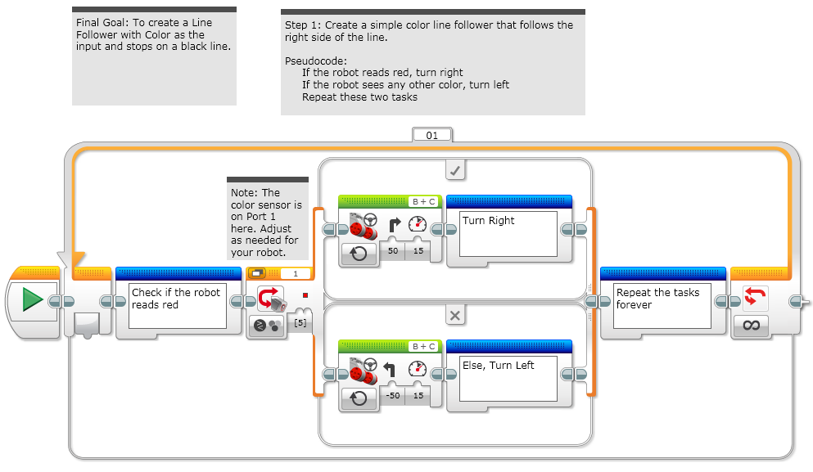
STEP 1: MAKE A SIMPLE LINE FOLLOWER

Slide 7
STEP 1: MAKE A SIMPLE LINE FOLLOWER

Slide 8
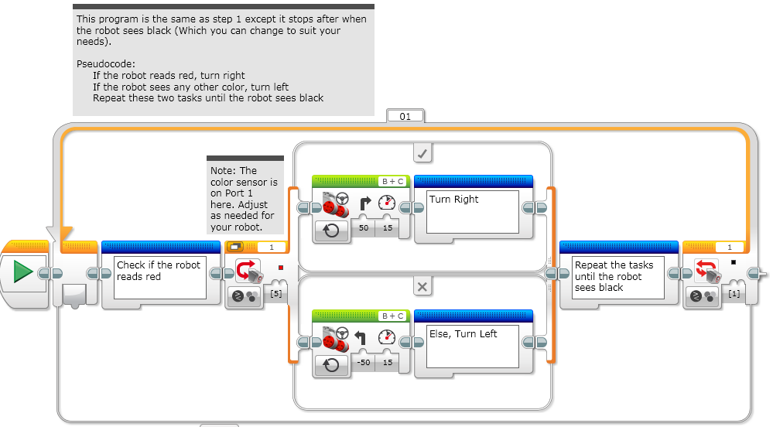
STEP 2: STOPS ON BLACK

Slide 9
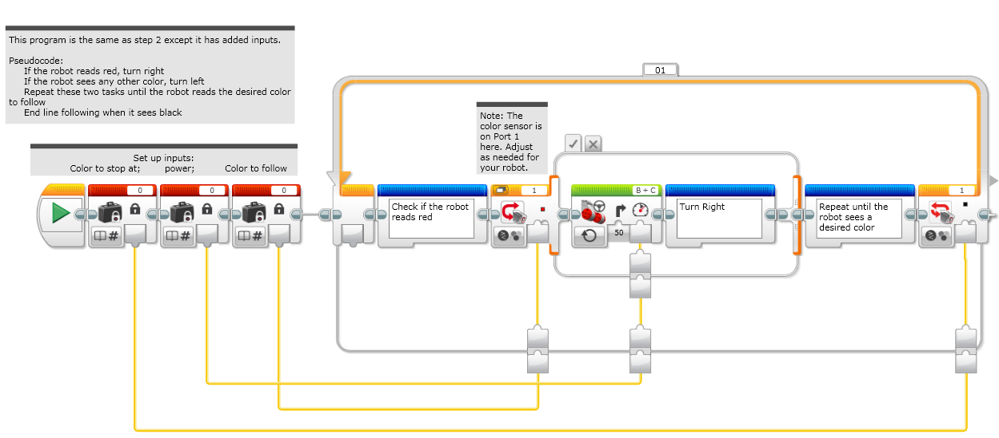
STEP 3: ADDING INPUTS

Slide 10
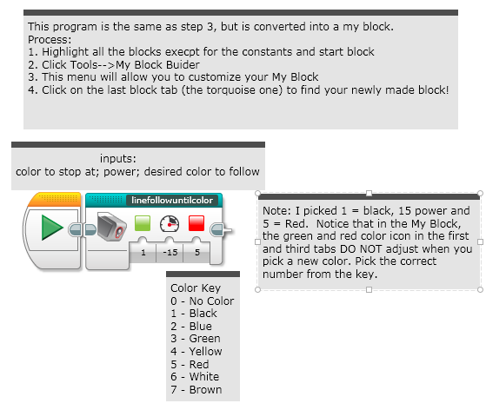
STEP 4: THE MYBLOCK

Slide 11
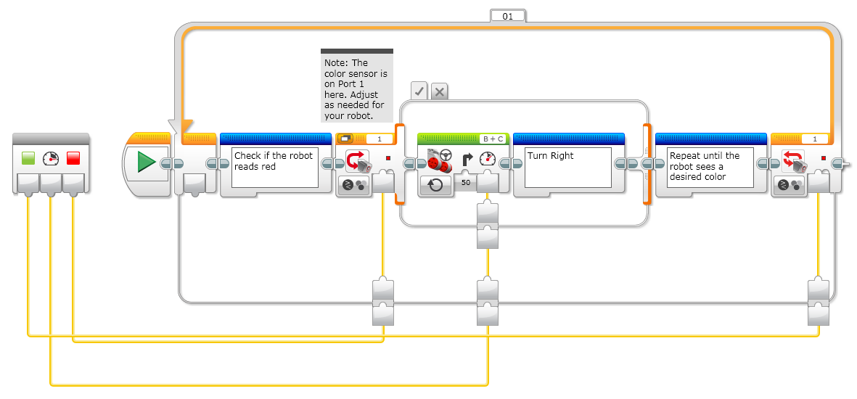
INSIDE THE MY BLOCK

Slide 12
Next steps
We use a simple line follower in this lesson. You can combine these techniques with any line follower.
Learn how to create a proportional line follower for light or a smooth line follower for color → check out our Advanced: Proportional Line Follower lesson.

Slide 13
CREDITS
This tutorial was created by Sanjay Seshan and Arvind Seshan from Droids Robotics.
More lessons are available at www.ev3lessons.com
Author’s Email: team@droidsrobotics.org
This work is licensed under a Creative Commons Attribution-NonCommercial-ShareAlike 4.0 International License.

