Slide 1


Improving Robot Reliability in FLL
By Droids Robotics

Slide 2
Common Sources of Problems in FLL
Problem | Impact
Alignment in base varies from run to run | Each run is different and missions sometimes work.
Robots don’t travel straight or turn exactly the same amount | It is hard to predict the robot location exactly.
Errors accumulate as you travel | Missions far from base fail often. It is hard to do many missions on the same run.

Slide 3
Starting Points in Base are Critical
FLL teams need to figure out where to start in base
Jigs: a LEGO ruler/wall that your robot can align against them in base
Same start each time: pick one spot and start there no matter what the mission for easy starts
Tick marks: Use the inch marks to pick a starting spot for each run
Words: Base has words. If you aren’t near an inch mark, pick a word or letter to start on.
Even better, try to find a way to align the robot using other techniques
Use a jig
Use marks

Slide 4
Robot Doesn’t Travel Straight & Errors Accumulate Over Time
By the time you get to the far side of the table, you are no longer in the right position
Solution: Repeat alignment techniques multiple times in a run for better reliability (see next slide)
Mission Model 1
Mission Model 2

Slide 5
Other Factors in Reliability
Battery level
If you program your robot when the battery level is low, it won’t run the same when fully charged
Motors behave differently with low battery
Motors and sensors don’t always match
Some teams test motors, sensors and wheels to make sure that they match
You will never get a perfect match so we recommend use other techniques and accept that they will be different

Slide 6
Why use Sensors in FLL?
Sensors increase your reliability
Sensors can help you know your position on the FLL table
Sensors can help you be more accurate therefore receiving less touch penalties
Sensors can help you do accurate turns, straighten up on lines, move until a certain distance from a wall, and know when you are on a wall
Moving up to a mission model accurately might need a sensor

Slide 7
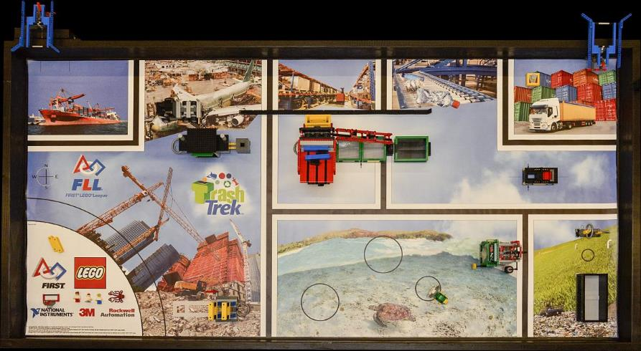
Increasing Reliability In Trash Trek
Square on lines
Ride walls
Follow lines
Move until you see black
Align on a mission model

Slide 8
What Can you learn/Try?
Move Until a line
Square on Lines (Advanced Lesson on EV3Lessons.com)
Line Follow (Basic, Intermediate and Advanced Lessons on EV3Lessons.com)

Slide 9
MOVE UNTIL
In
By Droids Robotics

Slide 10
WHY SHOULD YOU LEARN TO USE SENSORS IN YOUR ROOKIE YEAR
Save you lots of time and frustration
Increases the reliability of your robot

Slide 11
“MOVE UNTIL” is all you need
Move Until…you touch something
Move Until...a certain distance
Move Until....see a line

Slide 12
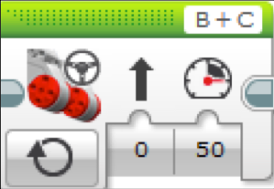
Move STEERING on and OFF
First step to use your sensor is to know how to use the Move Steering Block in ON Mode
Rookie Tip: Motor On needs to be followed by another block (e.g. Wait Block)

Slide 13

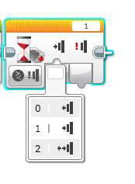
How do you program “Do SOMETHING Until…” ?
You need the Wait For Block
Orange Flow Tab: Wait for Block
Used to wait for a sensor reading (or time)

Slide 14
Try it out on the Touch Sensor
Program your robot to move until it hits the edge of a wall. Then back up and turn right 90 degrees.
0 = released
1 = pressed
2 = bumped
B
C
Hint: You will combine Move Steering + Turning + Wait Block

Slide 15
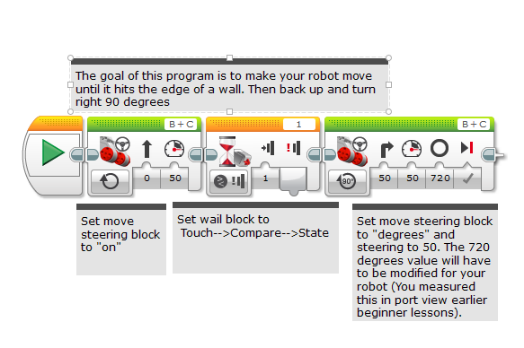
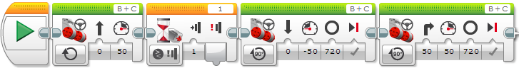
Challenge Solution

Slide 16
“Move Until” IS POWERFUL
Now use the same idea of “move until” with all your other sensors.
Color Sensor: Can you program your robot to move until it sees a black line?
Ultrasonic Sensor: Can you program your robot to move and stay 10 inches away from an object?

Slide 17
Robot Design
In
By Droids Robotics

Slide 18
Droid Bot 2.0 & Attachments
Location of sensors
Outer Wall
Attachment options
Sample attachment styles

Slide 19
Credits
This tutorial was created by Sanjay Seshan and Arvind Seshan from Droids Robotics.
Author’s Email: team@droidsrobotics.org
More lessons at www.ev3lessons.com
This work is licensed under a Creative Commons Attribution-NonCommercial-ShareAlike 4.0 International License.

