Slide 1
Sharing
By Not the Droids YOU ARE LOOKING FOR

Slide 2
Coming Soon

Slide 3
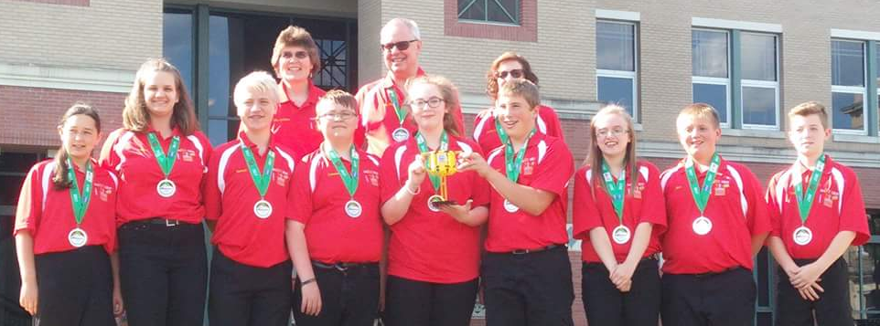
About Us
Middle school team from Garrett County, Maryland
13 years in FIRST LEGO League (including competing in International Tournaments)
First place 2013 Global Innovation Award for the Gramma Jamma
Top 20 GIA Semi-Finalist in 2017 for innovative solution, BeeHaven
First Place Innovative Solution at Mountain State Invitational in 2017

Slide 4
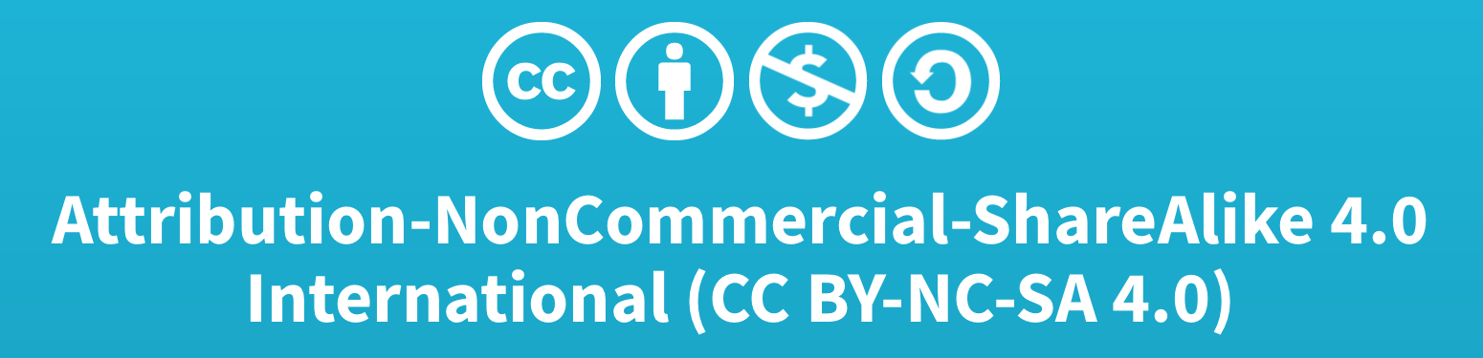
Credits
This lesson was written by Team 3659 NeXT GEN, with some edits by EV3Lessons
You can contact Team 3659 NeXT GEN through their Facebook page: Garrett County FIRST LEGO League Team 3659.
More lessons available at www.ev3lesssons.com

