Slide 1


Gyro Turns
ADVANCED EV3 PROGRAMMING LESSON
By Droids Robotics and Construction Mavericks

Slide 2
Lesson Objectives
Learn what Gyro Lag is
Learn two ways to correct for this lag
Understand why it is important to explore alternative solutions to a problem
Pre-requisites: My Blocks with Inputs and Outputs, Data wires, Math Blocks, Loops, Proportional Control

Slide 3
Gyro Problem 2: Lag
What is lag?
The gyro sensor readings lag behind the true value sometimes
When the turn starts, it takes time for the gyro to begin changing
This lesson presents two ways to deal with lag in a turn
Reduce the amount of angle that you turn to compensate for lag (slides 4-9)
Use proportional control to continue performing your turn for a requested duration (slides 10-12)

Slide 4
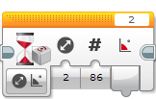
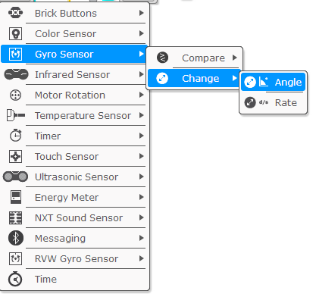
Change Mode in Wait Block
In this lesson we use the Wait Block (gyro sensor) in Change Mode
Advantages over Compare Mode:
You do not need to reset the gyro beforehand
You can measure if the value has changed the target degrees by both decreasing or increasing (no need to change the wait block for a left turn)
Direction (the first input) defines:
0 – check if the value has increased the desired degrees
1 – check if the value has decreased the desired degrees
2 – check if the value has either increased or decreased the desired degrees

Slide 5
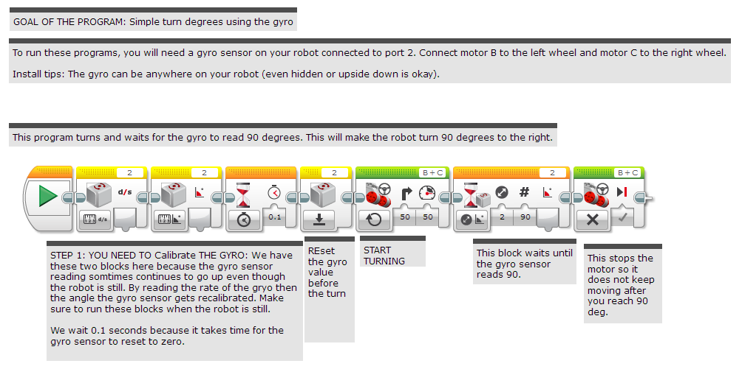
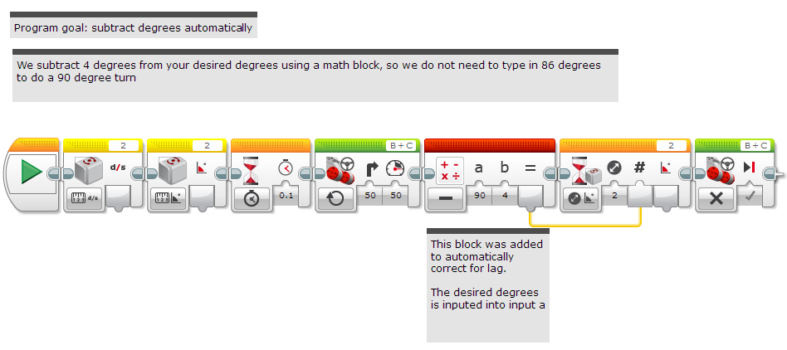
Gyro Turn in Four Easy Steps
STEP 1: Create a simple Gyro Turn program that turns 90 degrees using the Wait for Gyro block in Change Mode
Remember to Calibrate the Gyro before the Wait For Block (see Gyro Lesson for help)
STEP 2: Compensate for Lag
Compensate for the lag by reducing the amount of angle to turn based on your robot (e.g 86 degrees instead of 90 degrees)
Use a Math Block to create an automatic calculator to compensate for lag
STEP 3: Create and Wire the My Block
STEP 4: Repeat the steps to make one for Left Turns vs. one for Right Turns.

Slide 6
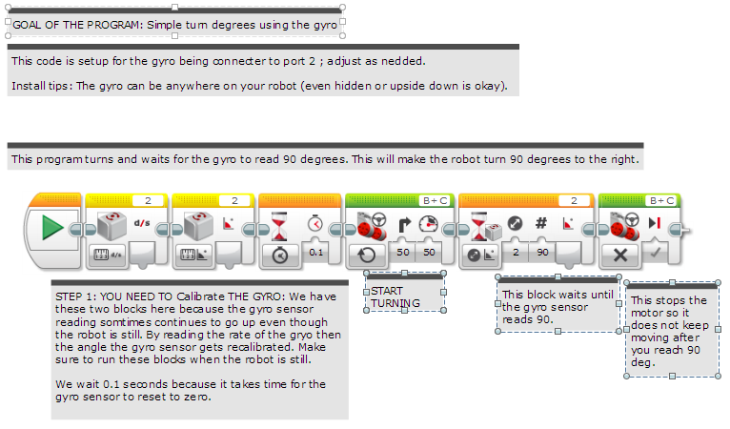
Step 1: Simple Gyro Turn

Slide 7
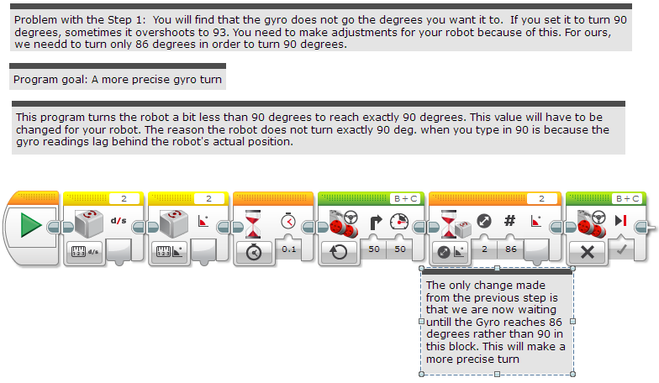
Step 2A: Dealing with Lag

Slide 8
Step 2B: Automatically Correct for Lag

Slide 9
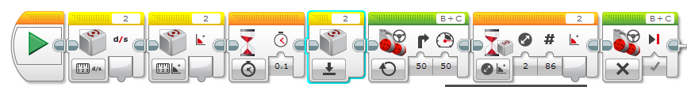
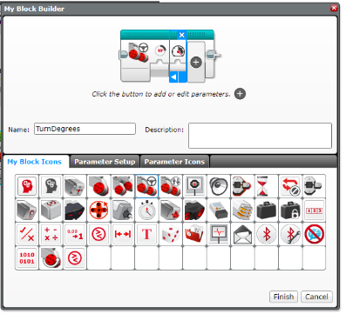
Step 3A: Create a My Block
Highlight all the blocks then go to My Block Builder
Add 2 inputs: one for power and one for and degrees
Refer to the My Blocks with Inputs & Outputs lesson if you need help setting up the My Block
A
B

Slide 10
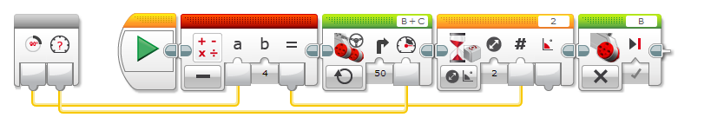
Stage 3B: Wire the My Block
degrees
power
Connect the degrees value into the math block and the power into the move steering block

Slide 11
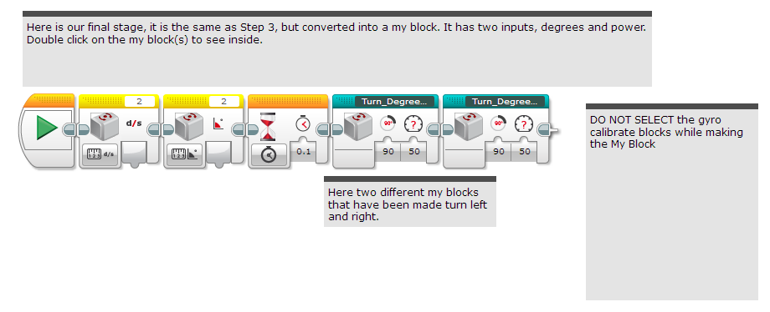
Stage 4: Using the My Block

Slide 12
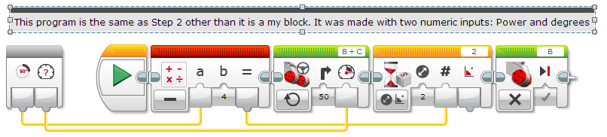
Step 4: Turn Degrees Right

Slide 13
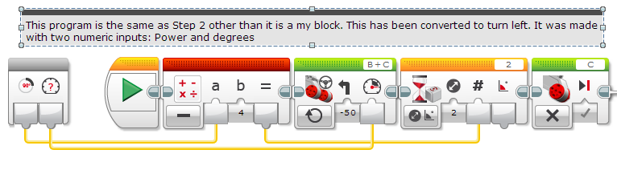
Step 4: Turn Degrees Left

Slide 14
Proportional Gyro Turns by The Construction Mavericks
The remainder of this lesson is a contribution by The Construction Mavericks.
This method improves over the simple overshoot correction mechanism from earlier by using proportional control
If you are unfamiliar with proportional control, please see the advanced lesson on proportional control before continuing.
The basic idea is to use the current gyro position and where it wants to point to determine how to set the motor power.
Note from Construction Mavericks: It's not perfect, but we have had much better success with these blocks than the overshoot-corrected ones.
Tip from Construction Mavericks: Try to set the outer loop to an infinite loop. Once the robot settles into place, pick it up and rotate it and watch it try to get back to where it wants to be.

Slide 15
Sample: Proportional Gyro Right Turn
Read the gyro value
Compute Error: Subtract the gyro value from the target amount of degrees to turn. Use scaling (multiply to tweak how much to adjust the power) if necessary.
Apply Correction: Use data wires to wire the result from the previous step to the Move Steering block’s power input, with steering 50
Repeat for the specified duration

Slide 16
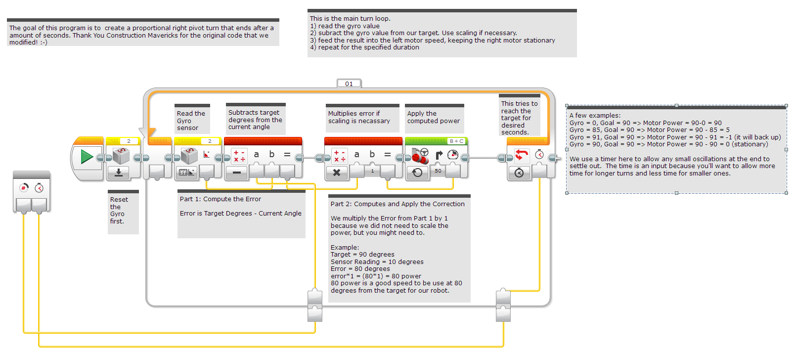
Proportional Right Turn

Slide 17
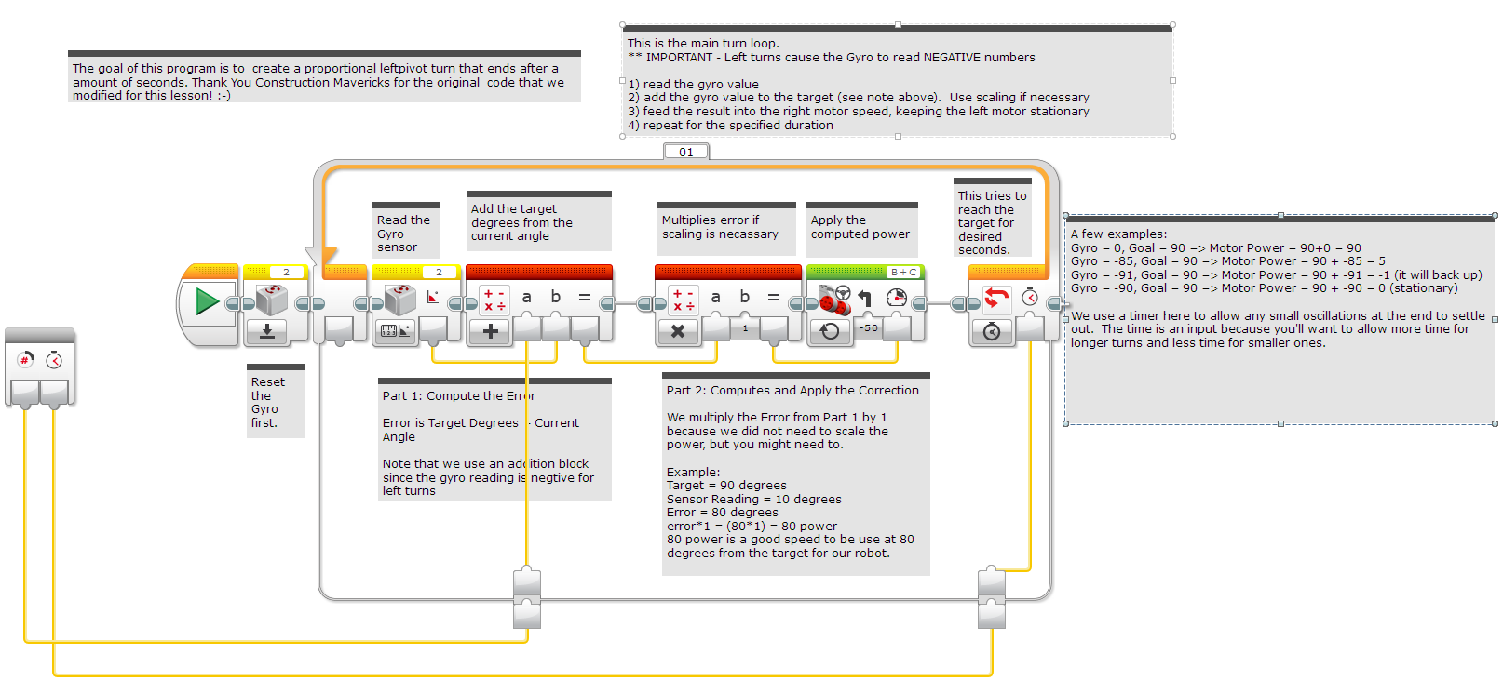
Proportional Left Turn
What is going on with the math block in Left Pivot Turn? You always calculate TARGET/GOAL MINUS CURRENT VALUE. So why an Addition Math Block? When you make a Left turn, the gyro always returns negative degrees. From math, we know that adding a negative number is the same as subtracting the number. So, that is why we use the Addition Math block in a Left Gyro Turn.

Slide 18
Discussion
What is gyro lag? Ans. The gyro sensor’s reading lags behind the true reading
What is the difference between the two solutions presented in this lesson? Ans. The first way was to reduce the amount of angle that you turn to compensate for lag. The second way was to use proportional control to continue performing your turn for a requested duration

Slide 19
Credits
This tutorial was written by Sanjay Seshan and Arvind Seshan from Droids Robotics using code shared by The Construction Mavericks (http://fllmavericks.wix.com/fllmavericks)
More lessons at www.ev3lessons.com
This work is licensed under a Creative Commons Attribution-NonCommercial-ShareAlike 4.0 International License.

