Slide 1


What is FIRST LEGO LEAGUE?
By Sanjay and Arvind Seshan

Slide 2



FIRST LEGO League Overview
International competition organized by FIRST
For kids ages 9-14 in North America and 9-16 elsewhere
Each year has a theme
About 29,000 students in over 80 countries participate in FLL
Runs approximately from September – December (or longer if you qualify for Sate and International-level Championships)

Slide 3

Three Parts to FIRST LEGO League
Core Values
Robot Game
Research Project

Slide 4
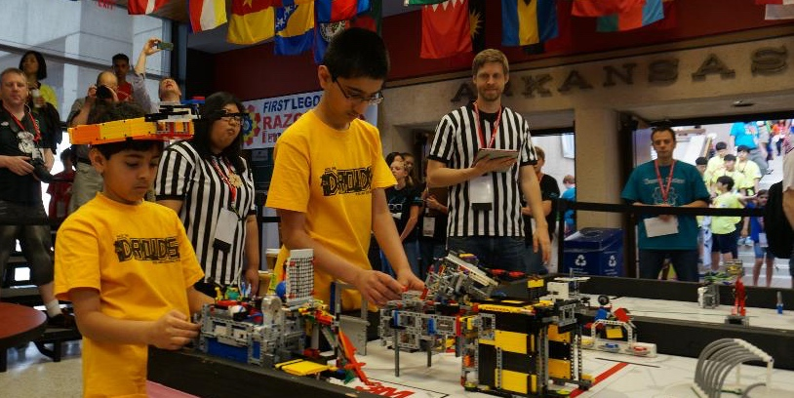
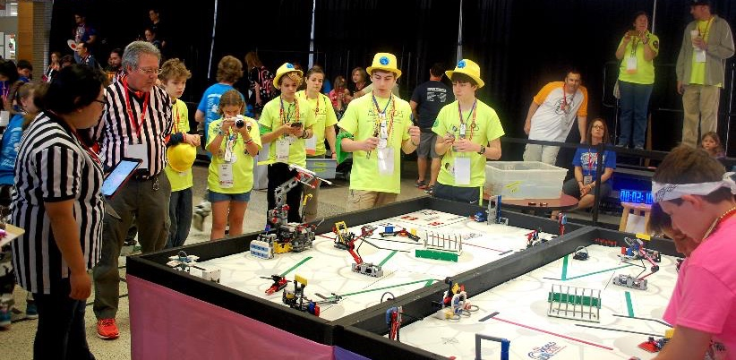
Robot Game
Goal:
Complete LEGO-based missions in 2.5 mins
Build a LEGO MINDSTORMS robot and program it to autonomously solve the missions
Teams participate in timed matches
Teams are judged on the quality of their design, strategy, innovation & programming

Slide 5
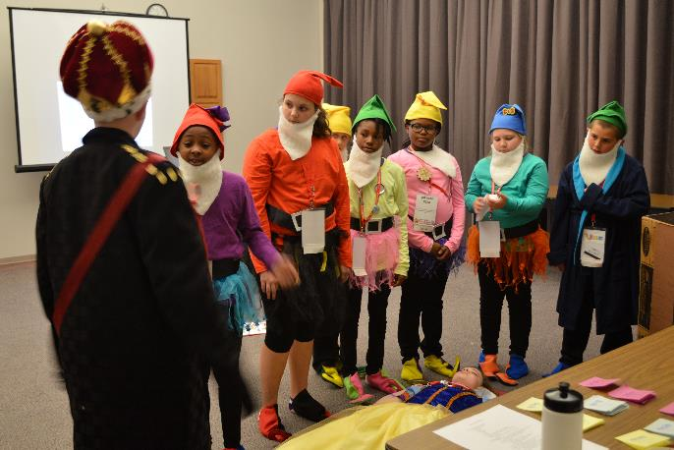
Research Project
Goal:
Identify a problem
Come up with an innovative solution
Share the solution with others
The topic is always related to the year’s theme
Teams are judged based on the quality of their research and solution, but also the creativity of their presentation to judges

Slide 6
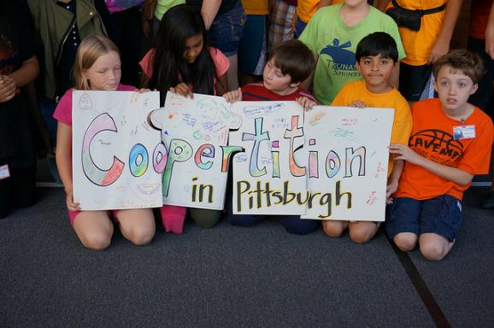
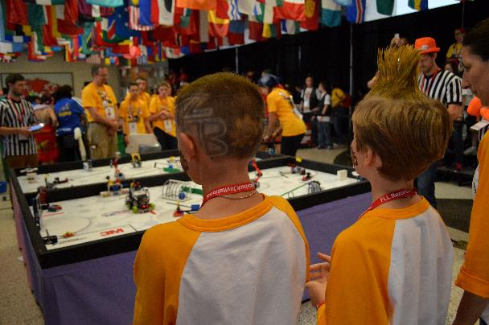
Core Values
Goal:
Helping and working with each other and other teams (Gracious Professionalism and Coopertition)
Spreading STEM
Inspiring others
Many teams do outreach events such as running a demo at a library
Teams develop their own identity with team shirts, hats and even team haircuts!
Teams are judged based on how students work together, and their understanding and application of the 8 Core Values (https://www.firstinspires.org/robotics/fll/core-values)

Slide 7
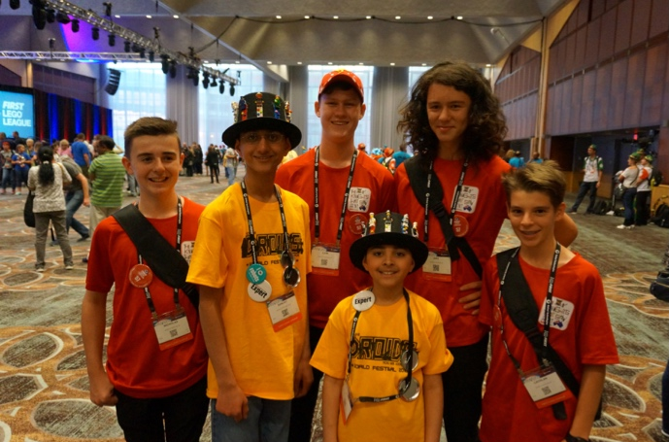
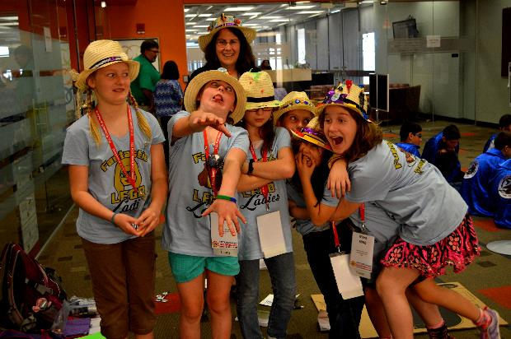
FIRST LEGO League is HARD FUN!
Learn STEM skills (Math, Science, Research…)
Learn life skills (teamwork, presentation, interviewing, confidence…)
Make friends from around the world
Have fun!

Slide 8
Useful Resources
Coaching Resources:
FIRST Steps: http://info.firstinspires.org/fllfirststepsrequest
Programming Lessons/Starter Robot Designs:
www.EV3Lessons.com
Challenge Documents:
http://www.firstlegoleague.org/challenge
Organizers in each country:
http://www.firstlegoleague.org/countries

Slide 9
Credits
This presentation was compiled by Sanjay and Arvind Seshan
Photos By: Not the Droids You Are Looking For, Razorback FIRST LEGO League Invitational (2015)

